Slide 1
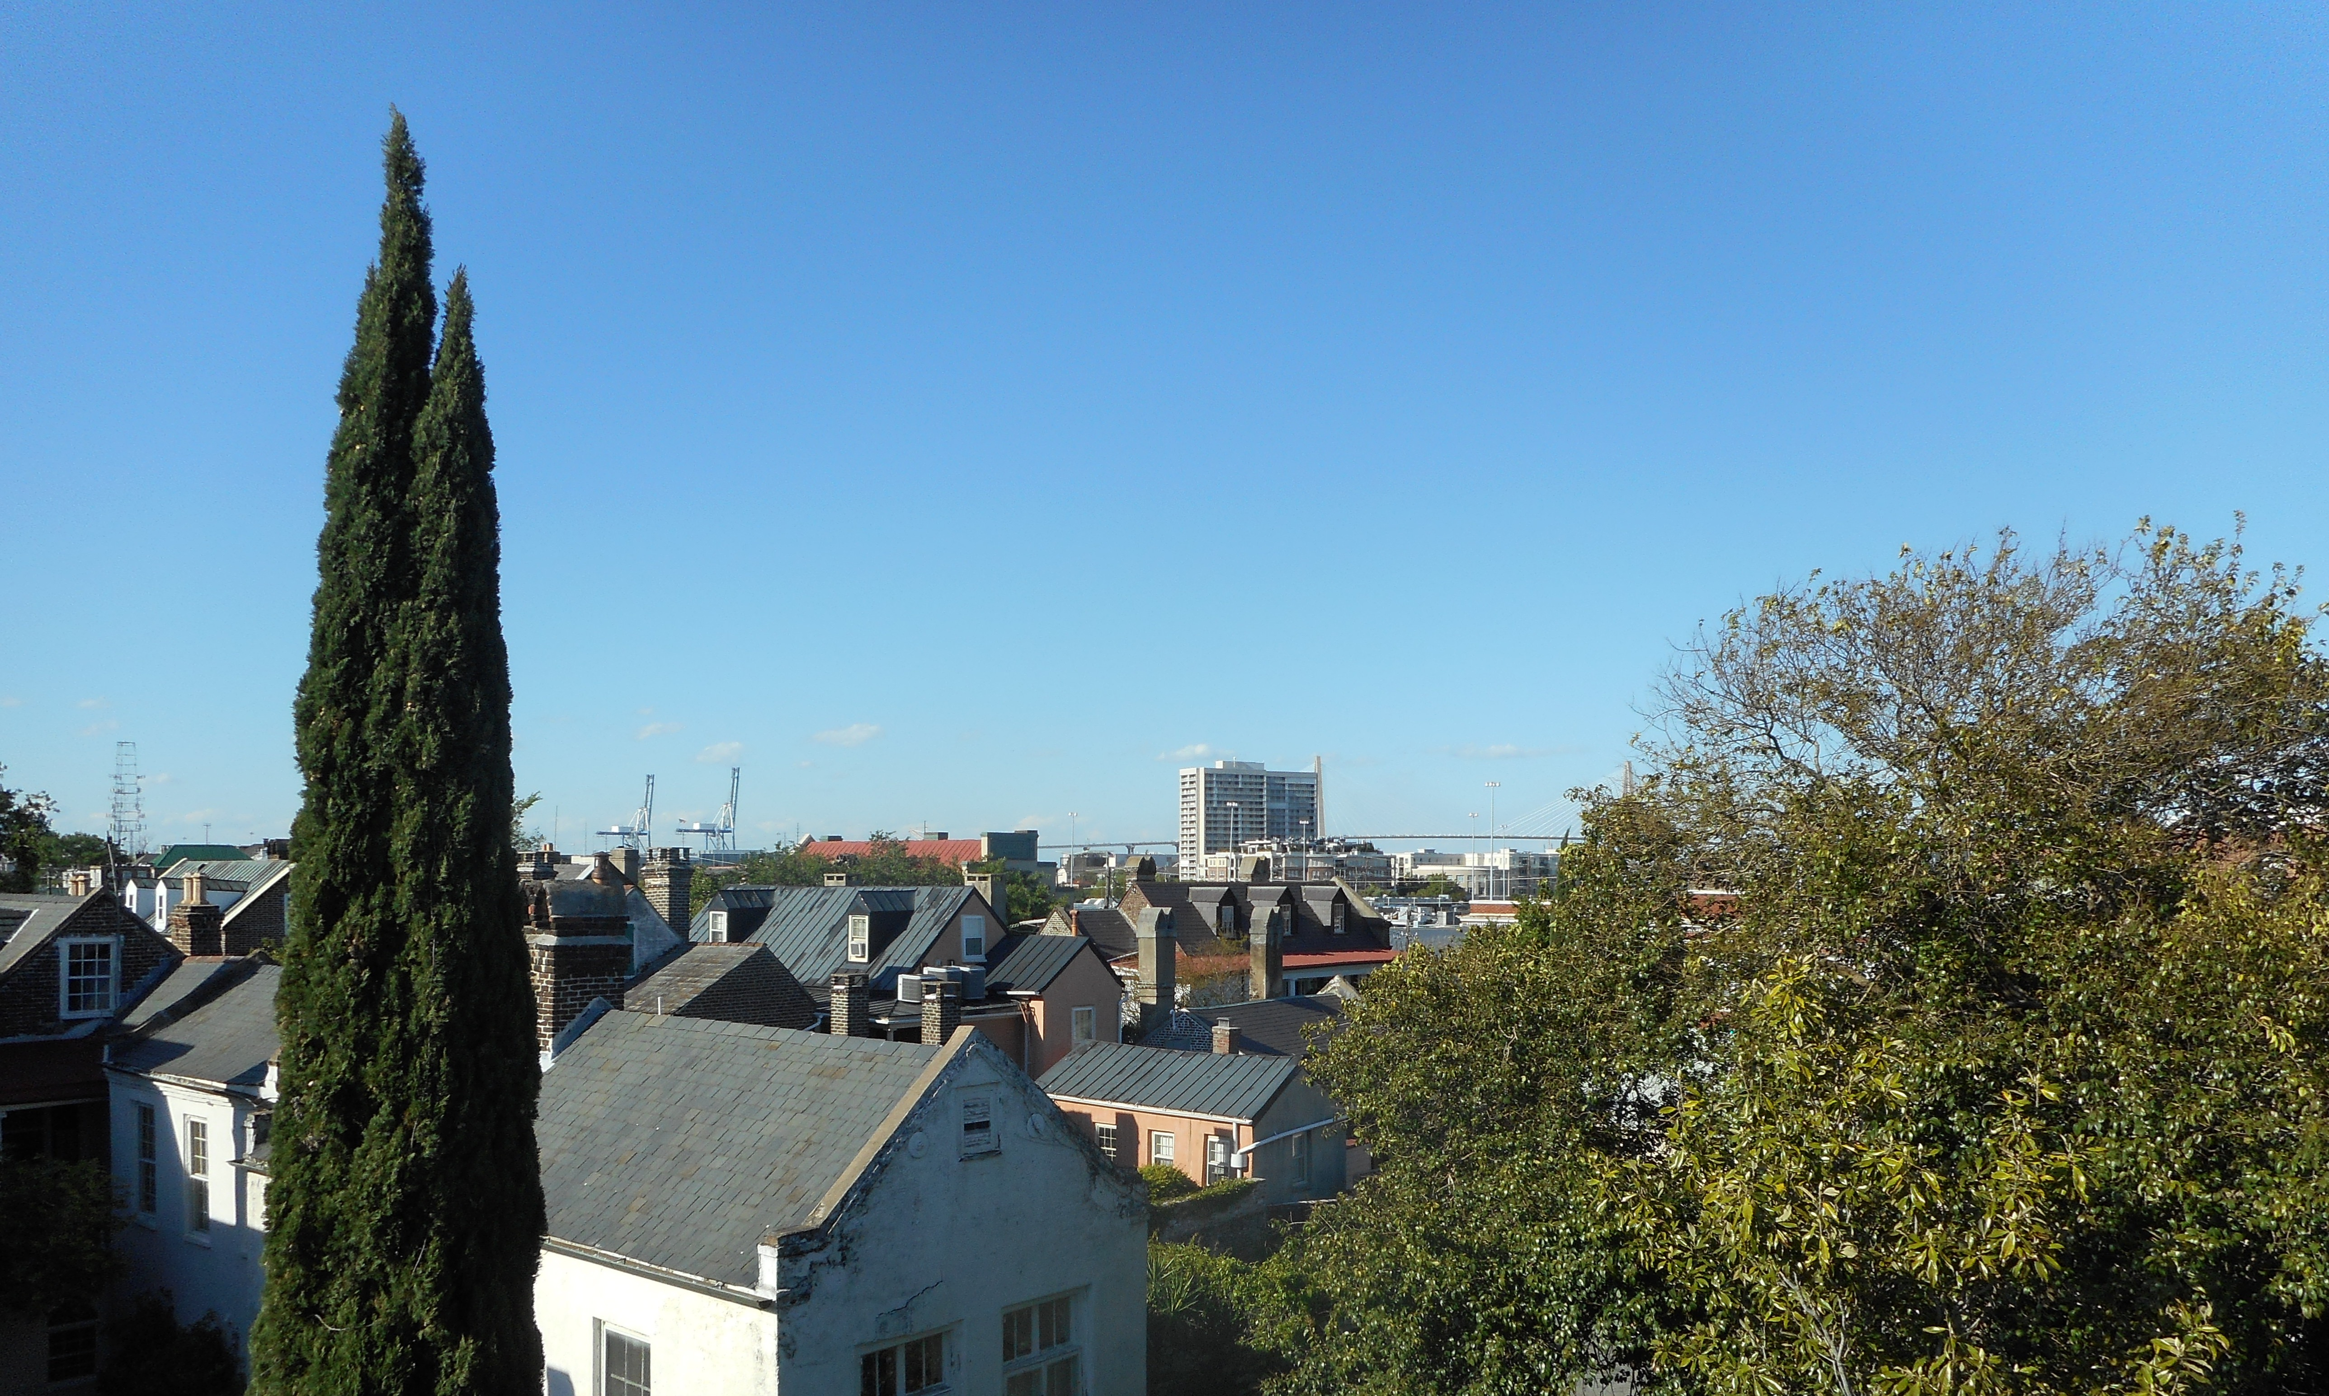
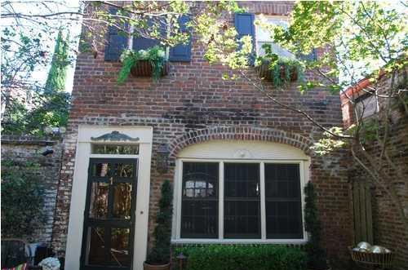

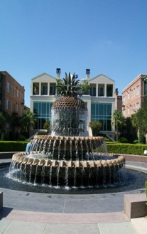
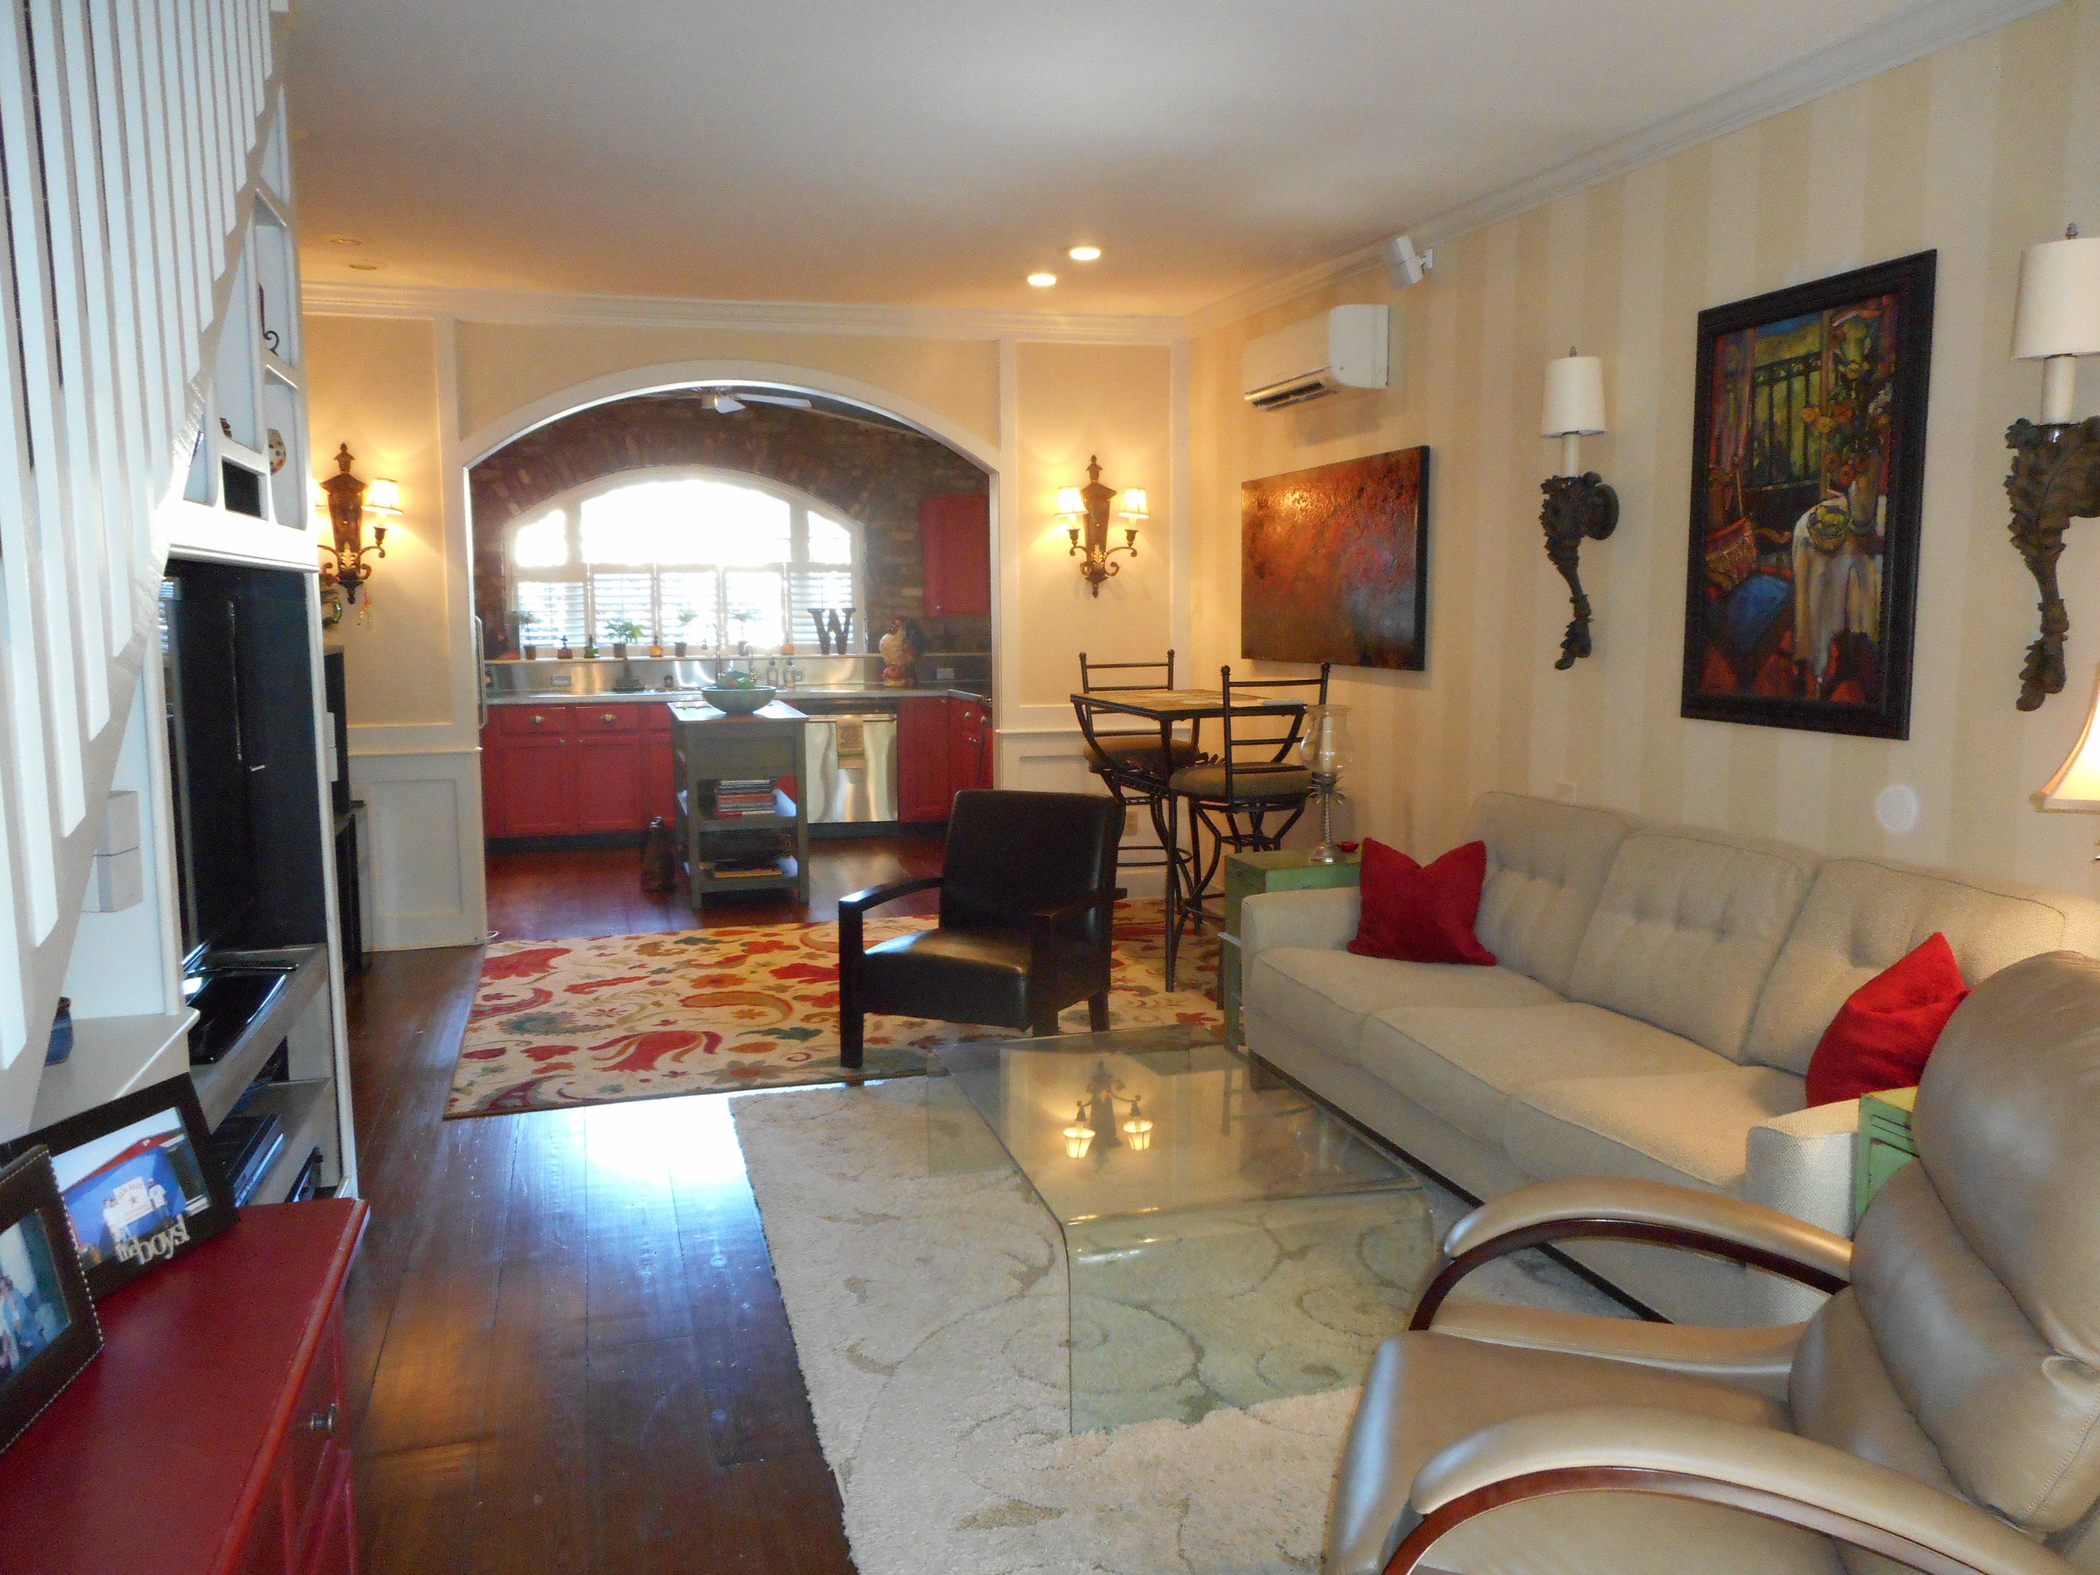
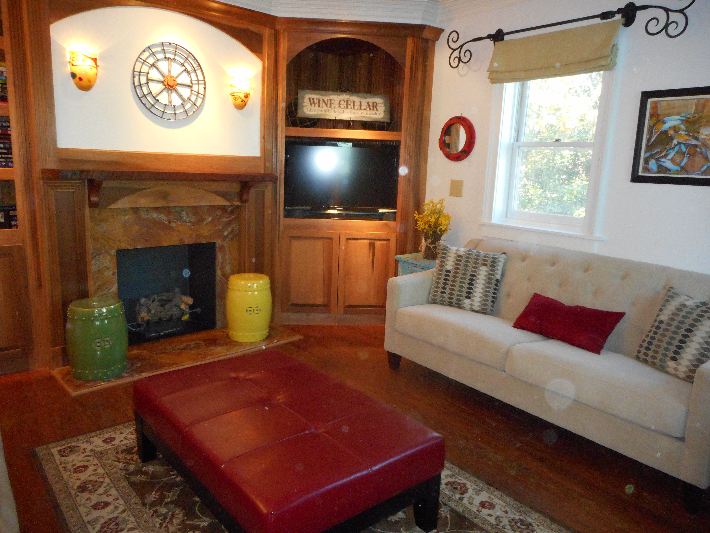
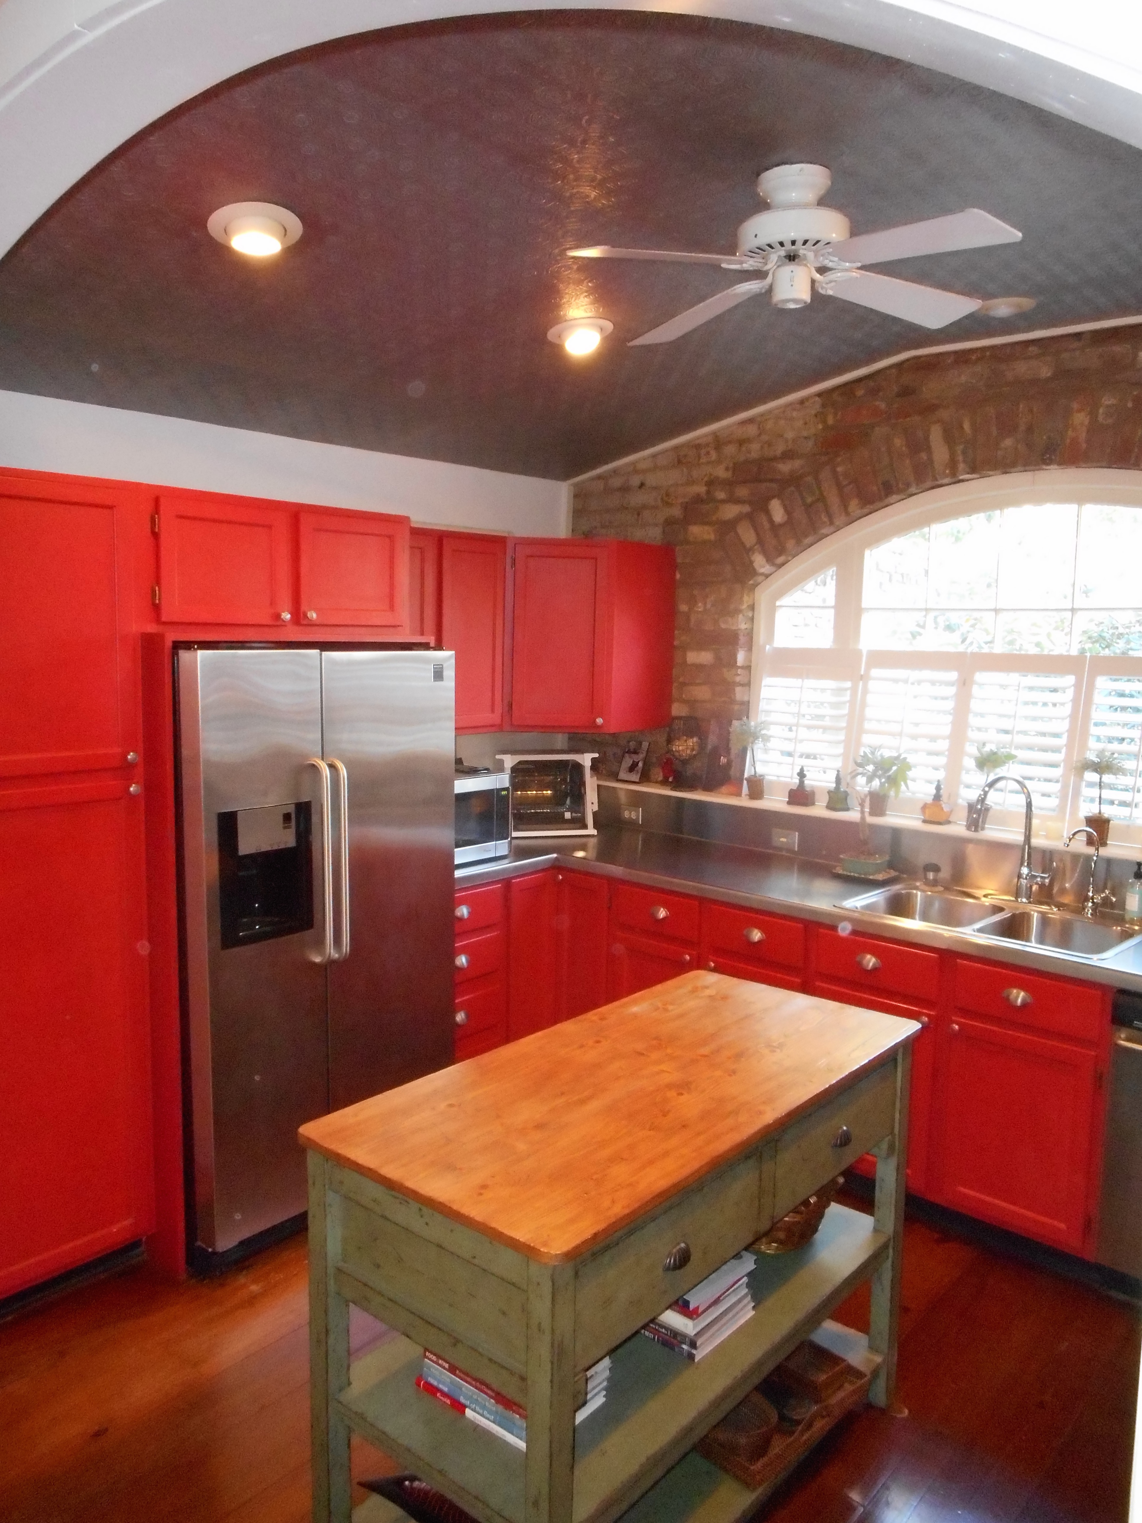
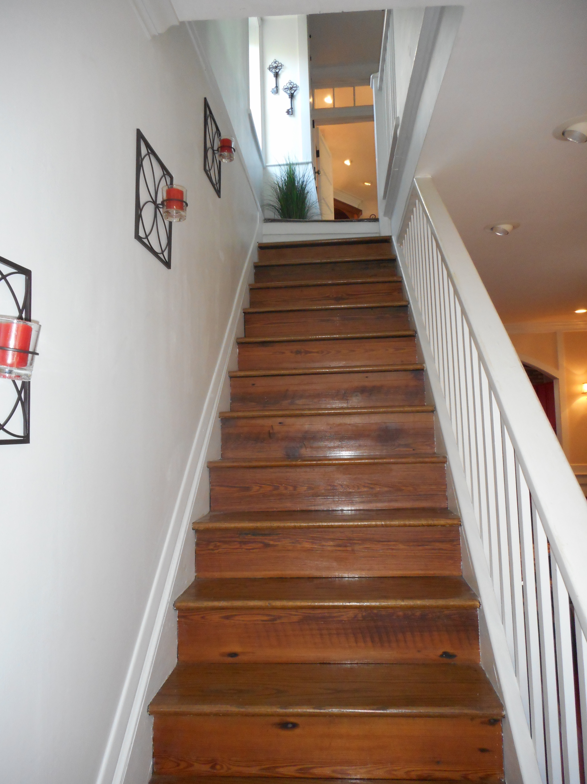
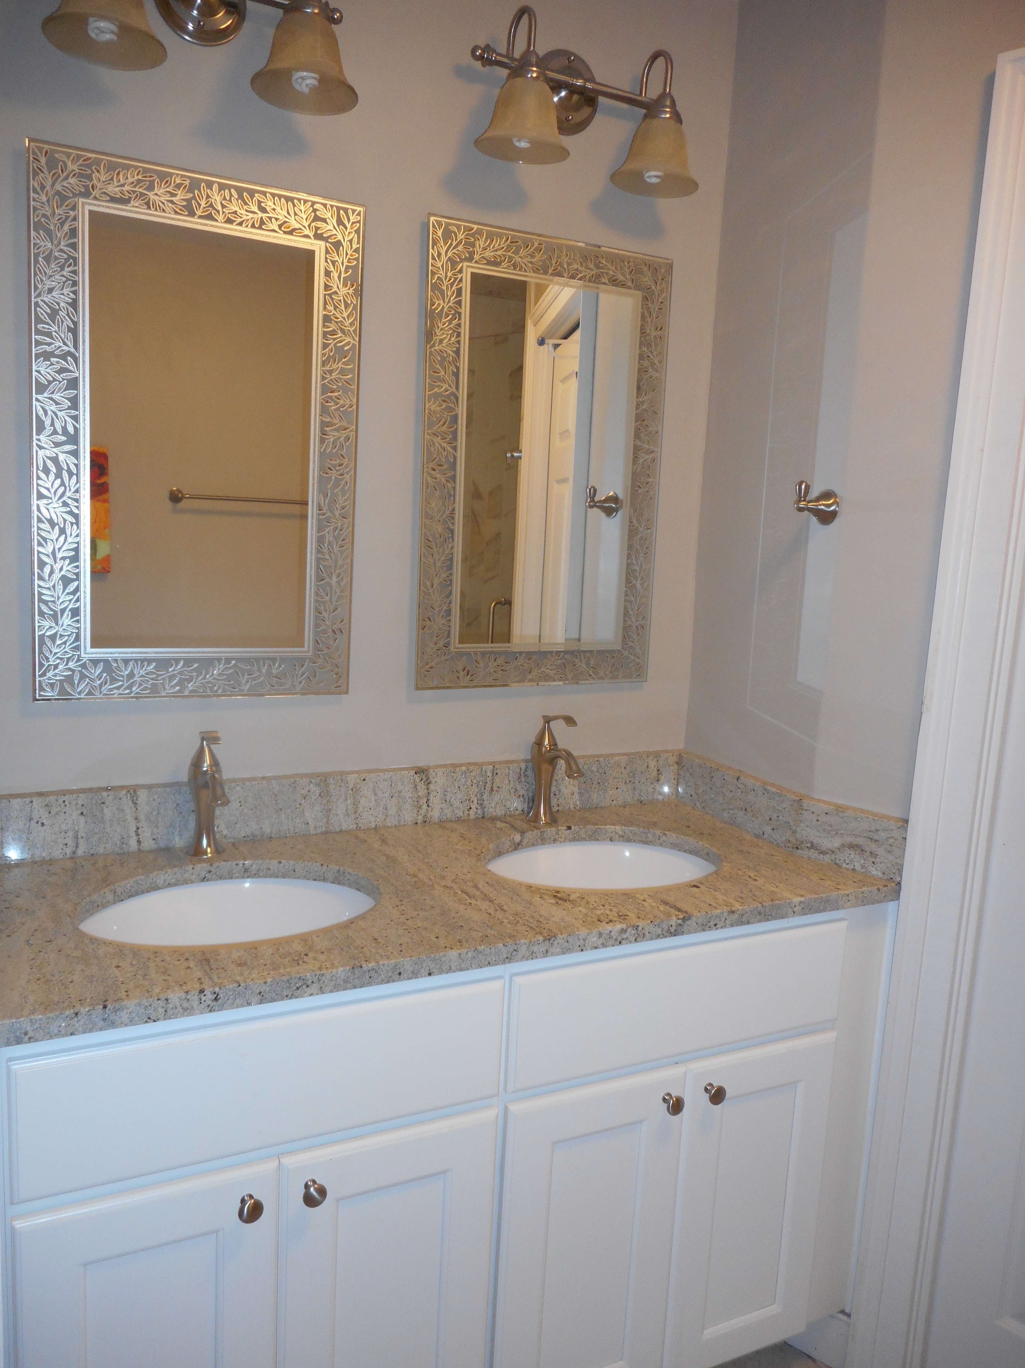
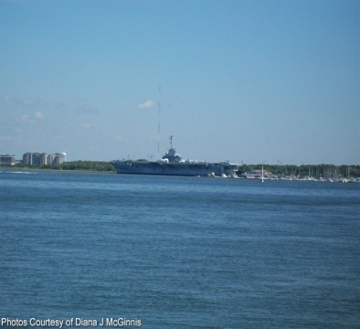
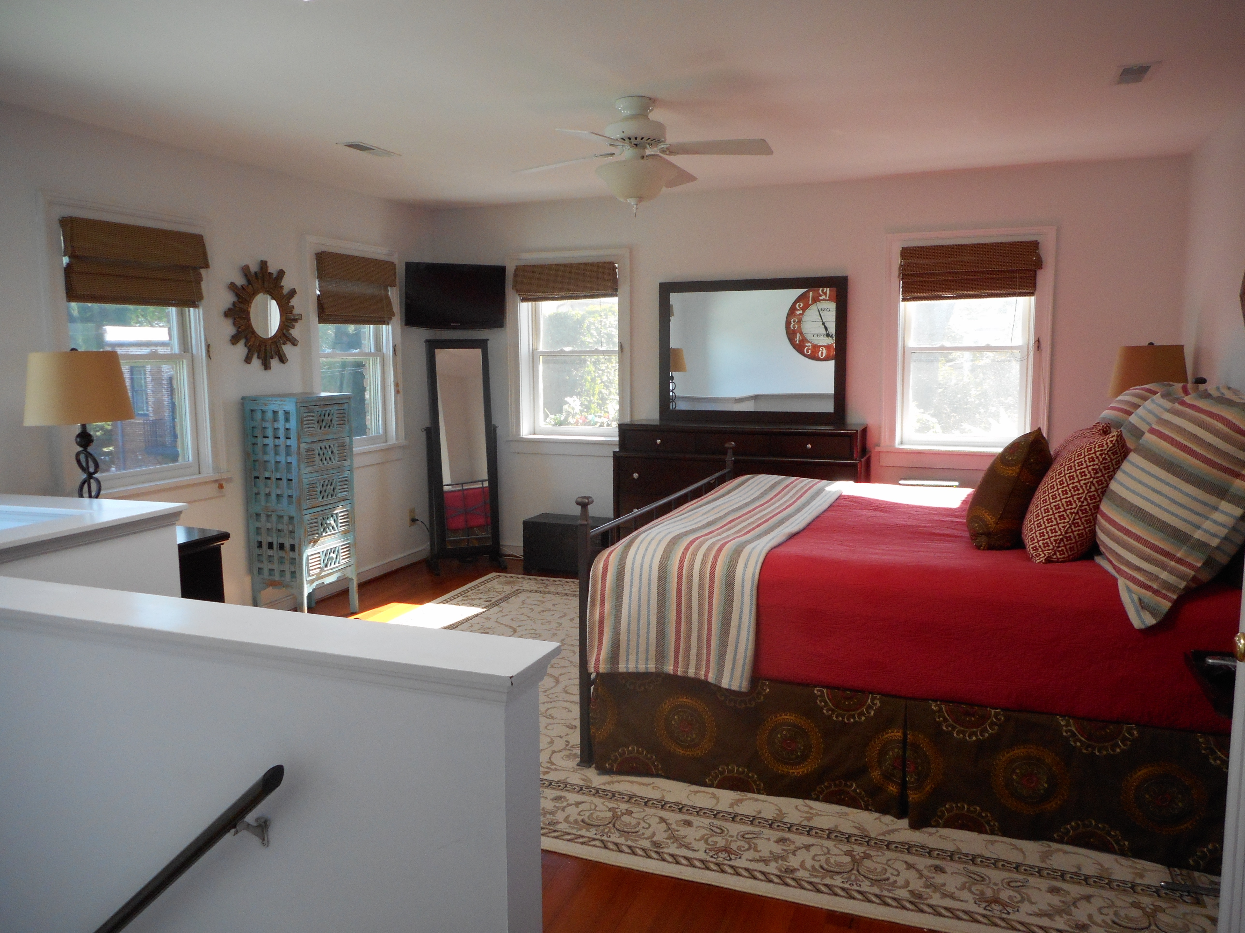
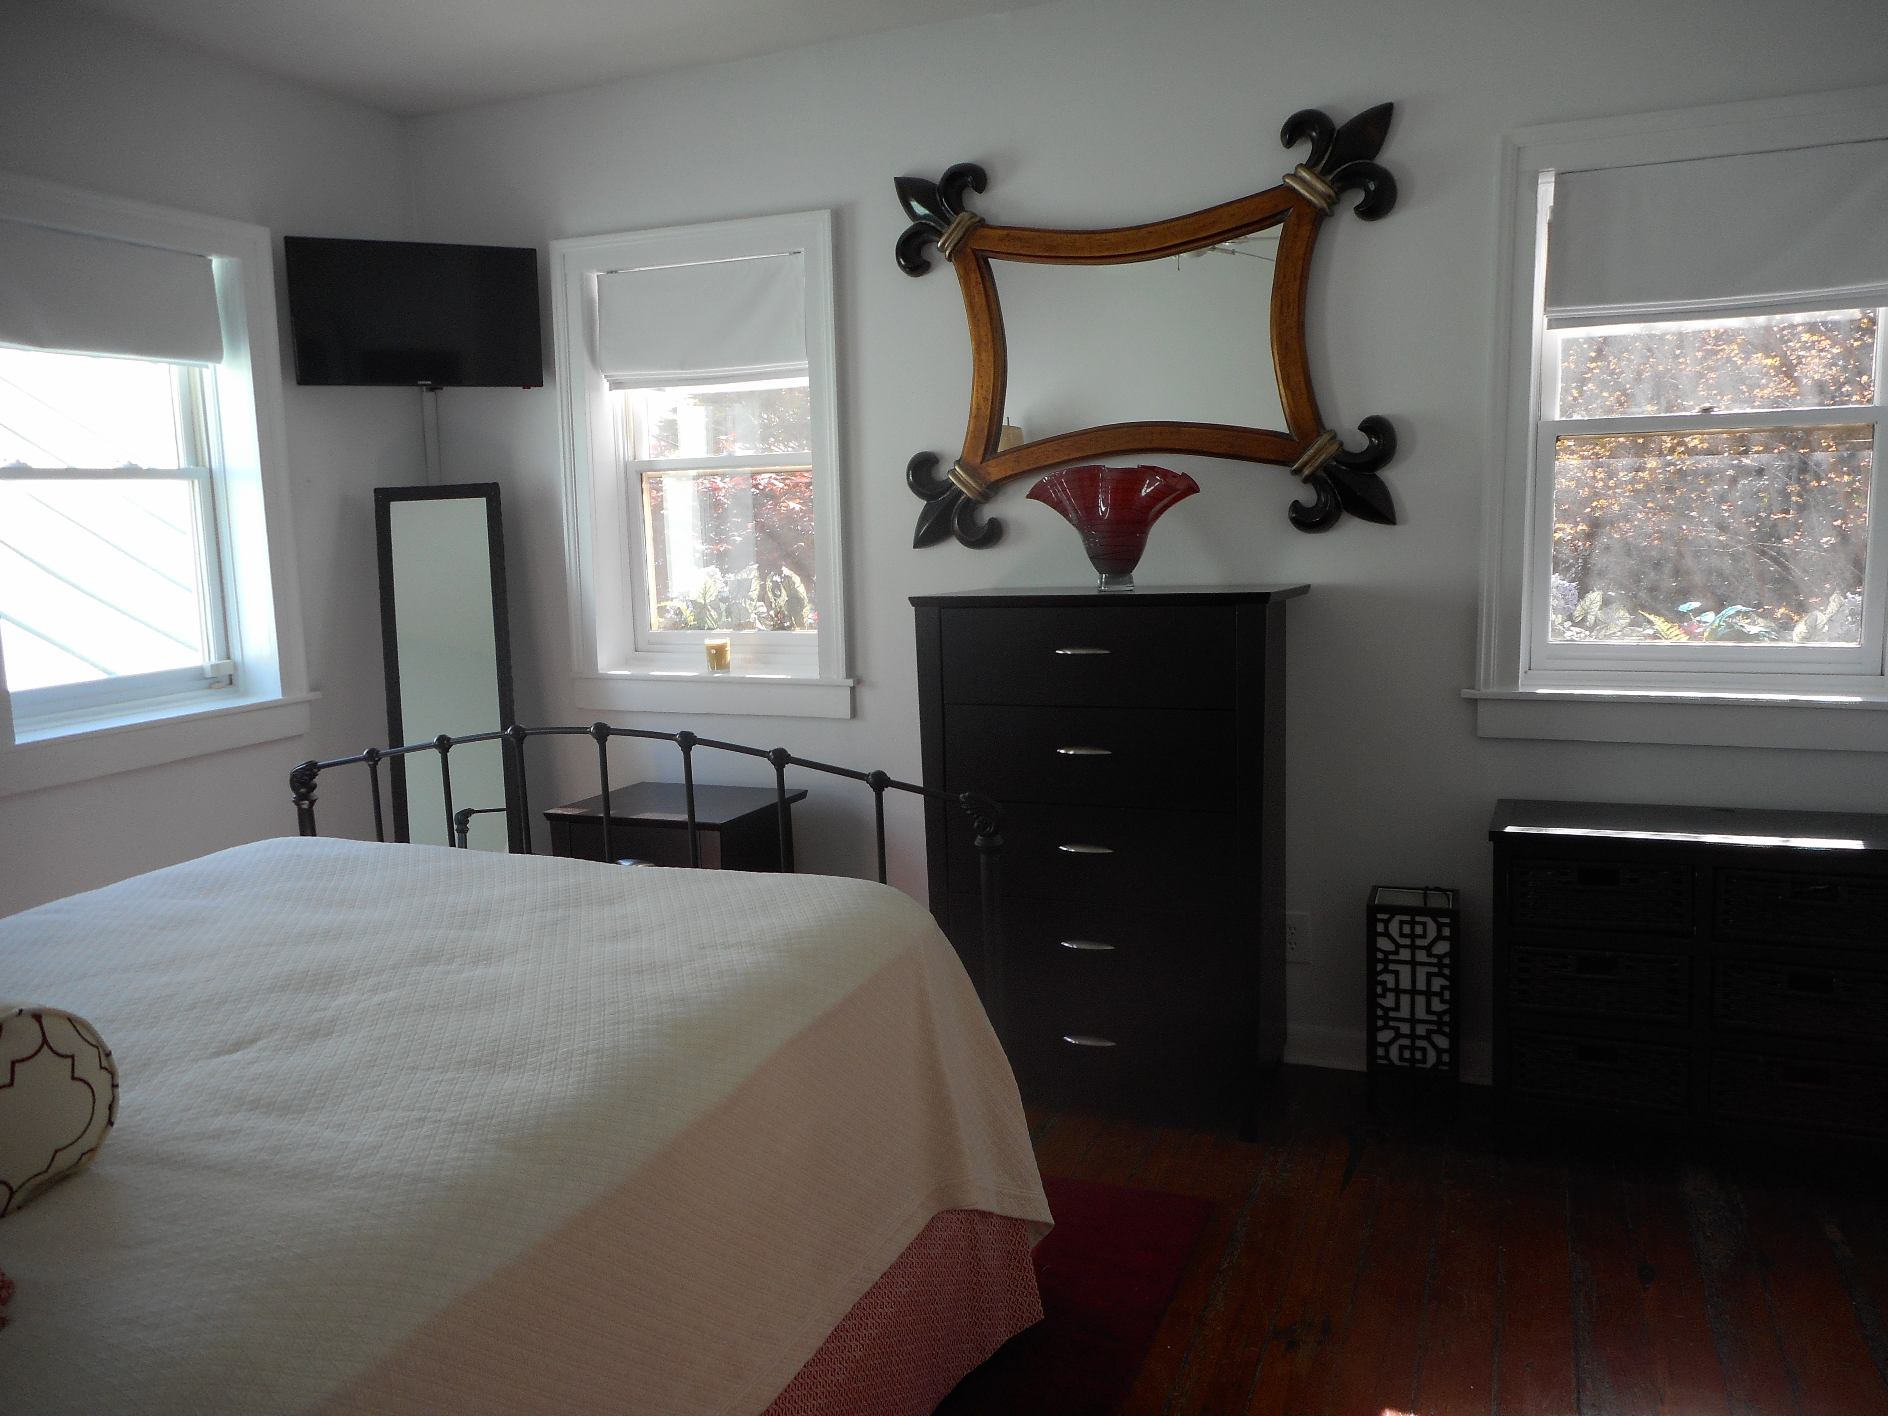


Historic Gem
Open House Sunday 4/24 12-3
$450,000
$450,000
1 Motley Lane
Ansonborough · Charleston · MLS# 16009554 · $1,060,000
Rodney Hancock
(843) 437-1347
rodneyhancock08@gmail.com mortgageprofessionalsonline.com
1850's brick carriage house, tucked away on quiet lane in the beautiful Ansborough neighborhood. The house is nestled behind a private Charleston brick wall with iron gate. The brick paver drive leads you to the home with a lush private garden with a fountain, and out door seating. Enter into the open concept kitchen, living area. The kitchen boasts a arched window with exposed brick and a tin ceiling, stainless steel counter tops and appliances. Architectural details include gorgeous heart of pine flooring through out the house, tall ceilings, transom windows and crown molding. The 2nd floor includes a bedroom, full bath and study. The elegant study has a gas fireplace, crown molding, and built ins. The third floor has another 2 bedrooms and full bath with amazing views of down town Charleston. Easy walk to restaurants, bars, library, cultural events and the water front. This house can be eligible for 0.5% of the loan amount cash back toward closing costs. Ask me how!
AgentOwned Charleston Group
902 Savannah Hwy
Charleston, SC 29407
Real Estate ● Mortgage Insurance ● Business Brokerage

