Slide 1
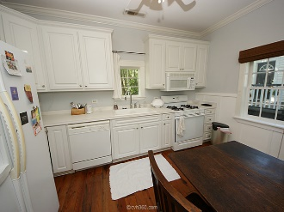
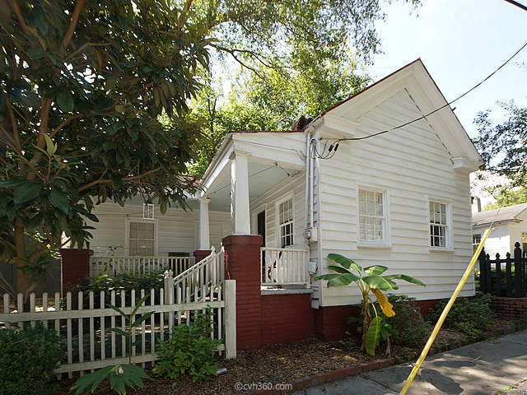
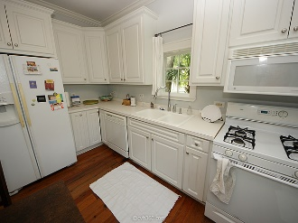
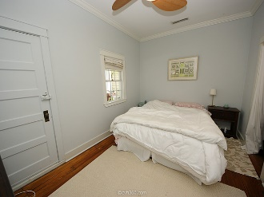
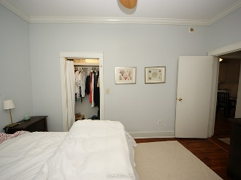
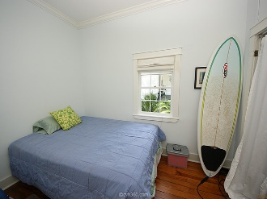
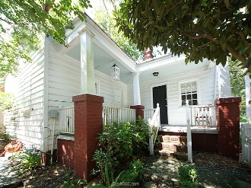
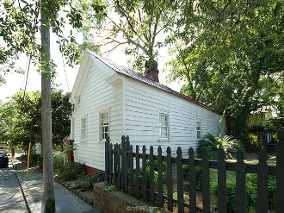
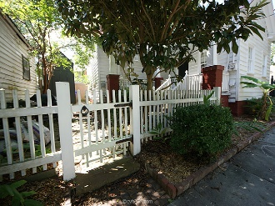


Hampton Park Terrace
Historic Freedmans Cottage
1 Sutherland Court
Charleston · MLS# 15023774 · $349,900
Come see this historic Freedman's cottage in desirable Hampton Park Terrace! This charming home is located on a quiet street, less than 1 block to Hampton Park. Recently updated and continuously improved, this home is ready for you to move in. It features two good-sized bedrooms, a large bath, and an updated, streamlined kitchen with all the appliances. Charm and character abound with tons of original details including a newly coated standing-seam metal roof, original hardwood floors, wraparound porch, original and recently painted wood siding, a charming courtyard, and much more. This home has all the historic character you could want, conveniently tucked quietly within one of the most desirable neighborhoods downtown. Walk the dog to beautiful Hampton Park, less than a black away.
Casey Anderson
Cell 843-410-3525
casey@charlestondwellings.com
Keller Williams Realty Charleston | 496 Bramson Ct, Suite 200 | Mt Pleasant, SC 29464

