Slide 1
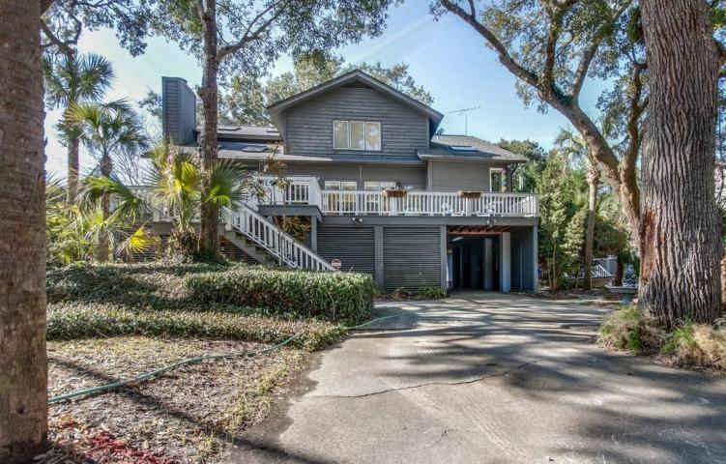
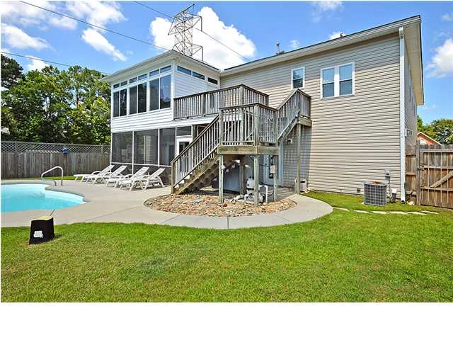
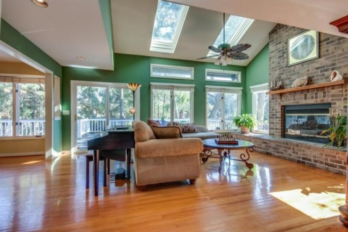
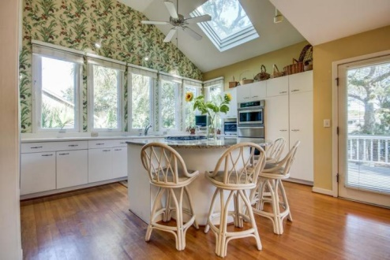
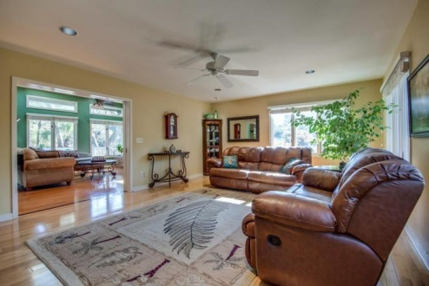
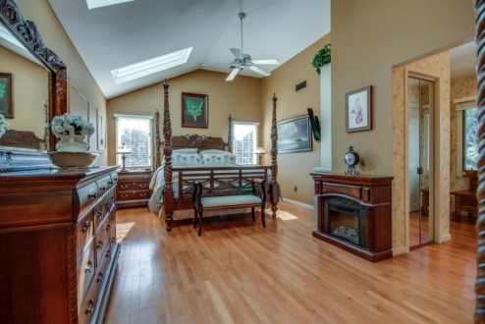
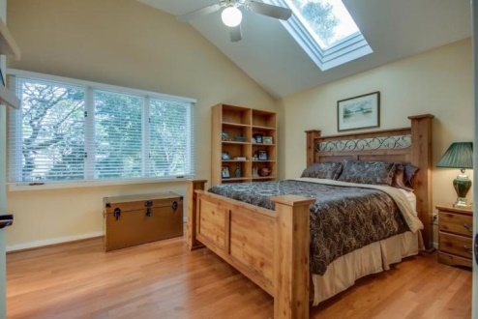
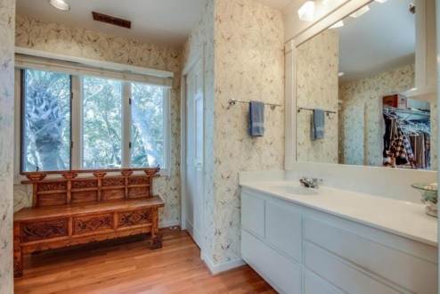
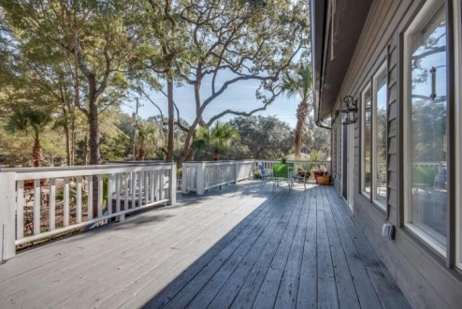
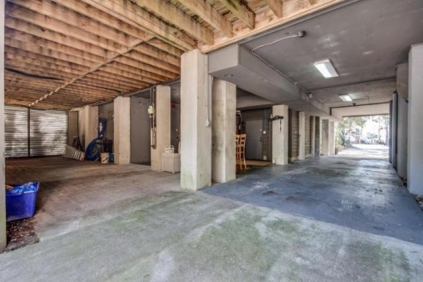

Price Reduced!
Just Listed near the Beach
1 Tabby Lane ~ Isle of Palms ~ MLS# 15002058 ~ $849,000
Dreams come true on the Isle of Palms with this two story stunner which offers four bedrooms, three full bathrooms, a home office, an entertainment room and 2,953 square feet of living area. Situated on a .30 wooded acre lot on a quiet cul-de-sac, there is plenty of shade from towering oak trees and a cool breeze from the palms, and direct beach access is just two blocks away from the rear of the home located on 25th Street. Imagine a warm, sunny day on your kayak in the Intracoastal Waterway accessed at the end of the Cul-de-Sac. There is an irrigation system that helps keep yard maintenance easy. Accessed from Tabby Lane and 25th Avenue, the spacious covered parking area beneath the elevated home leaves plenty of room for your cars, boat, golf cart, water toys and extra storage. Not to mention the incredibly outfitted 390 square foot workshop with industrial wooden shelving, storage, a dehumidifier, and air conditioning. The front porch provides a great outdoor living space option with room to relax and entertain. Step inside to find an open concept floor plan with beautiful hardwood floors throughout and tons of natural light from many windows and skylights. The updated kitchen features a breakfast bar around the center island, granite counters, a skylight on the vaulted ceiling and a wall of windows with serene views that you can enjoy while washing dishes. The kitchen opens to the dining room where there is room to host large holiday parties. Continue through to the family room and gather around the cozy fireplace with its brick surround. The vaulted ceiling here lets sun pour in through the skylights and sliding doors allow access to the deck. The formal living room sits off of the family room and is a great place to curl up with a book and unwind. Upstairs the owner's retreat boasts a sitting room, a huge custom walk-in closet and en-suite bath with a walk-in shower and jacuzzi tub. The additional bedrooms are spacious, quiet, and flooded with natural light. This home boasts additional features which include a fenced yard with under house access and pet shield, dual water heaters and air conditioners, a central vacuum, and a security system. If a day at the beach is your idea of heaven on earth, you're in luck as this home is just a short walk to the white sand shores. With no HOA fee, close proximity to the beach and a home that's truly move-in ready, you better not miss this home!
For more information, contact
Ben Laaper | Ben@MattONeillTeam.com | 843-642-3546

