Slide 1
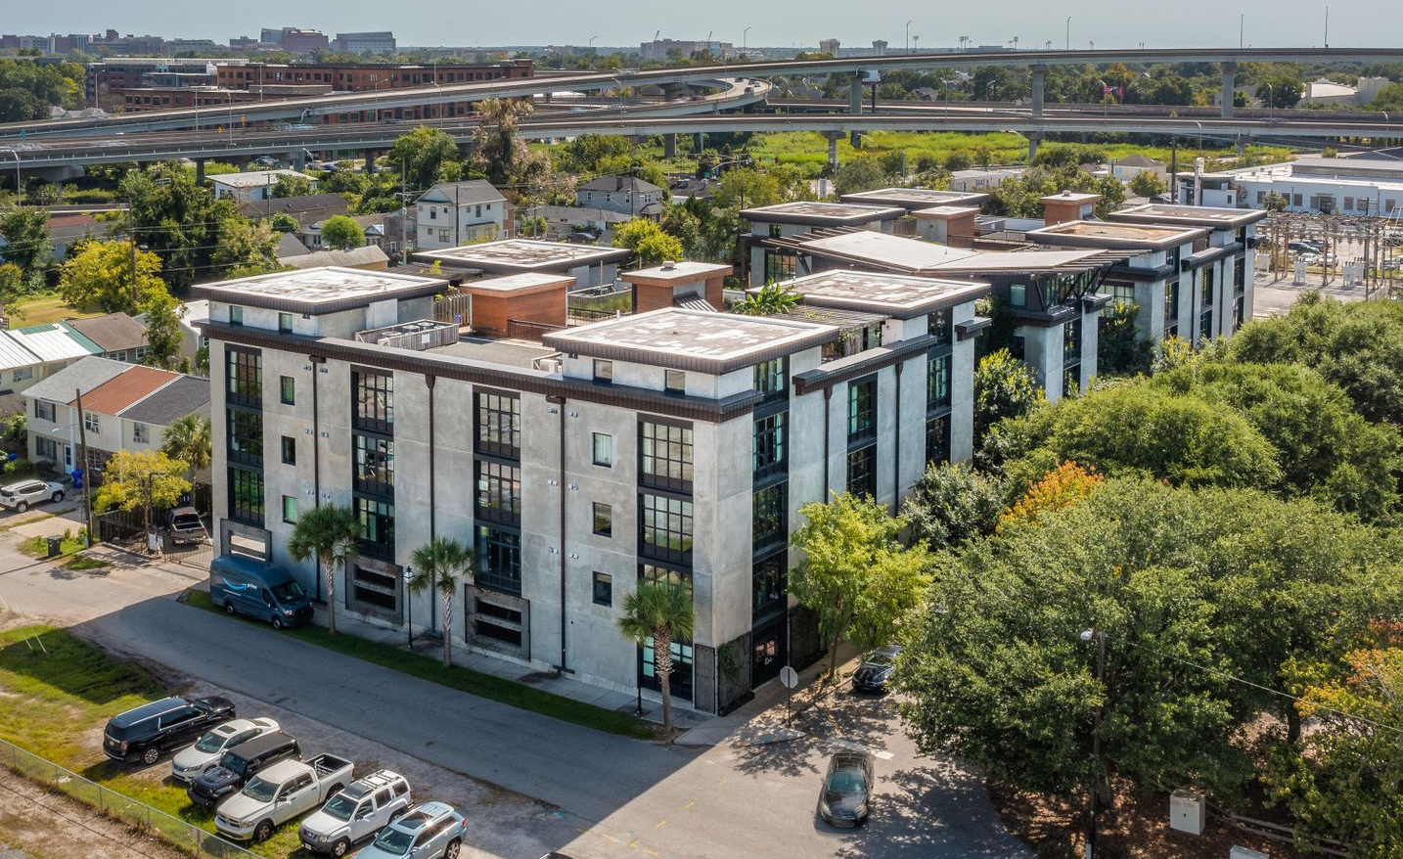
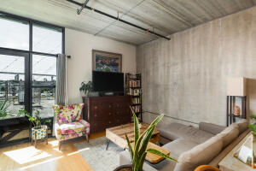
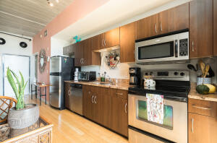
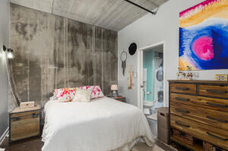
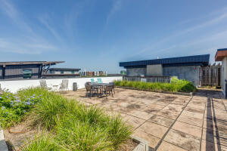

Minutes From EVERYTHING Downtown
1 Cool Blow Street 337
One Cool Blow | Charleston
MLS# 21023917 | $298,000
Located in the popular downtown area of NoMo, or North Morrison, this is the condominium you've been dreaming of within walking distance to restaurants, parks, and breweries. One Cool Blow is a small community featuring only a couple of gated buildings, off-street parking, and rooftops terraces with views of the Ravenel Bridge and the Charleston skyline. This peaceful third floor unit off of a quiet courtyard, features an open-floor plan with a living/dining space that runs the entire length of the home. The area is large enough to host all of your family and friends, while letting the natural light of a sunset seep through floor-to-ceiling windows. The exposed concrete walls and 10' ceiling makes it the perfect urban loft. Stretching along the left side of the home is the bedroom with double-door closets, the bathroom with a stackable washer/dryer unit tucked away inside, and a flex space giving you a potential spare bedroom, office, or additional living area. This home is centrally located in downtown Charleston and will be the idyllic mix of city & beach life, only twenty minutes to Sullivans Island or Folly Beach.
Kelly Snyder
843-457-5951
kelly.snyder@agentownedrealty.com
Greg Gelber
843-494-2354
greg.gelber@agentownedrealty.com
AgentOwned Charleston Group | 902 Savannah Hwy | Charleston, SC 29407-7802

