Slide 1
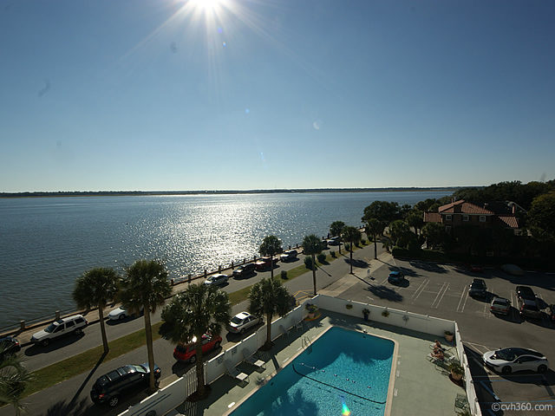
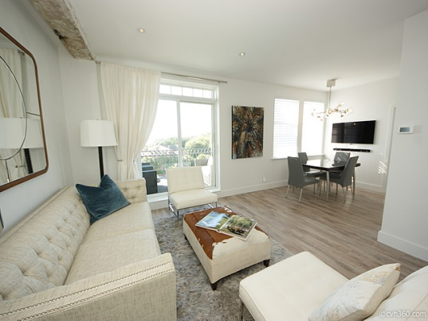
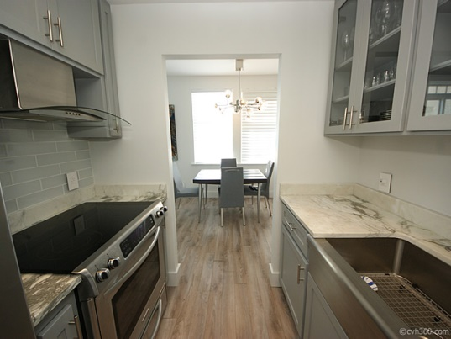
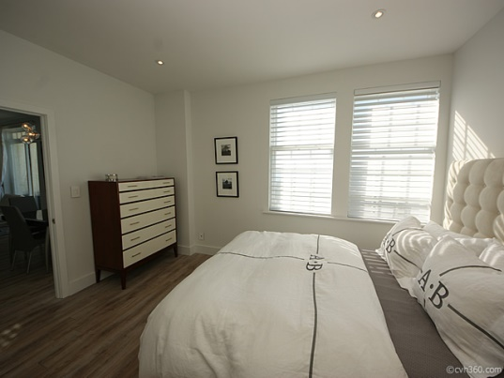

Stunning Views from Fort Sumter House
1 King St #403 – Charleston, SC
MLS# 14028684 - $525,000
Elegant and completely renovated South of Broad condo with breathtaking panoramic views of the Ashley River. Enjoy the sunsets and the Battery while lounging on the exterior balcony. Bright and open with hardwood floors, gourmet kitchen with custom cabinets, and a boutique bathroom. Amenities of the Fort Sumter House include an ornate and sophisticated lobby, 24/7 on site staff security, parking, exercise room and private swimming pool. A one of a kind condo that offers a unique Charleston luxury lifestyle.
Angela Black Drake Broker Associate
angela@limehouseproperties.com
O: (843) 577-6242 | C: (843) 991-0337 | F: (843) 577-0504
Limehouse Properties • 8 Cumberland Street • Charleston, SC 29401

