Slide 1
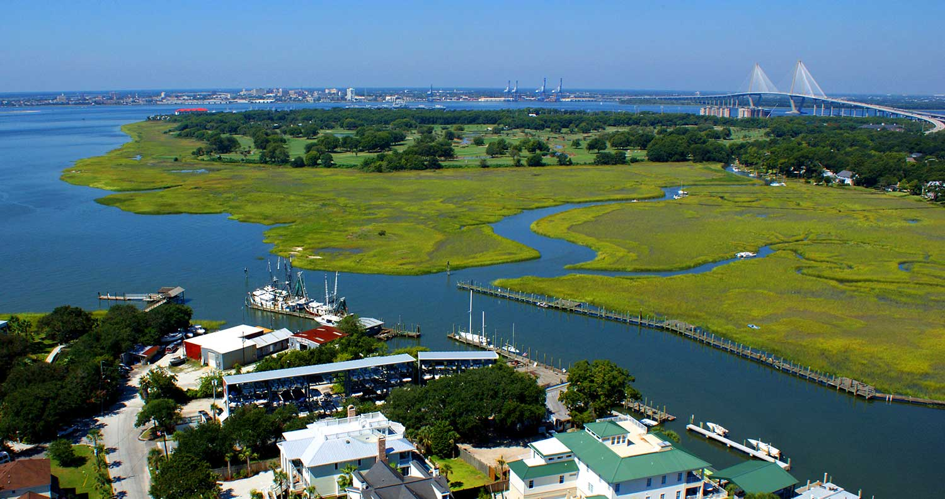
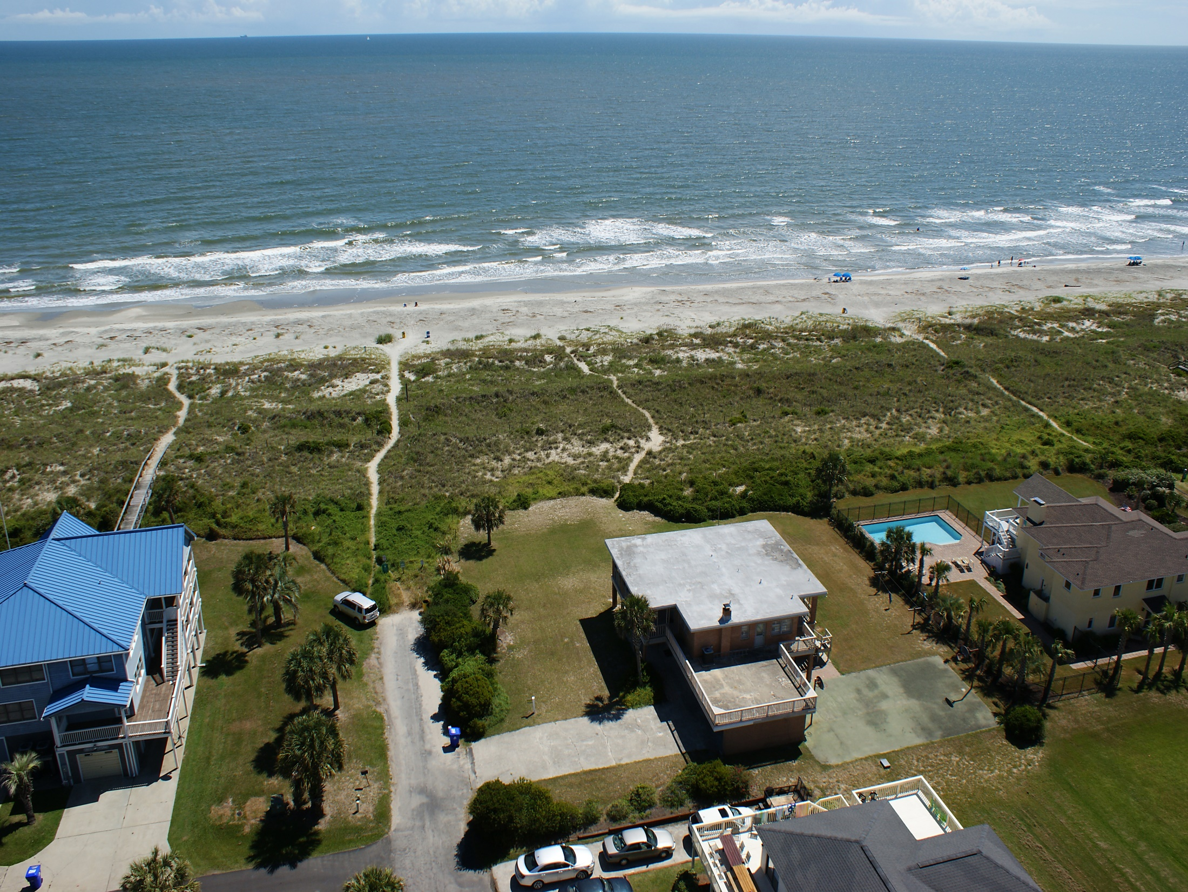



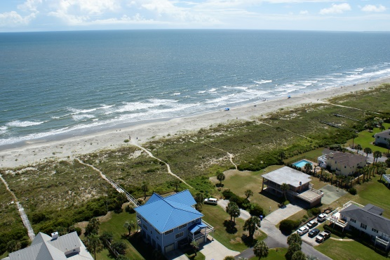
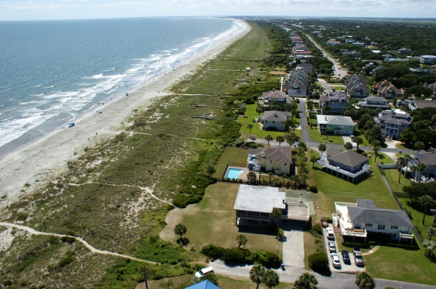
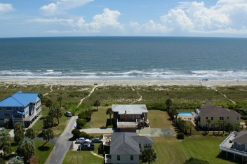
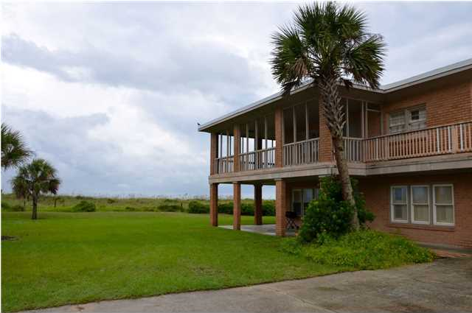
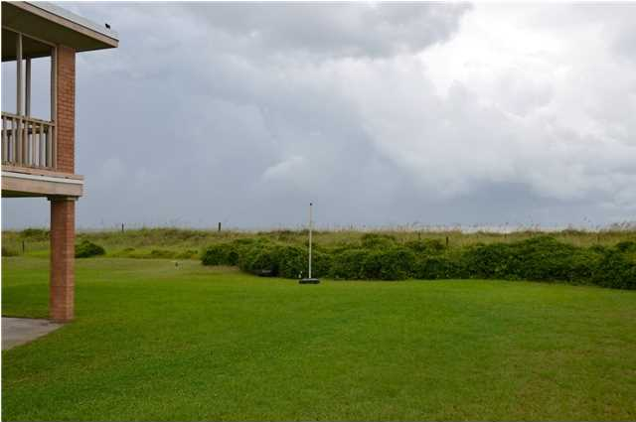
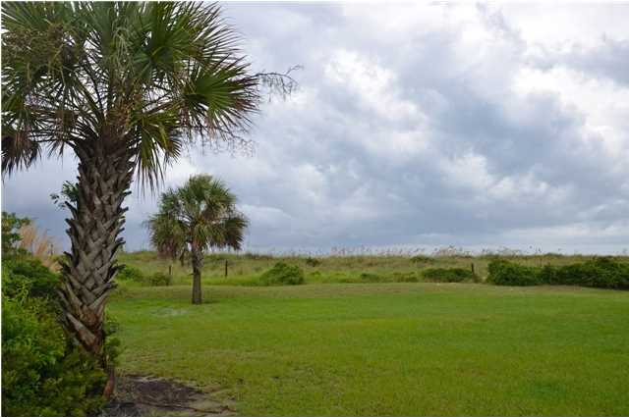
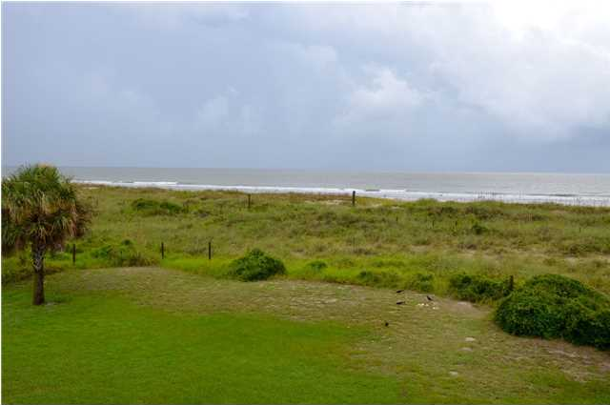
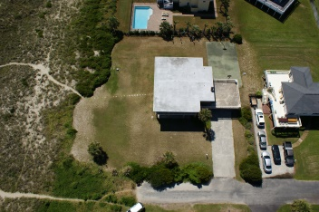
Oceanfront Paradise
Awesome location & ocean views at this charming, two story beachfront home! This rare gem is located in the desirable "Avenues" section of the Isle of Palms where 44th Ave dead ends at the beach. This is a quiet area with no busy traffic...and you are just steps away from the beach! Nice size lot to build your dream home if you desire. The current home is 5 bedrooms, 4 baths with a good rental history. Experience fantastic views from the large 2nd story wrap around porch which also includes a huge sundeck. You can also enjoy a game of basketball on your own court. Whether you are looking for an investment, second home or the perfect location to build your oceanfront dream home, you owe it to yourself to see this beautiful location!
1 44th Ave · Isle of Palms, SC · MLS# 1425715 · $2,850,000
Aerial Video Tour Available at:
http://youtu.be/601MZieo4T0
Bill Barnhill
843-364-6903
bill@billbarnhill.com
496 Bramson Ct., Suite 200
Mount Pleasant, SC 29464

