Slide 1
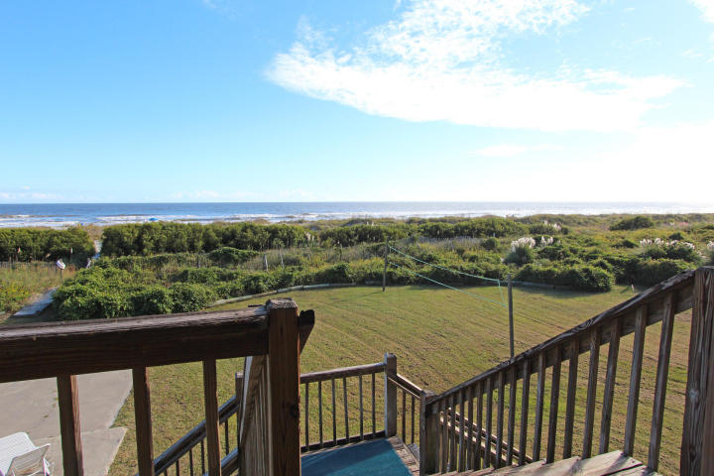
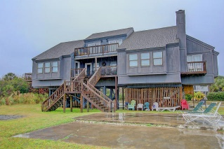
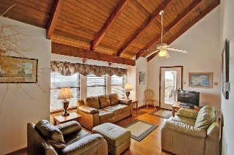
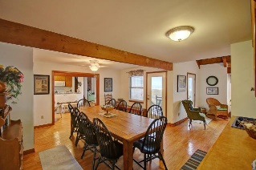
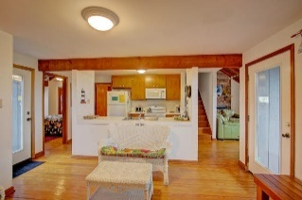
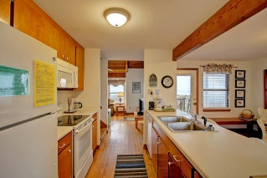
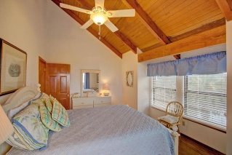
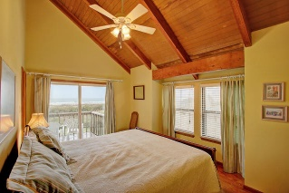
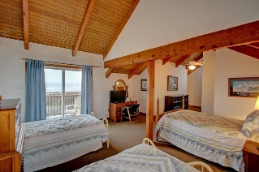
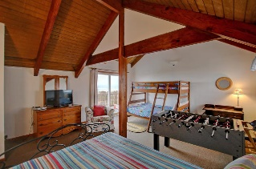
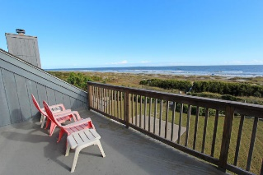


1 52nd Avenue Isle of Palms, SC 29451 MLS# 16003086 $2,500,000
Oceanfront IOP…Large Lot
Private and Great Rental
Enjoy Oceanfront living in this absolutely oceanfront home with one of the largest oceanfront lots on the IOP. 150X240 makes this an exceptional piece of property with a large home that is currently a vacation rental. Spectacular views!! This home has charm and lots of family history...lots of private space, views, kitchen open to large dining area, new heating and air, and appliances, Well maintained and a great spot on the Isle of Palms!!
This property is also listed as Vacant Land see MLS #16004569. A great lot for a buyer to build their dream home.
Darlene Smith Office - (843) 886-8110
Mobile - (843) 696-7824
darlenesmith@carolinaone.com
DarleneSmithTeam.com
Carolina One Real Estate
1503 Palm Blvd Ste
Isle of Palms, SC 29451

