Slide 1
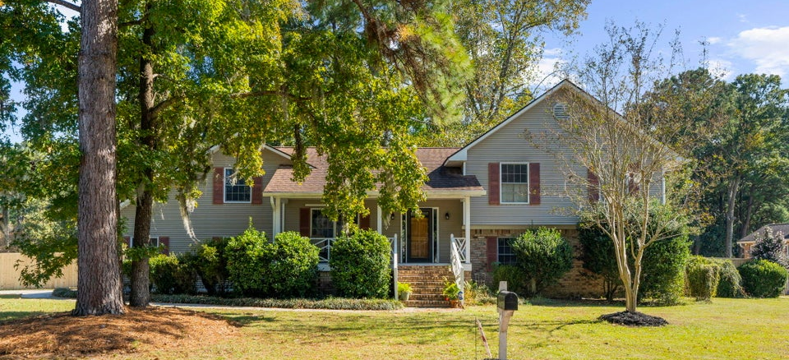
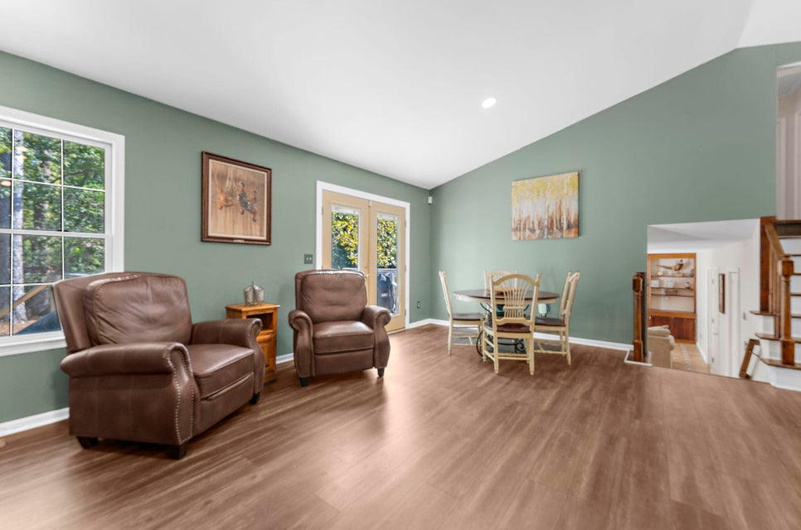
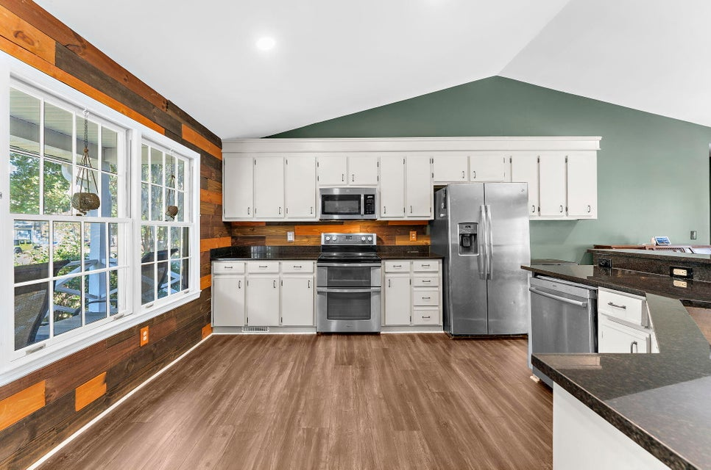
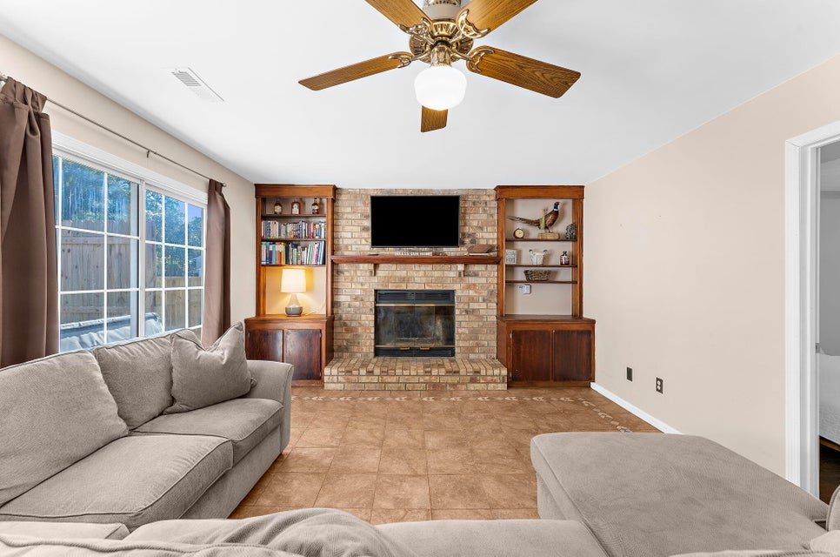
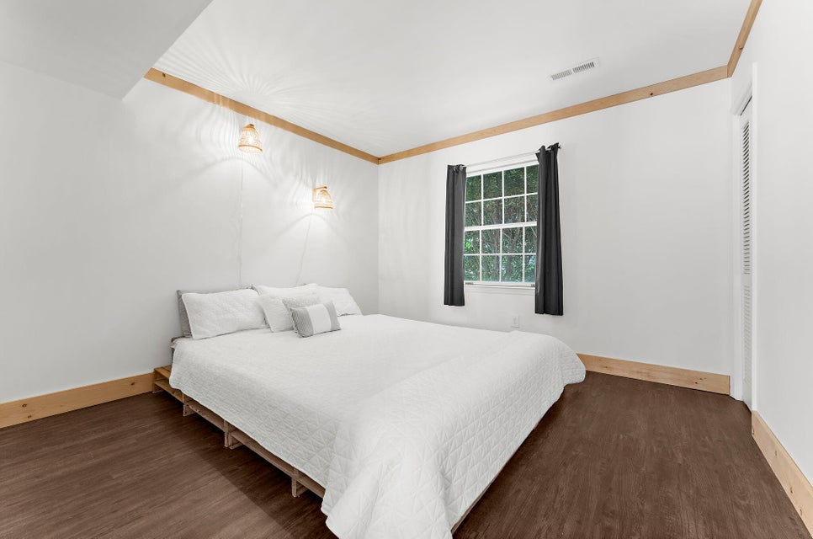
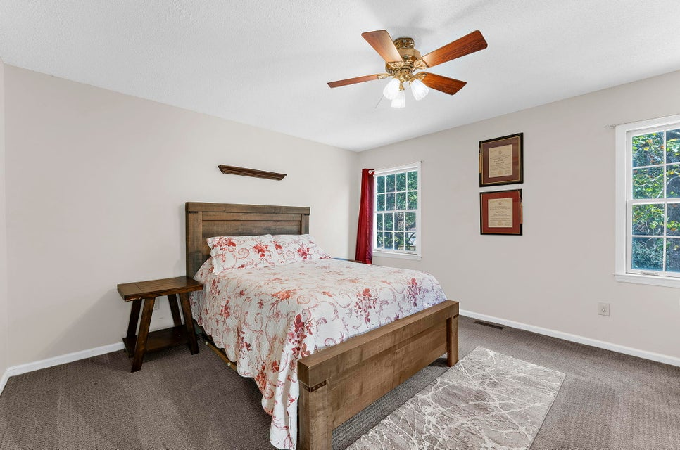
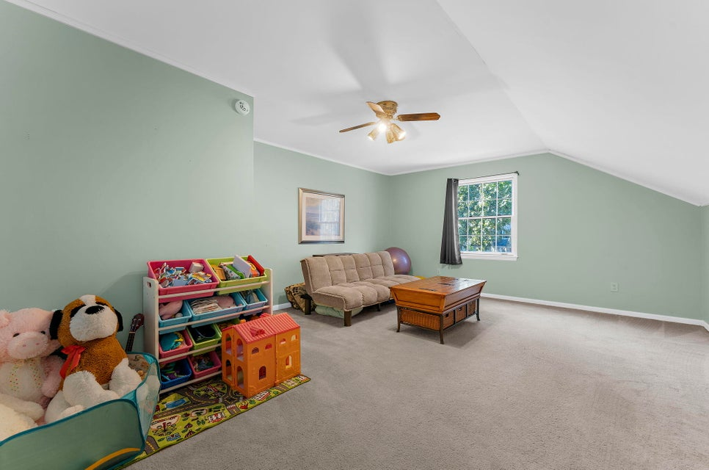
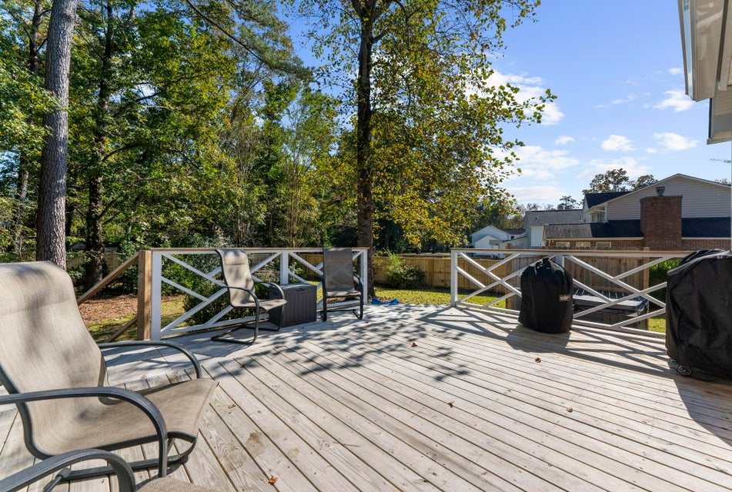
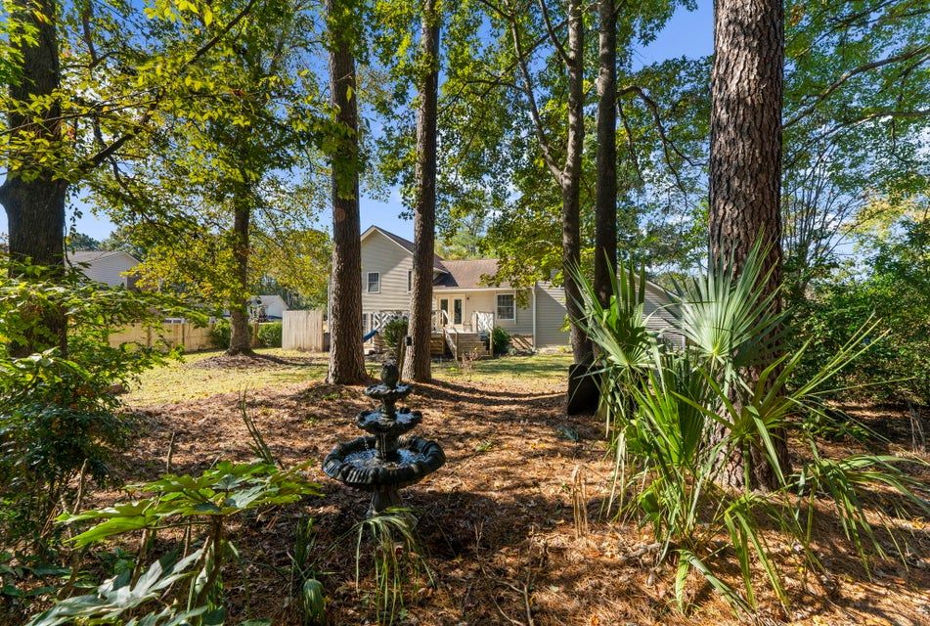
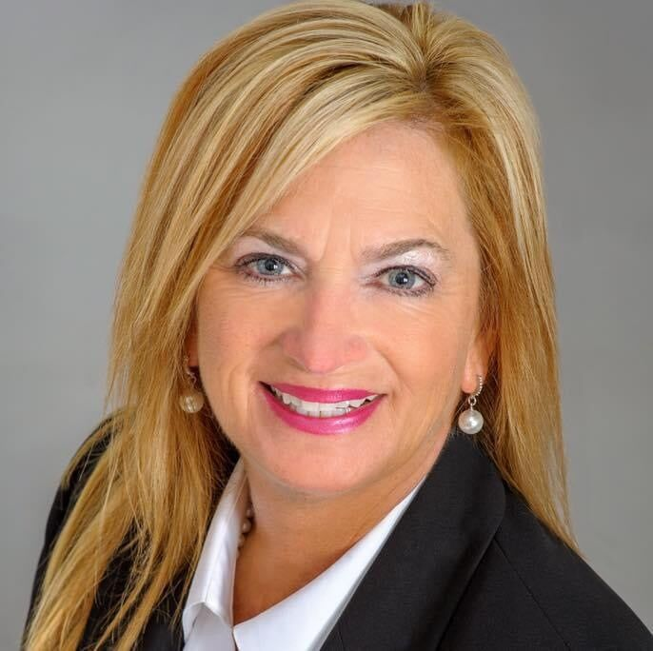

$5,000 AGENT BONUS
1 Lochmore Terrace
Shadowmoss · Charleston, SC 29414 · MLS# 25029854 · $624,900
$5,000 Agent Bonus with acceptable offer by 11/25/25 – Black Friday Special
New Price
NO HOA
Remodeled kitchen 2020
NEW HVAC 2021
NEW Garage drywall 2022
NEW Deck 2024
NEW Privacy fence 2025
VIRTUAL TOUR
Robyn Lane
843-222-5599
robynlane01@icloud.com
Becky Eakle
843-475-4149
becky@beckyeakle.com
beckyeakle.erawilderrealty.com
ERA Wilder Realty
1282 State Rd
Summerville, SC 29486

