Slide 1
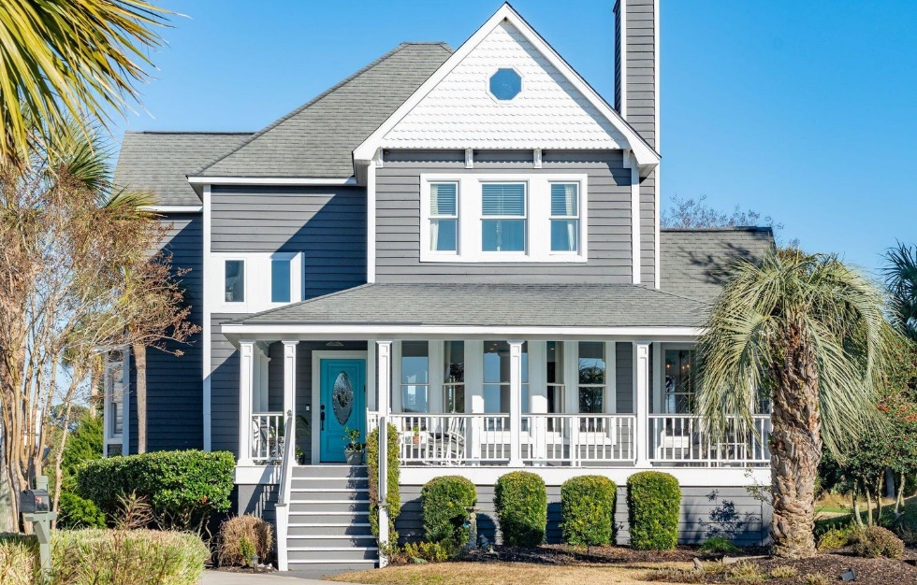
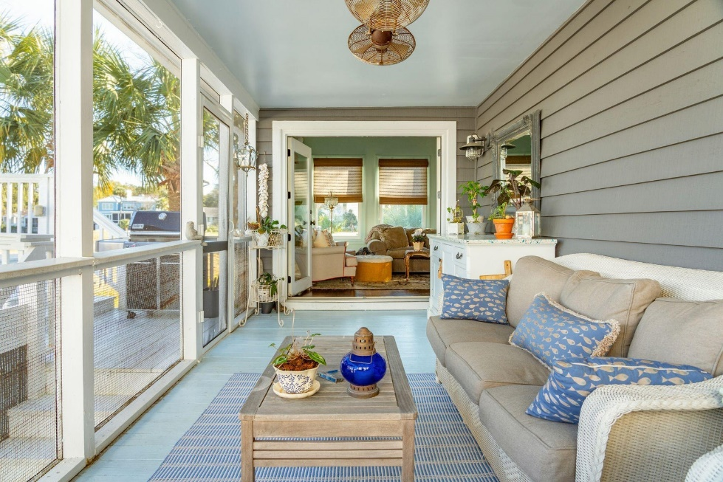








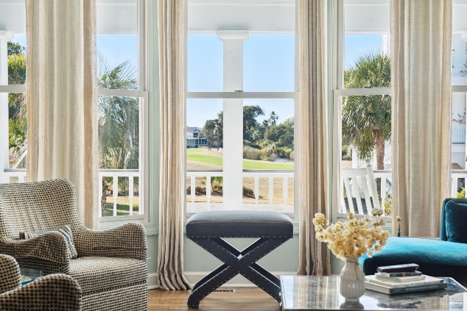
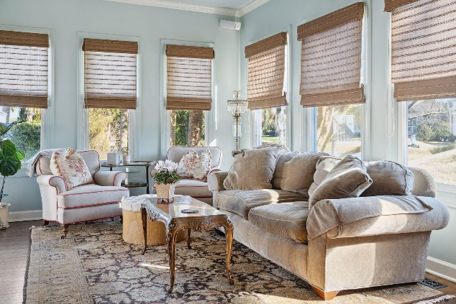
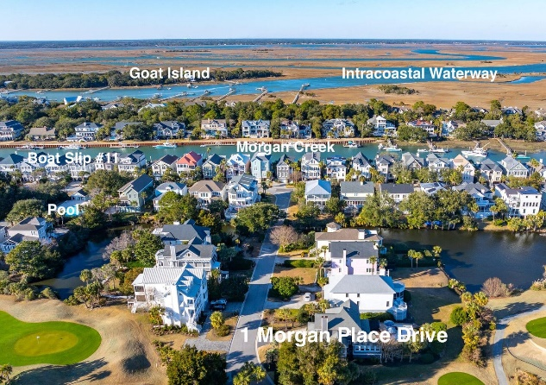
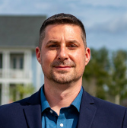
#24002234
1 Morgan Place Drive Wild Dunes
Isle of Palms, SC 29451
Includes 40’ Boat Slip!
Open House
Sat 10-12 & Sun 10-12
4 BED
4½ BATH
2,510 SF
$2,349,000
Welcome to 1 Morgan Place Drive! Located in the resort community of Wild Dunes on the Isle of Palms. This charming and well-kept home is in the highly desirable Morgan Place neighborhood and features panoramic lagoon and fairway views. A brief stroll takes you to the front beach of Isle of Palms, among the best on the east coast. Another short walk brings you to the deeded 40-foot boat slip and floating dock with water, electric and storage located on picturesque Morgan Creek. As you walk up the steps and enter the home you are welcomed into the family room with wood burning fireplace and dining room. The updated kitchen is complete with top-of-the-line appliances, large pantry, laundry room, a custom bar and a beautiful banquette. The cozy sitting room leads to a screened rear porch that overlooks the 400 square foot sundeck (with breathtaking views of the 15th fairway) that's perfect for sunning and entertaining. The first-floor master bedroom includes a large walk-in closet, updated bath with dual vanities, garden tub and a glass shower. Upstairs are 3 bedrooms all with en-suite bathrooms. A two-car garage is located at the rear of the property, perfect for storage and a workshop and has an attached outdoor shower. This property boasts mature landscaping and statuesque Palm trees with an irrigation system. Morgan Place offers a well-maintained community pool and cabana. The Wild Dunes resort is located just a short ride to the restaurants and shopping of historic downtown Charleston. A quick trip over the Isle of Palms connector brings you to all the amenities that the town of Mount Pleasant has to offer. The Wild Dunes resort boasts 2 award winning Tom Fazio designed golf courses with no membership required to play. The clay court tennis and pickleball facility are the best in the area. Wild Dunes has miles of beach, bike and walking trails that let you enjoy the lowcountry surroundings. This home is wonderful as a full-time residence or perfect as a vacation home.
Enjoy a virtual walkthrough
Steve Auerbach
917-750-6965 | steve.auerbach@carolinaone.com
Carolina One Real Estate | 1503 Palm Blvd | Isle of Palms, SC 29451-2280
Matt Kimes
843-860-1669 | mattkimeshomes@gmail.com
www.mattkimeshomes.com

