Slide 1
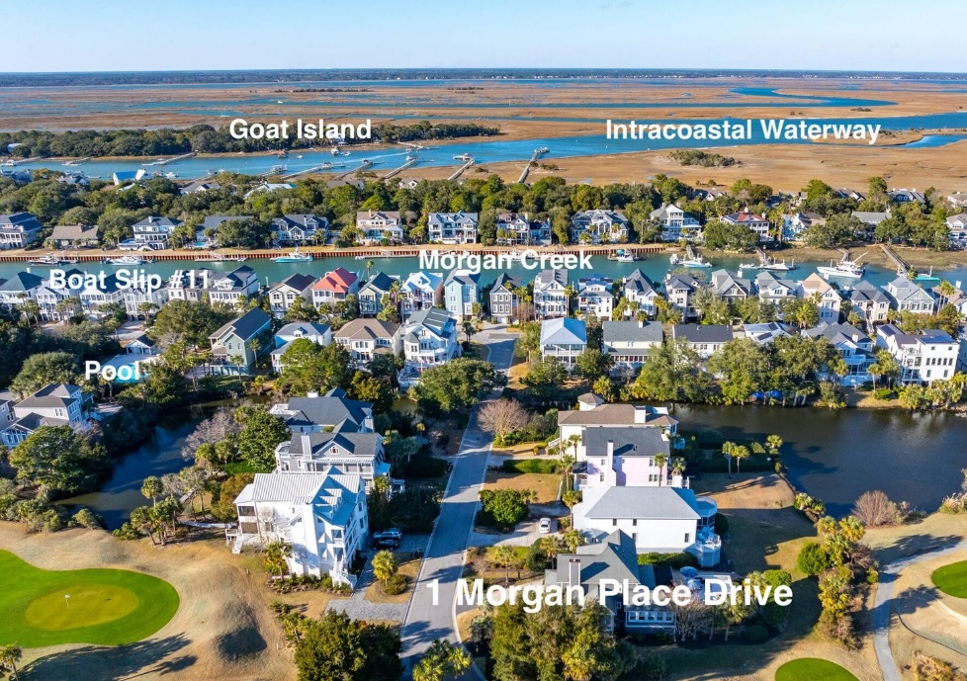
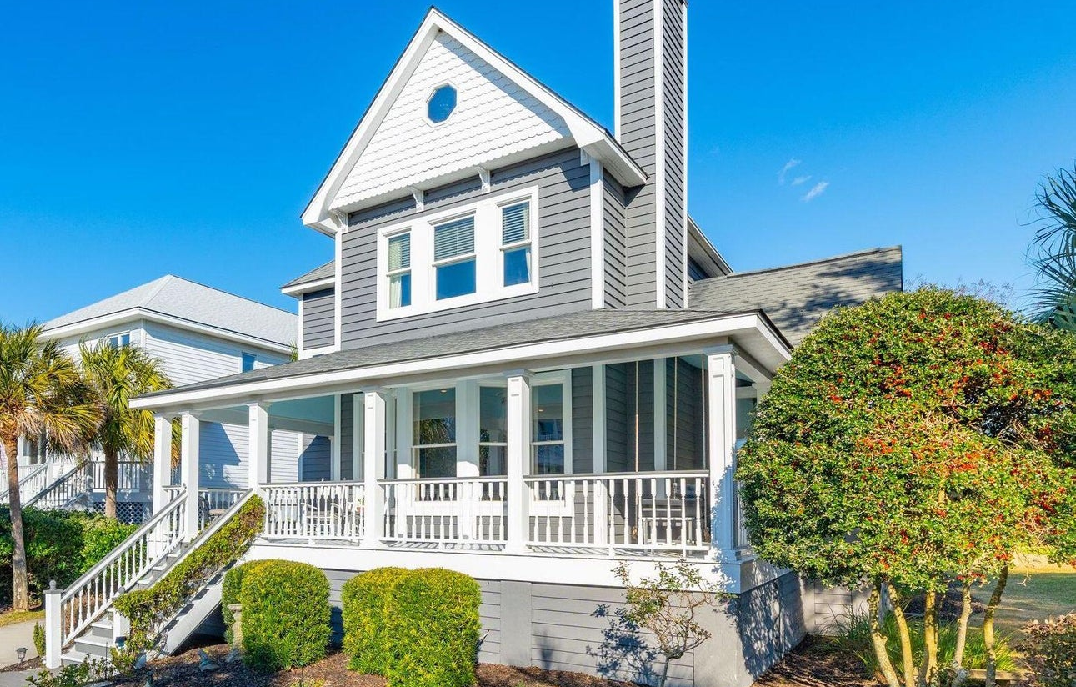








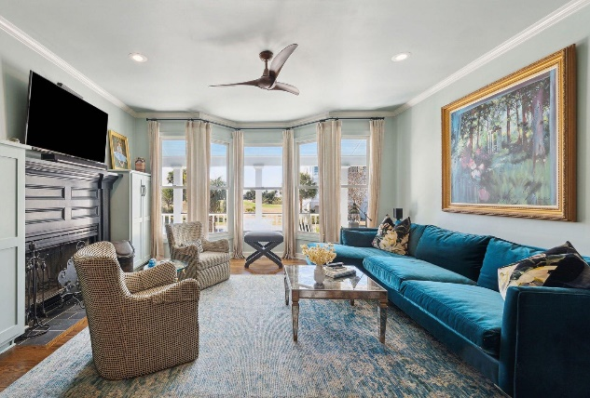
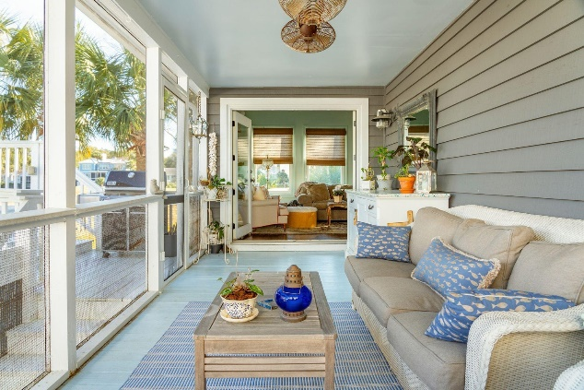
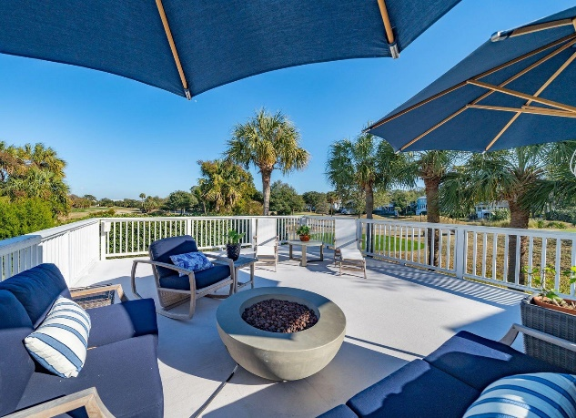
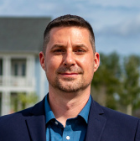
#24002234
Includes 40’ Boat Slip!
1 Morgan Place Drive Wild Dunes
Isle of Palms, SC 29451
Open House
Sat 10-12 & Sun 10-12
4 BED
4½ BATH
2,510 SF
$2,095,000
Welcome to 1 Morgan Place Drive. Located in the resort community of Wild Dunes on the Isle of Palms. This charming, well kept home is in the highly desirable Morgan Place neighborhood. It features panoramic lagoon and fairway views along with a deeded 40 foot boat slip. A brief stroll takes you to the front beach of Isle of Palms, among the best on the east coast. Another short walk brings you to the boat slip with a floating dock, water, electric and storage locker on picturesque Morgan Creek. As you walk up the steps and enter the home you are welcomed into the family room with wood burning fireplace and dining room. The updated kitchen is complete with top of the line appliances, pantry, laundry room, a custom bar and a beautiful banquette. The sitting room leads to a screened porch that overlooks a 400 square foot sundeck (with breathtaking views of the 15th fairway) that's perfect for sunning and entertaining. The first floor master bedroom includes a large walk-in closet and updated bath. Upstairs are 3 bedrooms all with en-suite baths. A two car garage with plenty of storage, a work bench and an attached outdoor shower are at the rear of the property. Morgan Place offers a well maintained community pool and cabana across from the boat slip access. The resort is located just a short ride to the restaurants and shopping of historic downtown Charleston. Wild Dunes boasts 2 award winning Tom Fazio designed golf courses with no membership required to play. The clay court tennis and pickleball facility are the best in the area. Wild Dunes has miles of beaches, bike and walking trails that let you enjoy the Lowcountry surroundings. Wild Dunes property owners can enjoy the use of the Wild Dunes Beach house which is currently undergoing renovation. This home is wonderful as a full time residence, perfect as a vacation home or can be used as a short term rental income producing property.
Enjoy a virtual walkthrough
Steve Auerbach
917-750-6965 | steve.auerbach@carolinaone.com
Carolina One Real Estate | 1503 Palm Blvd | Isle of Palms, SC 29451-2280
Matt Kimes
843-860-1669 | mattkimeshomes@gmail.com
www.mattkimeshomes.com

