Slide 1
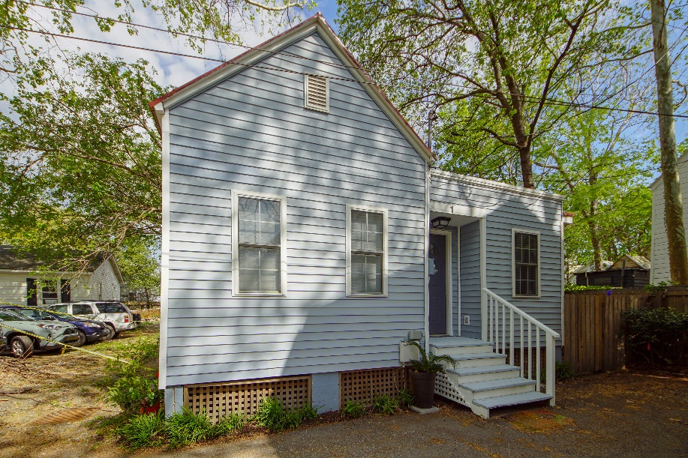
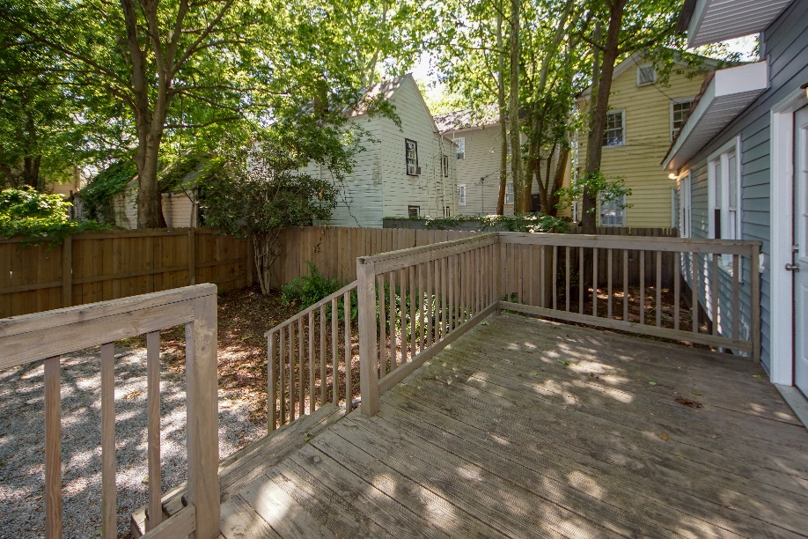
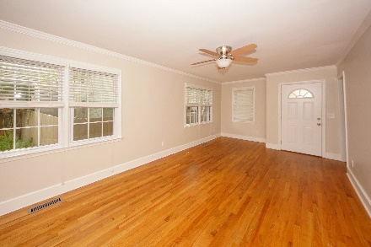
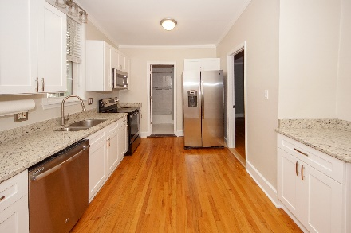
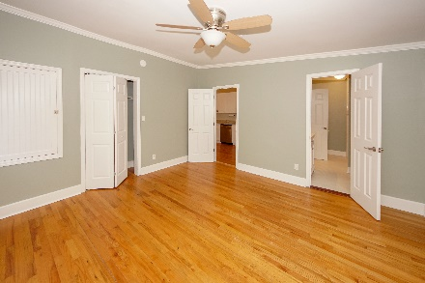
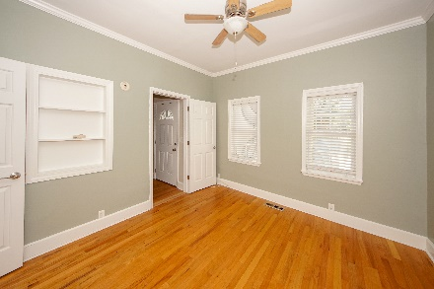
1 Oliver Court Cannonborough-Elliottborough · Charleston · MLS# 19008658 · $464,900
Darrell Creek Elevated Home With Elevator & Salt Pool
Downtown With 2 Off Street Parking Spaces For Under 500K
Completely renovated, spacious 2 bedroom, 2 bath historic carriage house in a quiet location near Hominy Grill and MUSC. This home is in the ''short-term rental'' overlay. Home has crown molding and recently refinished hardwood floors throughout (except in the bathrooms, which are tiled). The family room is open to the eat-in kitchen, which features custom white cabinetry, all new stainless steel appliances, granite countertops, and custom plumbing and light fixtures. The split bedroom plan includes en suite baths. Both bathrooms have custom plumbing and light fixtures, tile shower floors and surrounds, and custom vanities.
Other interior updates include a new tankless, Rinnai hot water heater and new HVAC unit.
Outside, you'll find a spacious deck that leads to the fenced-in back yard and off-street parking area. A large shed provides lots of additional storage.
Oliver Court is located just south of Cannon Street off of Rutledge Ave -- within walking/biking distance of many shops and restaurants as well as MUSC. Driveway is accessed from Carrere Ct.
Andrea Rogers
(843) 532-3010 | andrearogers1@gmail.com | www.andrearogersrealtor.com
AgentOwned Preferred Group | 1400-G Palm Blvd | Isle Of Palms, SC 29451

