Slide 1
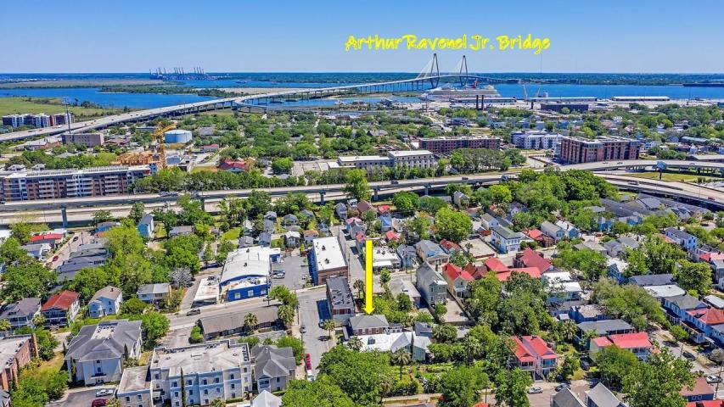



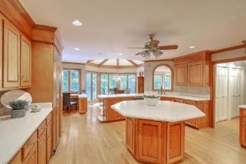
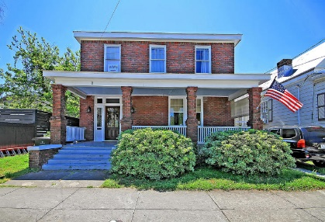



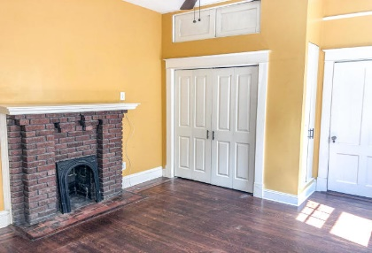

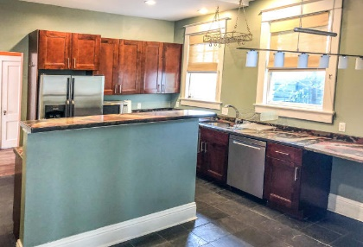
Parkshore Marshfront
Amazing Downtown
Location!
1 Race Street
Downtown ~ Charleston, SC 29403 ~ MLS# 20010615 ~ $699,999
Just a few blocks from the gorgeous Hampton Park in downtown Charleston, this two unit, renovated home presents an amazing opportunity. Live in one, rent the other, rent both out for great income or convert the home to a single family six bedroom house! Any way you do it, this is a fantastic location and home to be so close to Hampton Park, downtown dining and shopping, the Ravenel Bridge and the beaches. A covered front porch welcomes you and the foyer is shared by both units. Upstairs is a living room, kitchen 2BRs, full bath and private porch. Downstairs are 2BRs, full bath, living, kitchen and full laundry room. Outside in the fenced-in backyard is a patio as well as an outbuilding. Be sure to schedule a showing and not to miss out on this incredible property!
Additional features include:
350 sq ft outbuilding
12'x24' has full 100A sub panel with 3 phase circuit, fireplace
Open porches upstairs and downstairs
Amazing location!
Book your showing today!
Nate Gainey 843-513-2038
nate@mattoneillteam.com
Christopher Smith 843-267-0735
christopher@mattoneillteam.com

