Slide 1
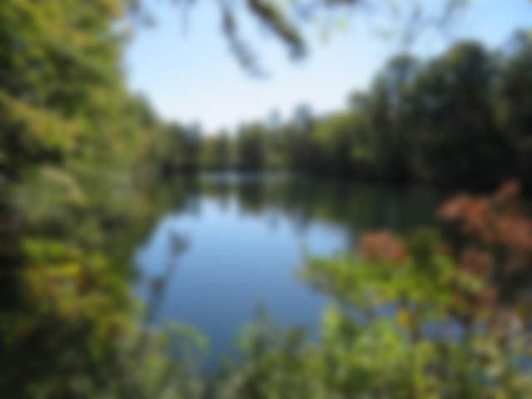
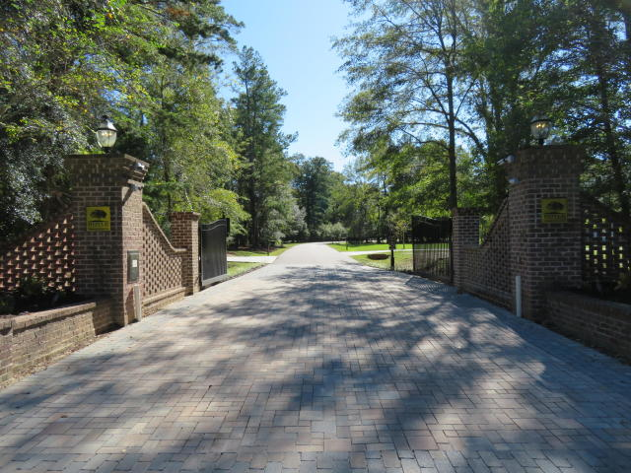
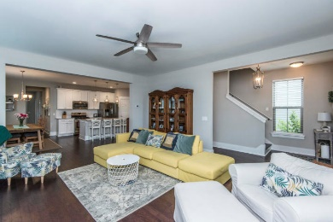
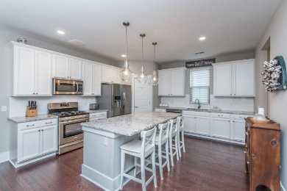
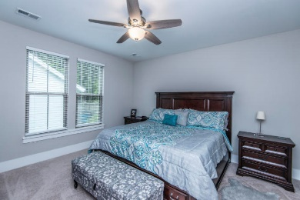
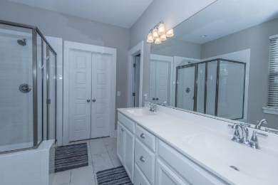
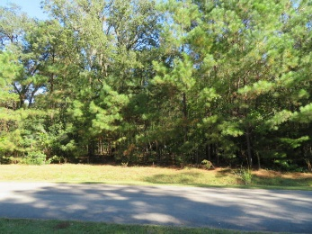
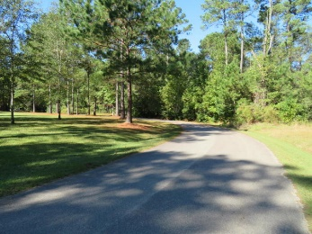
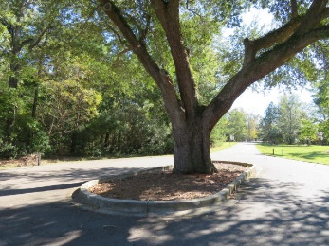
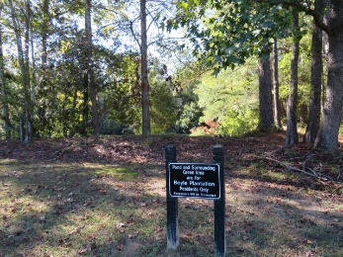


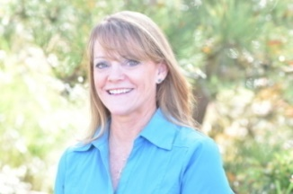
NOW IS YOUR CHANCE!!!
1 Rhetts Way
Boyle Plantation ~ Summerville, SC 29485
MLS# 19030600 ~ $133,000
One of the few lots left in the Desirable, Gated.... Boyle Plantation!!! Ashley Ridge High School, Beech Hill Elementary, Greg Middle School, all sought after Dorchester II schools. Boyle Plantation is a unique neighborhood with large lots, natural areas, variety of style of upscale homes. No cookie cutter neighborhood here! This lot offers 3.76 acres, approx. 1 acre is high, perfect for building your dream home while still allowing to blend with nature and maintain your privacy. Perk test done and ready. Buy now and you can build and be in by summer!
Laurie Loparo
(843) 442-1290 | laurieloparo@gmail.com
www.lauriesellscharleston.com
Carolina One Real Estate | 873 Orleans Road, Ste 102 | Charleston, SC 29407-5753

