Slide 1
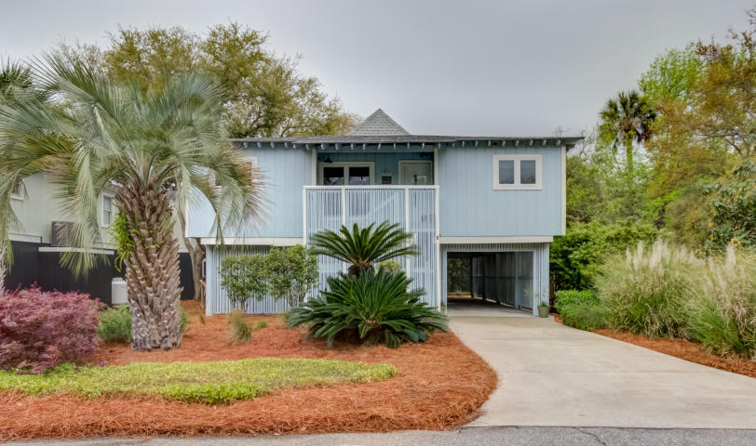
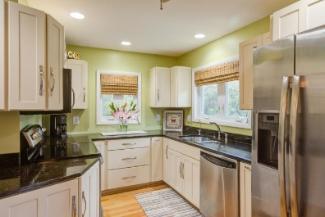
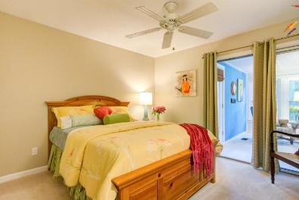
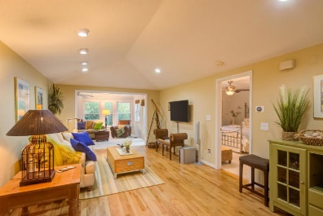
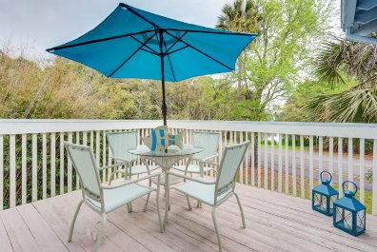
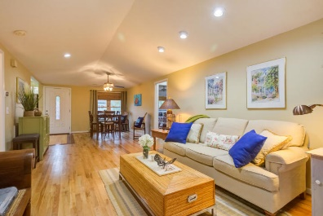
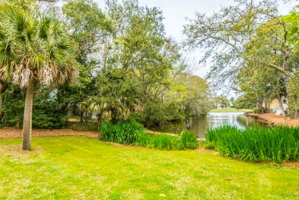
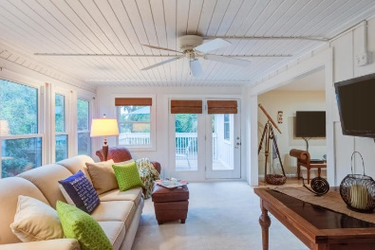
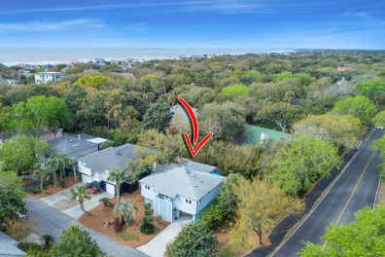


1 Sandcrab Court
Isle of Palms, SC 29451
MLS# 19010188
$689,900
Elevator to all levels
Lot Elevation is AE 13
Viwinco Hurricane rated windows
Raised seam metal roof
Water faucets on front, rear, and screened porches!
(No reason for dead flowers!)
Paver Patio
Garage is up fitted with additional electrical for golf cart charge or workshop
Custom heavy duty garage door, Custom Mahogany finished
Exterior door from inside garage to rear living area and paver patio
Hot/Cold Outdoor Shower
Spray foam insulation in attic ceiling
Multi zoned HVAC
10'Ceilings
Custom Rosewood Cabinetry in kitchen with 2 Corner lazy Suzanne's to maximize use of space, soft close drawers, pull outs
GE Profile Kitchen Appliances that include:
-Microwave/Convection Oven
-Wall oven
-Refrigerator
-Trash Compactor
-Dishwasher
Deep Sinks
Garbage Disposal
Custom Built closets throughout all bedrooms, linen and laundry
Granite in kitchen and all baths
Custom tile in all bathrooms and entry and oak wood floors throughout
Master bath elegant oval soaking tub with wand for body rinse
Oversized shower with wide glassed door entrance
Dual vanity with cosmetic seating area
Additional cabinetry
Separate commode area
Main level Bedroom/Office with window seat with storage
and attached bath.
Pocket doors maximize wall space.
Front entry door is custom Mahogany
Boat slips are available for lease and purchase Morgan's Creek Marina
Wild Dunes Cottage
Bring your checkbook! It's perfect.
$10,000 Bonus!
More than "JUST A PRETTY FACE!"
This "classy" move-in ready coastal cottage is located less than 2 blocks to BEACH, inside WILD DUNES GATES! Remodeled custom kitchen maximizes storage, has granite countertops, Kraftmaid solid wood cabinets, GE stainless appliances and walk-in pantry. Open design allows free movement from kitchen, dining/great room, to 12 x 20 sunroom and walk-out deck. Split bedroom plan! Master suite has Travertine tiled walk-in jetted shower. All windows and doors have been replaced. Wild Dunes Club offers A la Carte memberships! Measure!
http://www.charlestonhomeshotline.com/Property/Detail/CTAR/19010188/1-Sandcrab-Court-Isle-of-Palms-SC-29451
Listed by
Bill Donovan
843-991-0146
donovans@carolinaone.com
Renee Meyer
Mobile - (843) 991-0007
renee@carolinaoneplus.com
www.CharlestonHomesHotline.com
Carolina One Real Estate
1503 Palm Blvd
Isle of Palms, SC 29451

