Slide 1
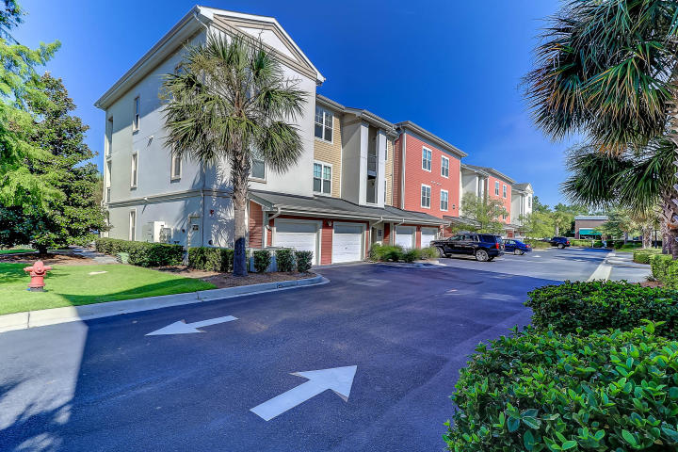
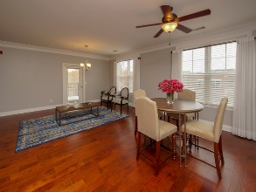
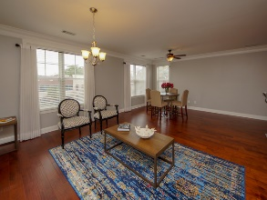
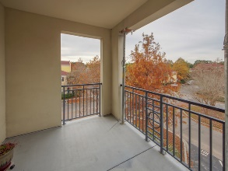
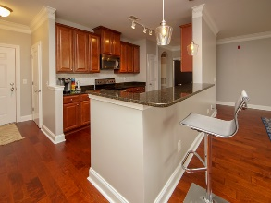
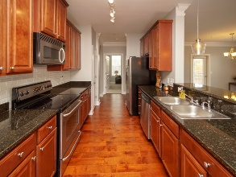
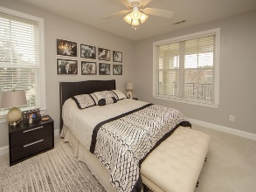
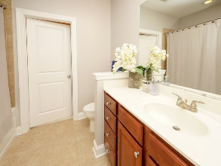
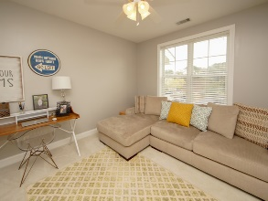
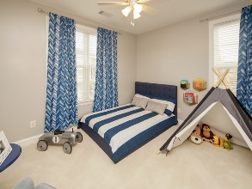
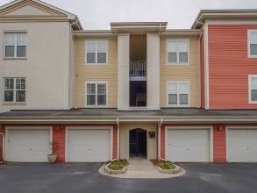

Urban Living and Agent Bonus with Ratified Contract!
2000 Belle Isle Avenue #301
One Belle Hall | Mount Pleasant, SC 29464
MLS# 18032881 | $300,000
Location Location! Beautiful top-floor, 3-Bedroom end unit in luxury One Belle Hall. This unit is one of only six 3-bedroom units in this urban living neighborhood. Freshly painted, this bright, sunny corner unit condo features hardwood floors throughout the main living areas, Kitchen with beautiful 42 inch cabinets with molding, granite counter tops, newly tiled back splash, new pendant lights, and stainless appliances. The Master bath has a good-sized walk-in closet. tiled bath/shower and raised vanity. Hall bath is also very spacious with a raised vanity and walk-in tiled shower. The other 2 bedrooms also have walk-in-closets, and one has a built-in bookcase. All rooms have lighted ceiling fans. Being on the top floor means privacy and no noise from neighbors above, and the corner porch is perfect for outdoor dining, catching the breezes and enjoying the views. Located behind Belle Hall Shopping Center in a quiet section, it is walking distance to the grocery store, restaurants, bank and retail. Neighborhood location is close driving distance to downtown Charleston, the beaches, Daniel Island, the airport, schools, and all of the Charleston area's attractions.
Jennifer Robinson
(843) 442-1145
jrobinson@carolinaone.com
Carolina One Real Estate
195 W Coleman Blvd
Mt Pleasant, SC 29464

