Slide 1

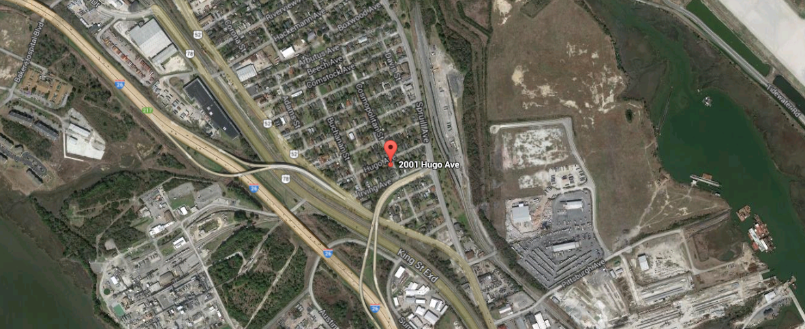
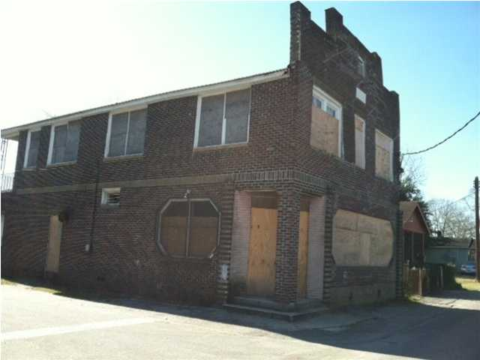
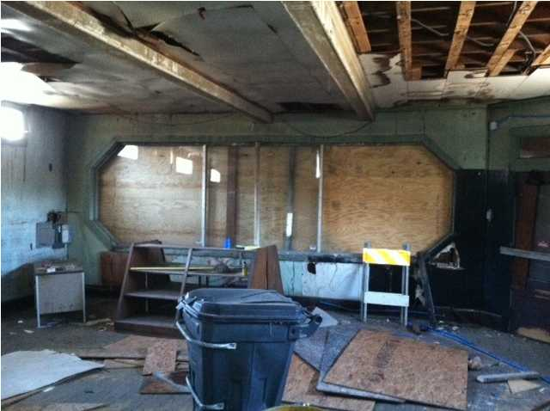
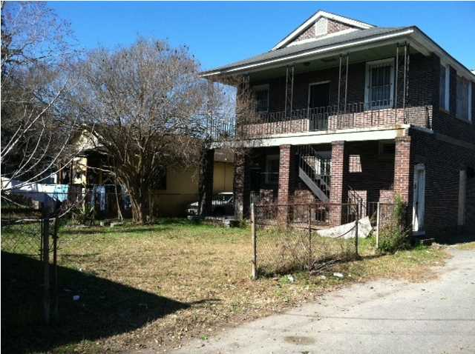


FORMER NEIGHBORHOOD GROCERY CLOSE TO I-26/DOWNTOWN/PARK CIRCLE
Formerly a neighborhood store inside of a residential areas with close proximity to I-26, Noisette, Downtown Charleston and the revitalized Park Circle. Building has great bones and brick facade being sold as is. Lot for parking at the back of the building and three additional VCR Lots will also for sale for an additional $30,000. (TMS 466-12-00-381, 466-12-00-383 and 466-12-00-384) all with 0.07 acres each. If square footage is important, please measure
Acres: 0.080
Address: 2001 HUGO AVE
Area: CHS-N.Charleston Area inside I-526
Bedrooms: 5
City: NORTH CHARLESTON
County: Charleston
Full Baths: 3
High School: N CHARLESTON
Listing ID: 1214902
Listing Price: $75,000

