Slide 1
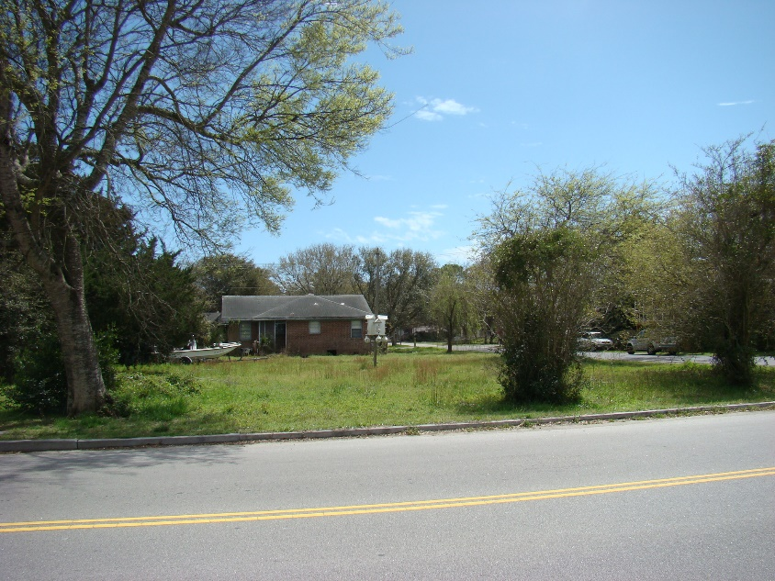
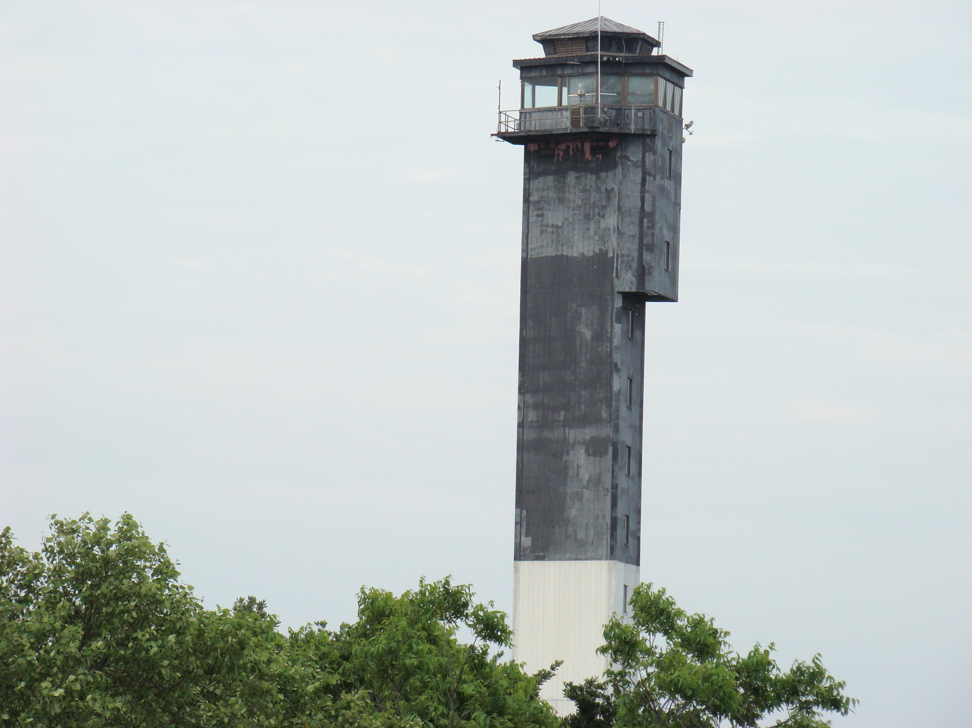
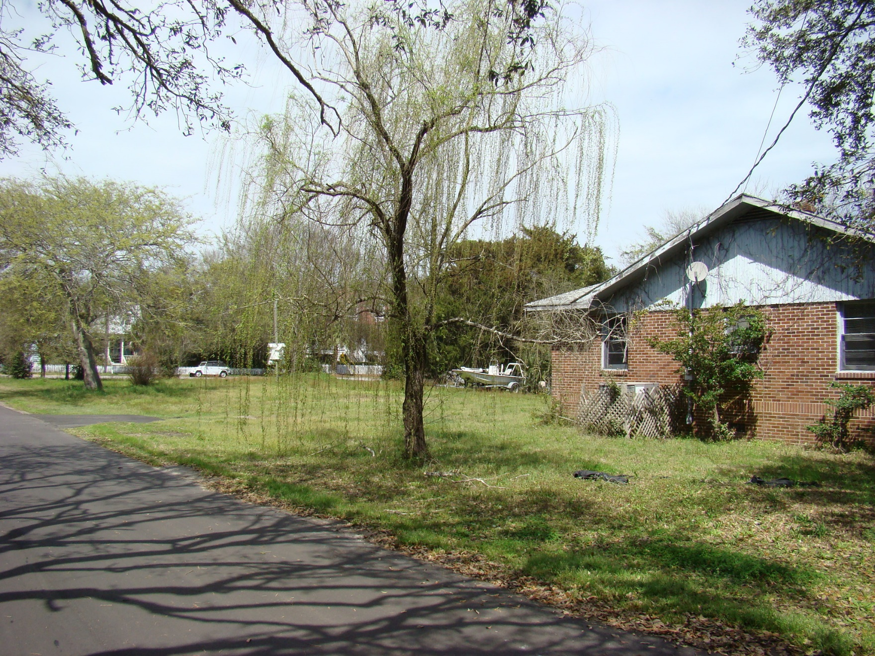
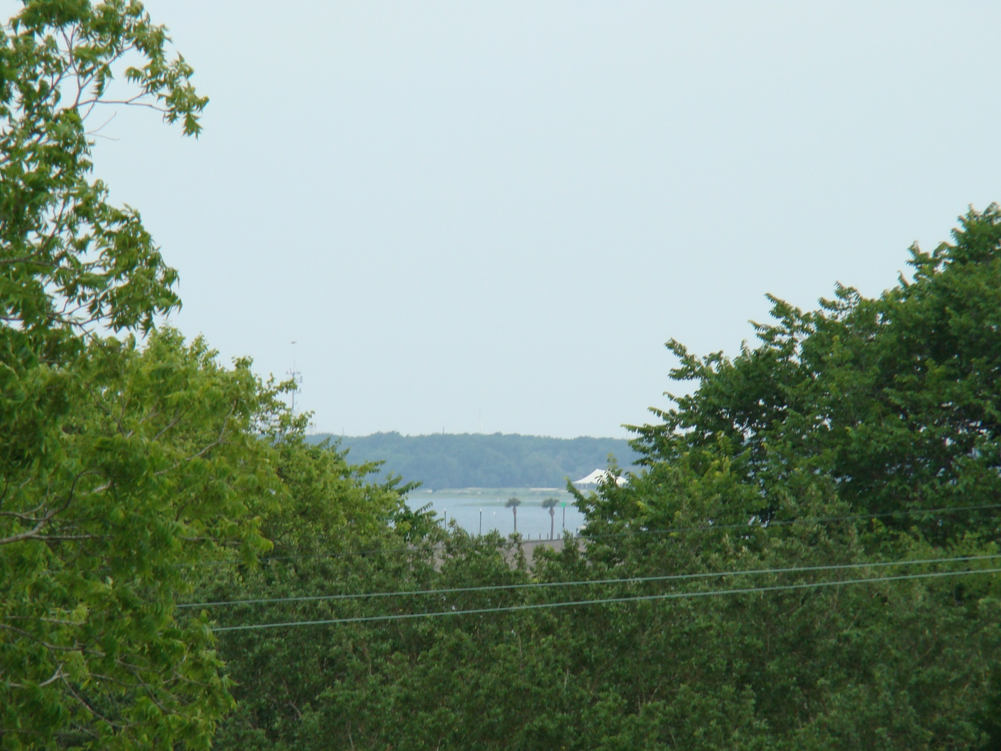
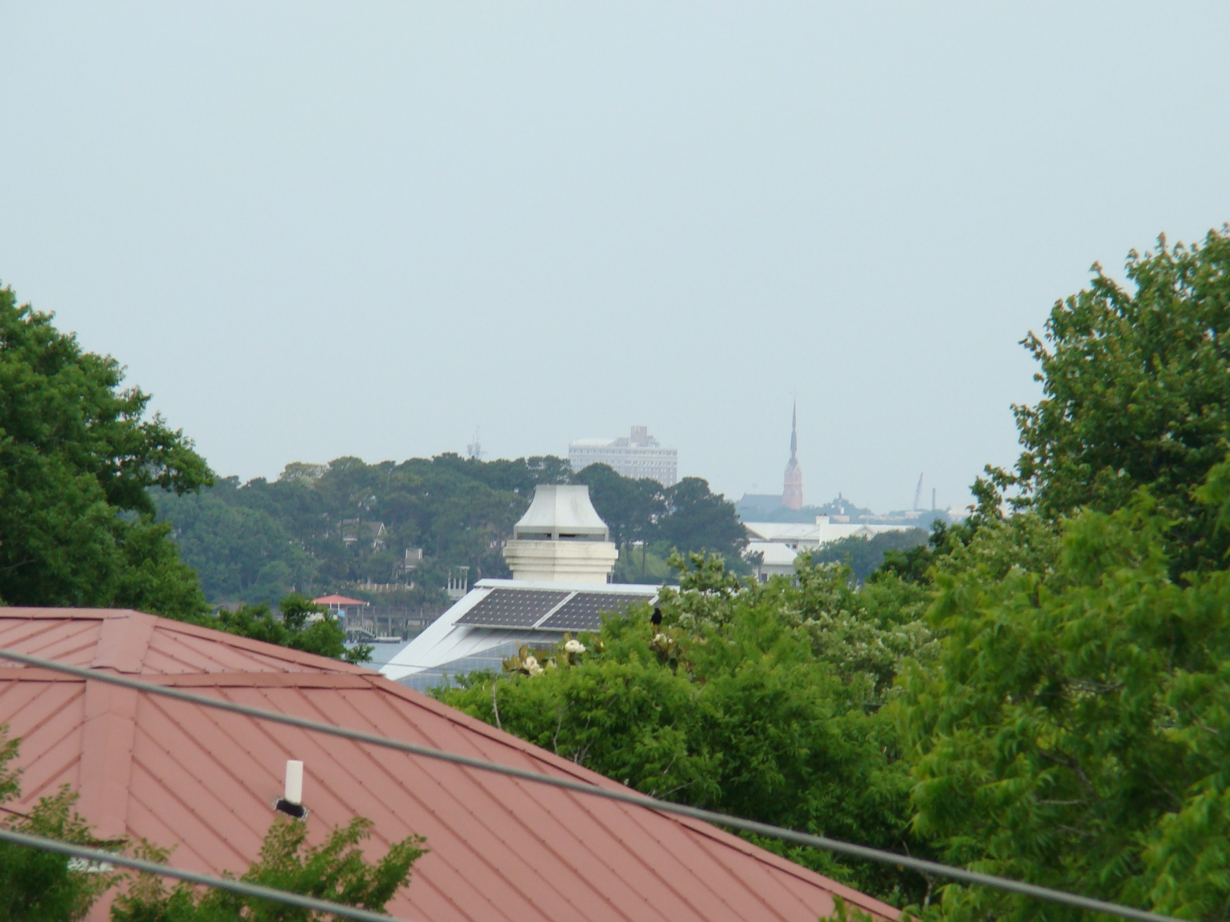


2002 I'On Avenue
Sullivans Island, SC 29482
MLS# 15007674 :: $950,000
Build your Dream Beach House!
Beautiful half acre+ lot between Middle St. and I‘On Ave on the corner of Station 20. Structure on the property is uninhabitable and strictly sold 'as is'. Wonderful location in front of the Edgar Allen Poe library and 'catty-corner' to Sullivans Island Elementary school.
Quiet lot within walking distance to beach and 'restaurant row on Middle St. Architectural plans available which gives you an idea of how a house and pool can be laid out on the property. Lot is not part of the historical district - no restrictions on lot, except standard Sullivans Island Town guidelines.
Jill F Miller
Mobile - (843) 566-5115
jillsellscharleston@gmail.com
CarolinaOneRealEstate.com
Carolina One Real Estate
195 W Coleman Blvd
Mt Pleasant, SC 29464

