Slide 1
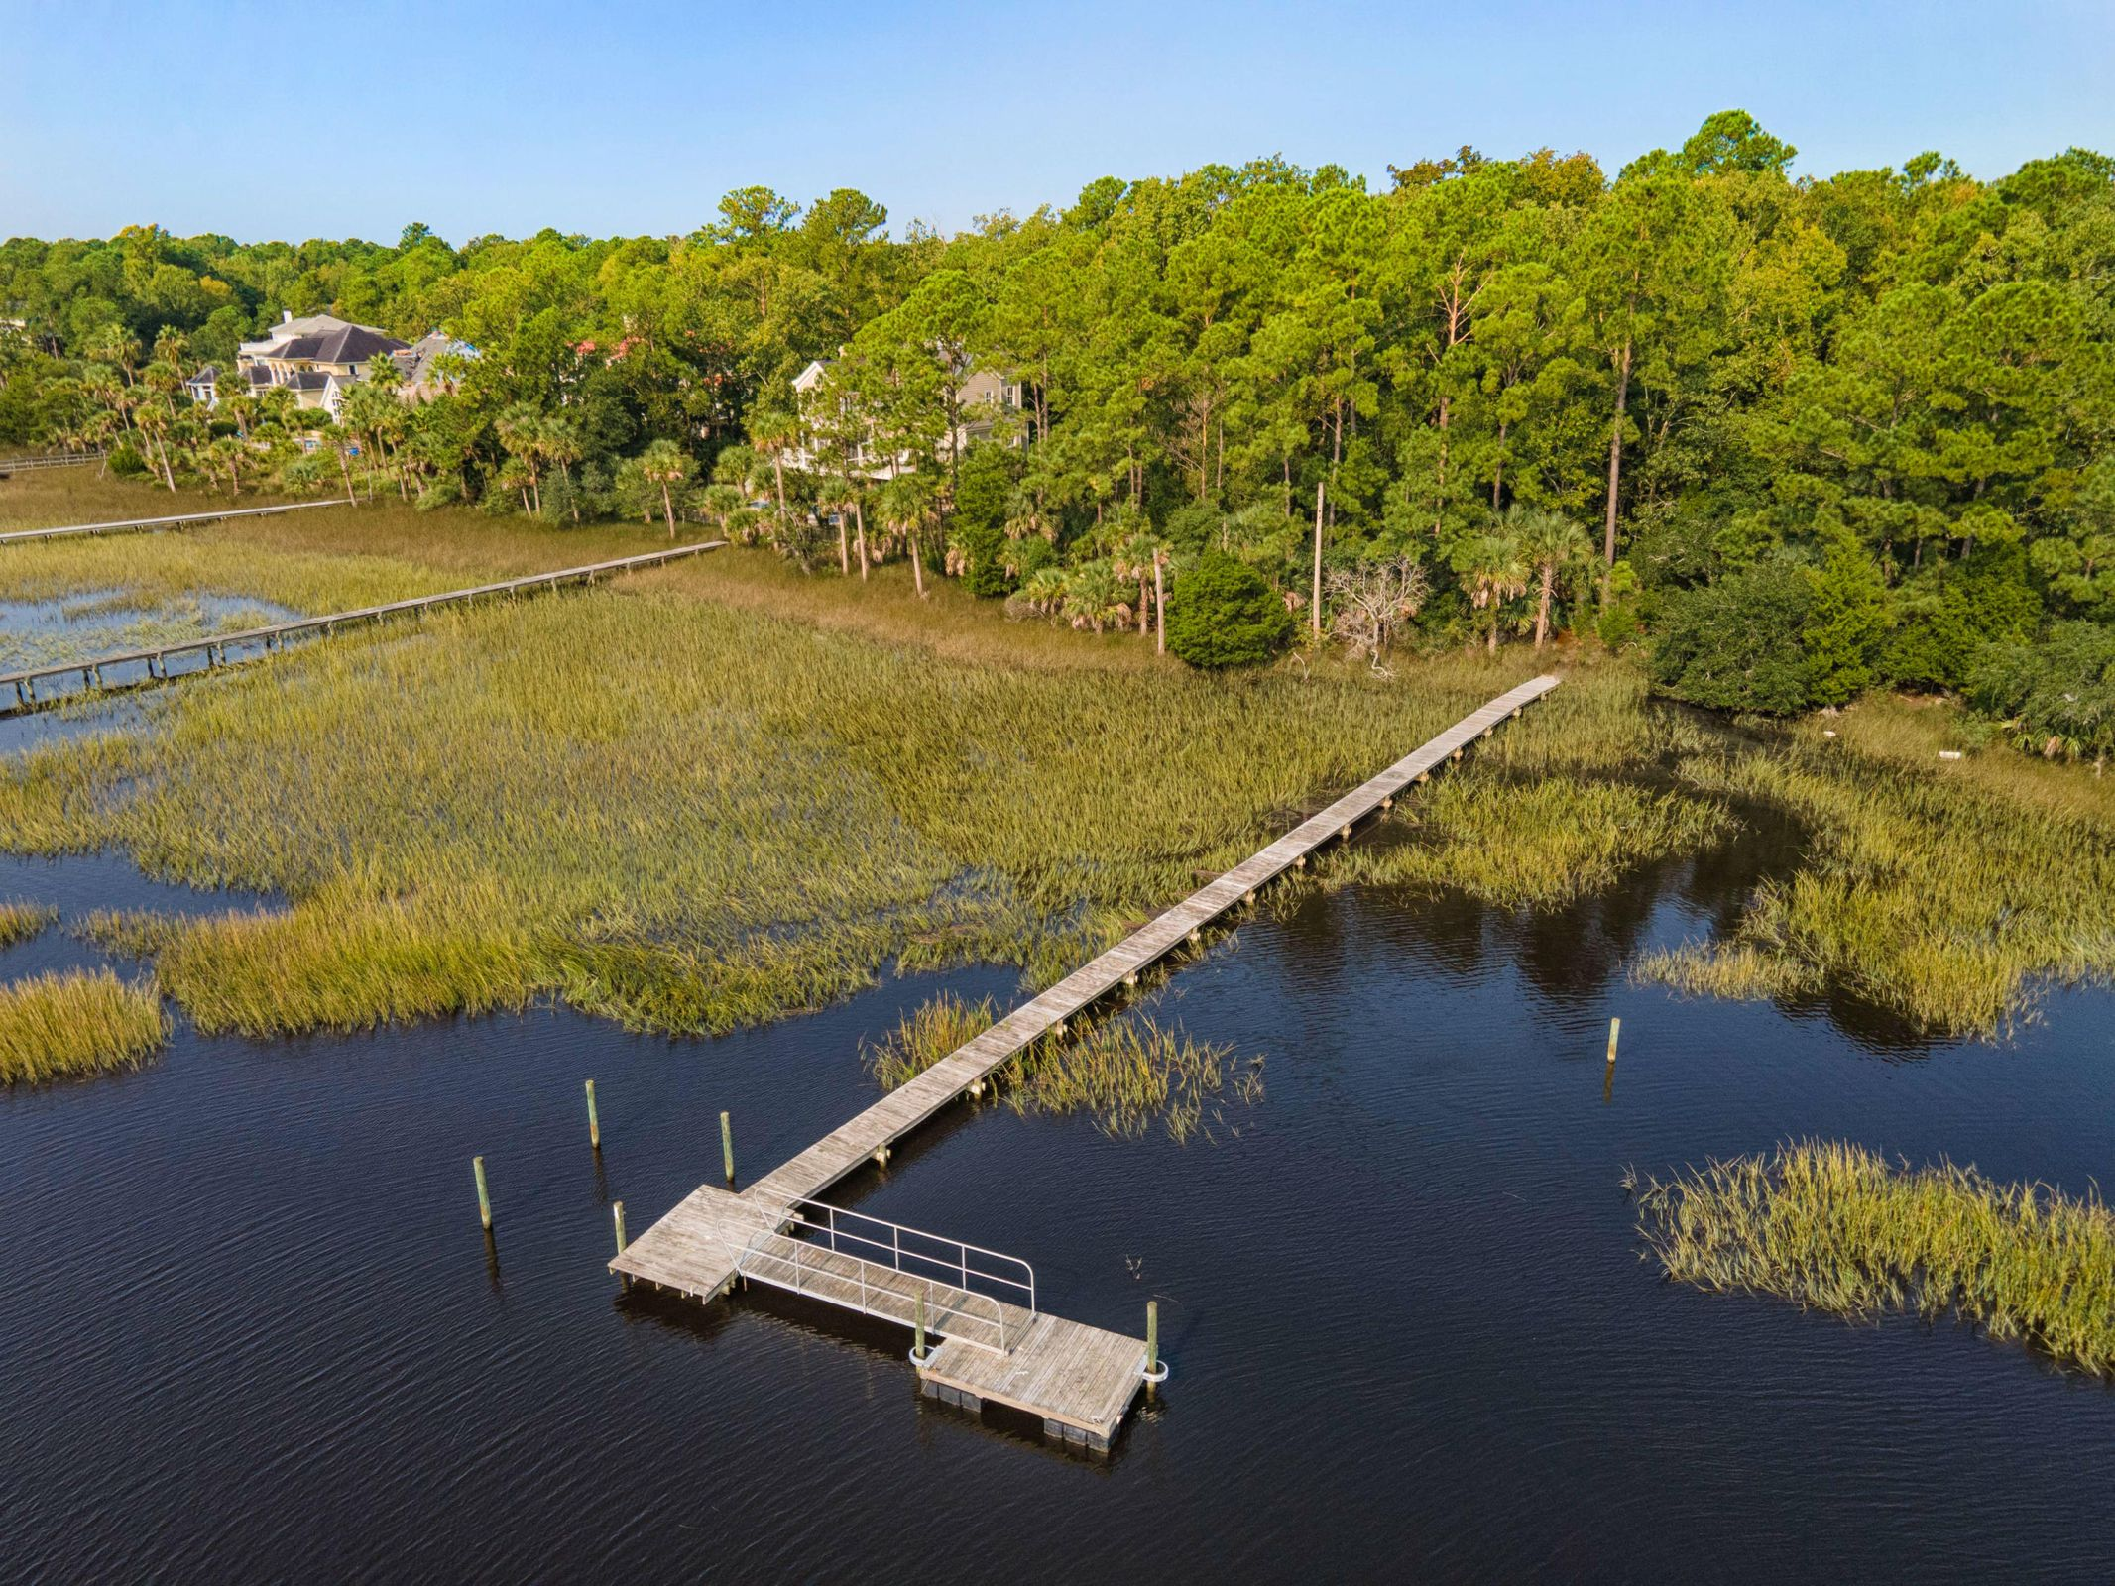
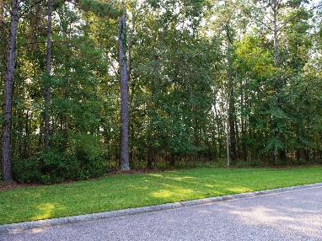
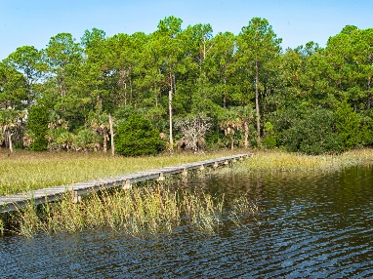
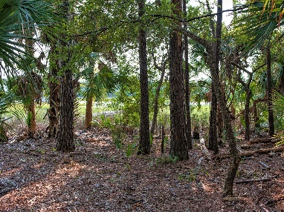
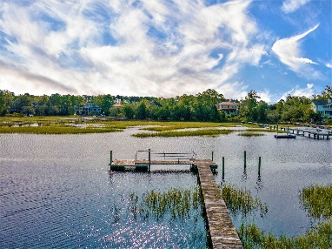
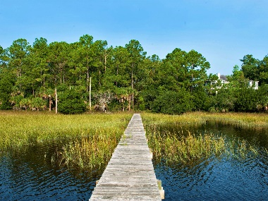


2003 Shell Ring Circle Dunes West :: Mount Pleasant MLS# 20027338 :: $650,000
Dunes West Waterfront Lot
New
Construction
5 Bedrooms, 4.5 Baths
Resort Style Pool and Patio Areas
Exceptional Rental History
Rare Double Lot
Block from Beach
2 Huge Great Rooms
Expansive Screened Porches
Separate Grilling and Observatory Decks
Multiple Fireplaces
Short walk to Restaurants & Shopping
Gorgeous one-acre lot located in the prestigious gated community of Dunes West, on Toomer Creek, with dock, floater, and lift pilings in place! Just minutes from the Wando River, you can boat, fish, crab, shrimp, paddleboard, kayak, or just float off of this short dock! Dunes West offers resort style amenities with Golf, Tennis, Walking Trails, 3 Pools with water park features, Fitness facility, Playground, and Clubhouse. Available waterfront lots are rare in established upscale communities.
Build your dream home here and enjoy your very own waterfront Paradise!!
Wendy Arnsdorff
843-364-8619 – M :: 843-284-1800 – O
wendy.arnsdorff@carolinaone.com www.wendyarnsdorff.com
Carolina One Real Estate :: Mt. Pleasant North Office :: 2713 N Highway 17 :: Mt. Pleasant, SC 29466

