Slide 1
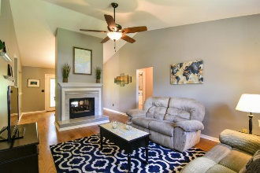
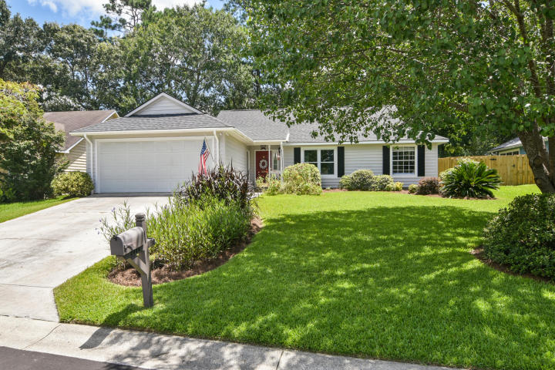
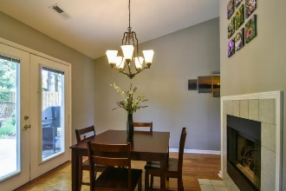
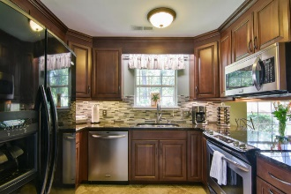
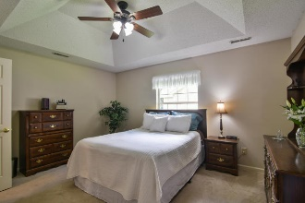
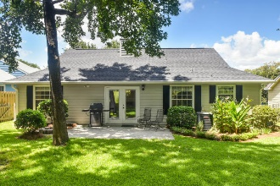
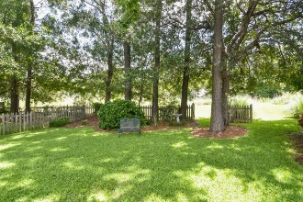
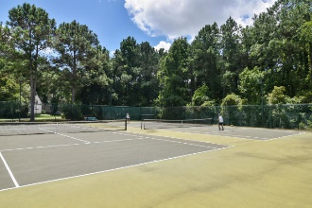
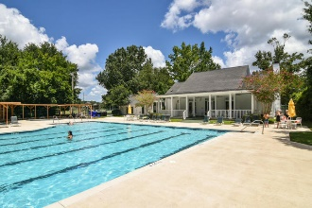
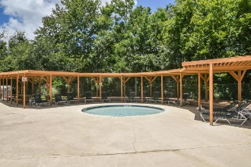


2004 Davant Circle Longpoint | Mount Pleasant, SC 29464 MLS# 17022278 | $365,000
The Only Deep Water Home On Daniel Island
New Listing!
Open House Sunday 1pm - 4pm
No stairs to climb! Precious one level home with split floor plan, vaulted ceilings, hardwood floors, updated kitchen with granite countertops and soft close cabinets and drawers. Enjoy the wildlife in your fenced, shady backyard! The owners have lovingly cared for this home and it shows! Great 2 sided fireplace for added ambiance!
Walk to the Longpoint amenity center which includes swimming pool, tennis courts, basketball courts, soccer field and sand volleyball court! Also biking distance to Palmetto Islands County Park. $3500 credit available towards buyer's closing costs and pre-pairs with acceptable offer and use of preferred lender. Hurry! Won't last long!
Helen Hudson
843-991-9875
helen.hudson@carolinaone.com
Carolina One Real Estate
2713 Highway 17 North
Mt. Pleasant, SC 29466

