Slide 1
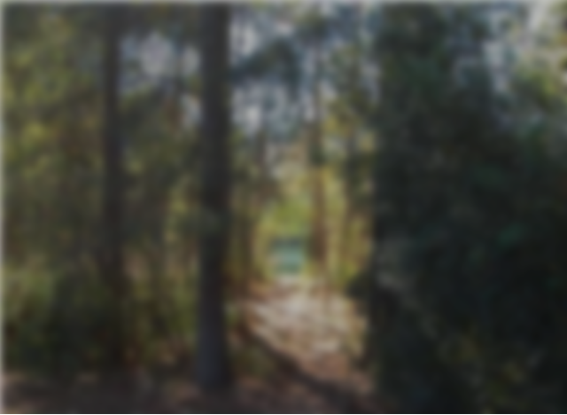
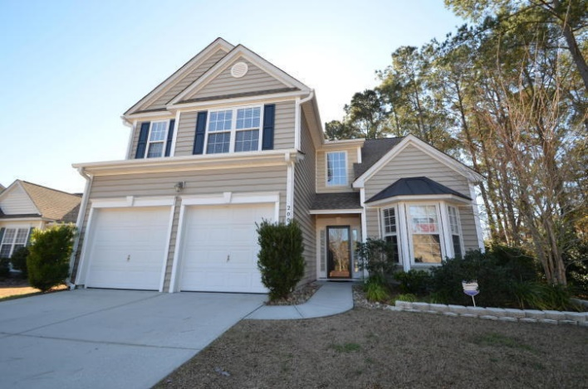
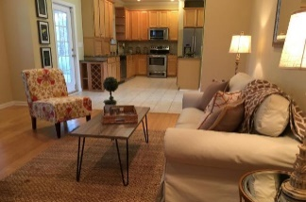
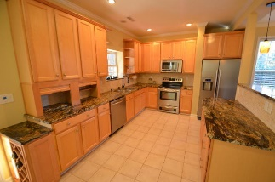
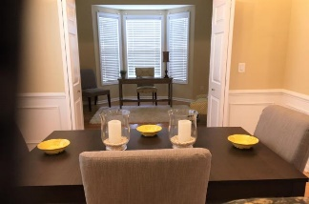
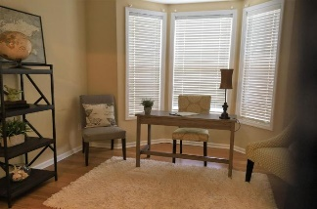
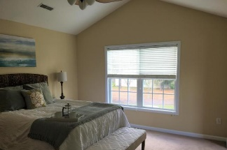
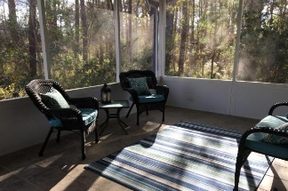
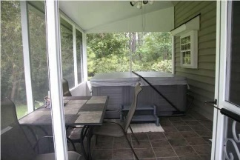
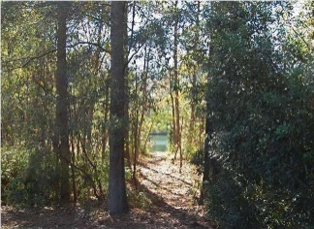


2004 Hammond Drive Park West ~ Mount Pleasant, SC 29466 MLS# 17004767 ~ $399,900
New Price! New Staging!
Remodeled, spacious home ready for your personal touch! Newer kitchen cabinets, granite counter tops, ceramic tile, stainless appl. Added coffered ceilings, recessed lighting, designer fans and wainscoting. MBR suite features vaulted ceiling, dual vanities, two lg. walk-in closets with built-ins, soaking tub and separate water closet. 3rd and 4th BRs share Jack and Jill bath. Extra space for office nook on 2nd. Laundry Rm on 1st plus W/D hook-ups in Upstairs Bonus Room. Huge screened porch constructed of powdered aluminum and tile floor. Few homes at this price can offer the beauty and privacy of woods on the rt side and back yard w/ it's own path to pond. Easy in and out of Park West. Bike to Shopping, Rec. Ctr/Pools. Taxes shown at 6% rate.
Lowest Price per sft. among comparable active listings
Lowest Price among comparables that are under contract
Lowest price per sft among comparable sold in 6 months!
Peggy Flanagan Morse
Realtor, ABR (843) 860-4953 pmorse@carolinaone.com
www.peggymorse.com
Carolina One Real Estate | 2713 Highway 17 North | Mt Pleasant, SC 29466

