Slide 1
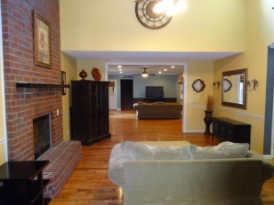
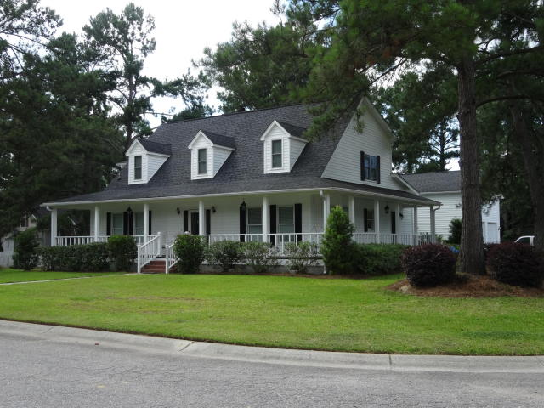
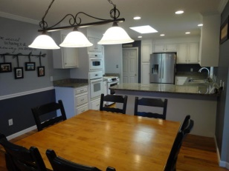
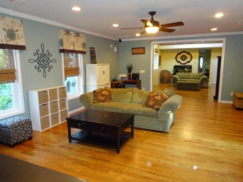
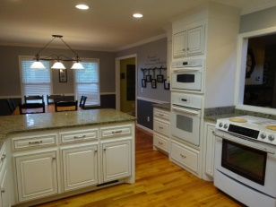
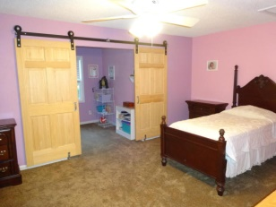
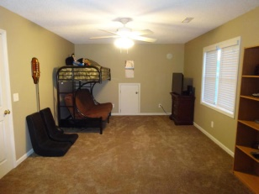
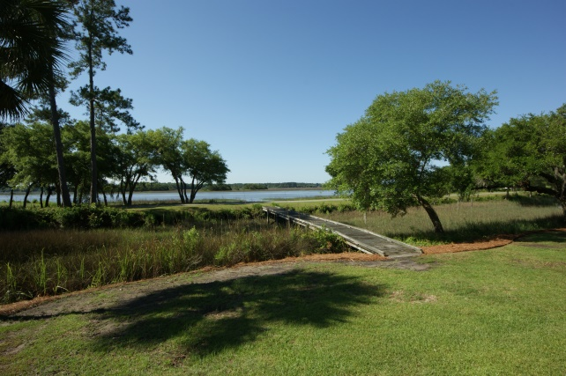
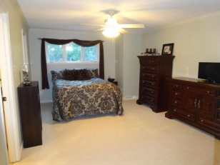
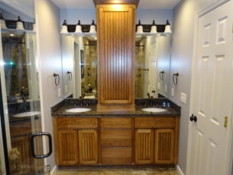
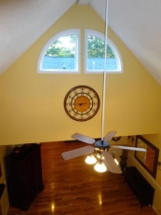
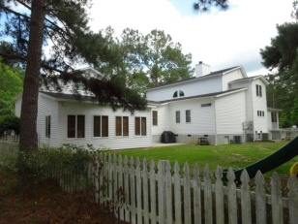
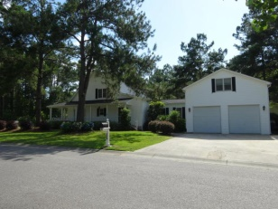



Price Reduced ~ Motivated Seller
2004 Trotters Run Road
Trotters Ridge ~ Summerville ~ MLS# 15015023 ~ $348,000
This beautiful southern style home with wrap around porch is situated on a large corner lot in quiet Trotters Ridge. This home boasts a spacious open floorplan, complete with cathedral ceiling and glistening 3/4' oak hardwood flooring. The living room has a wood-burning fireplace and opens up into the expansive family room - perfect for entertaining and family get-togethers. Beyond the family room and down the stairs to ground level, you'll find a beautiful sunroom that opens right into the backyard, with large windows, ceramic tile floors, soaring 14' ceiling and its own half bath. The newly renovated kitchen and dining room come with 42'' custom cabinetry, granite countertops, smooth top range, additional GE Profile wall oven, microwave convection oven, and stainless steel dishwasher. The kitchen and family rooms have additional canned lighting to brighten and enhance the main areas. The master bedroom is off the living room and comes with a cozy gas fireplace, beautiful remodeled bathroom with stand-up double walk-in shower and double-sink custom vanity. A large walk-in closet, and separate private water closet. A second large bedroom with full private bath and walk-in closet is located off the extended family room. Beyond the living areas and above the garage, is a spacious finished room complete with beautifully remodeled full bath. There is plenty of extra storage on each side of the FROG that can be used as closet space for a 5th bedroom. At the other end of the home, upstairs, you have two extra-large bedrooms connected by a walkway overlooking the living room. The upstairs walkway has a full bath as well as large linen closet. One upstairs bedroom has a private sitting area with custom sliding barn doors for privacy. The other bedroom has a "secret attic room" perfect for the adventurous child. The laundry/mud room has 2 full pantry areas and an in- the-wall fold-down ironing board for easy access and convenience. The large 2 bay garage provides ample room for cars, storage, and even work space for the hobbyist. It has a high ceiling with 9' garage doors, as well as a workshop area with workbench and utility sink. Situated in the large fenced in backyard there is a custom built treehouse and slide swing set, as well as a trampoline for the kids to enjoy the outdoors. There are four HVAC units - the main house has a gas unit, the upstairs is on a heat pump, and the Frog and sunroom are on a dual mini split unit. This home has earned the SCE&G Goodcents certificate. All blinds convey. Agent related to sellers.
Joan Burgess, REALTOR
(843) 709-0121
joansburgess@gmail.com
Jim Burgess
(843) 714-3190
jburgessc21@gmail.com
Century 21 Expert Advisors | 100 Seven Oaks Lane | Summerville, SC 29485

