Slide 1
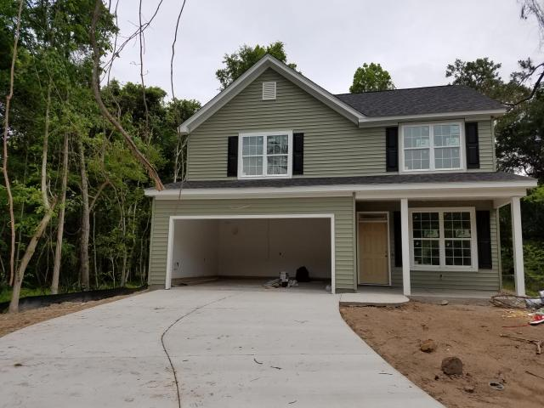
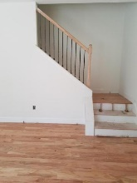
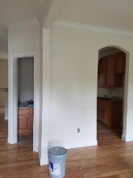
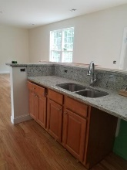
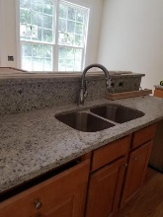
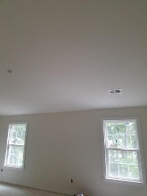
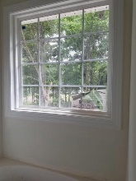
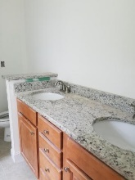
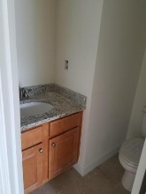


NEW Construction
NO Cov & Restrictions
ALMOST 1900sf for under $300K!
2005 Nitsa Street
Cedar Springs ~ Johns Island ~ MLS# 16013040 ~ $284,000
Own this NEW home with no neighborhood Rules & Fees *Your family will love this 2 Story BRAND NEW home on a LARGE BEAUTIFUL LOT (around 1/3 ac) *NO HOA FEES or COVENANTS & RESTRICTIONS! Plenty of Room for a BOAT & outdoor hobbies AND in an ADVANCED STUDIES MAGNET MIDDLE SCHOOL ZONE *WOOD FLOORS throughout downstairs *OPEN CONCEPT FAMILY ROOM & KITCHEN w/granite, stainless steel appliance pkg *Separate Pantry*Upgraded oak treads on stairs *Powder room with granite*Must see to appreciate the spaciousness of ALL the Bedrooms *MASTER Bedroom HAS VAULTED CEILING *Master bath has separate tub & shower *Smooth ceilings throughout *2 CAR attached finished garage *Ask your agent to schedule today!
Sheila Romanosky
(843) 224-0242
sromanosky@carolinaone.com

