Slide 1

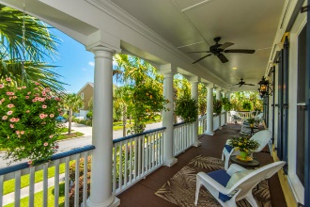
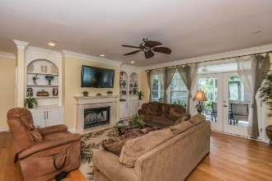
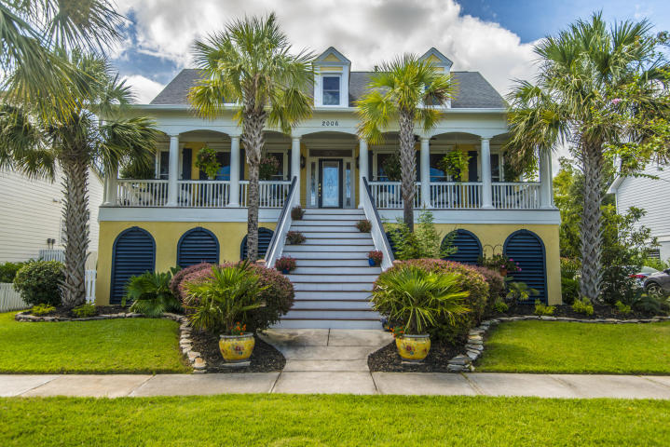
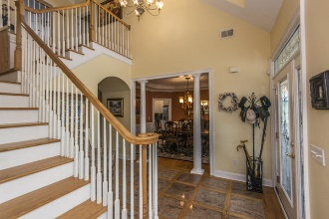
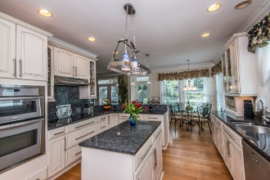
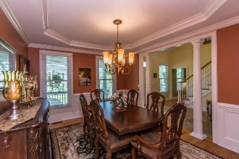
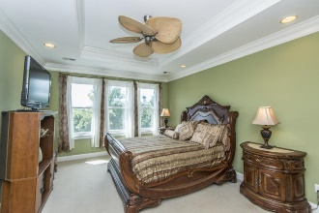
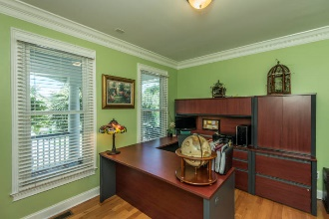
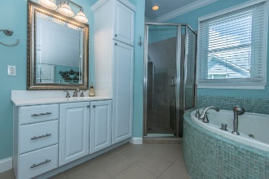

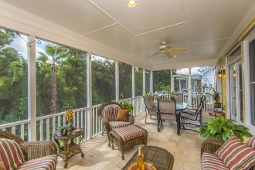
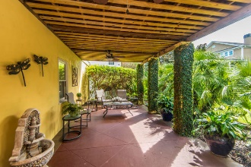
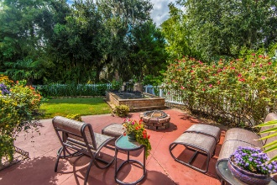
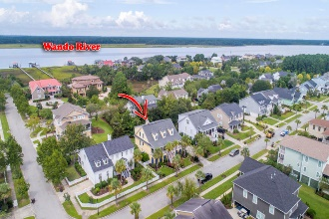


2006 Shields Lane
Mount Pleasant, SC 29466
MLS# 18030025 | $585,000
Recently Reduced in
Rivertowne On The Wando!
Nestled amongst the lush tropical foliage near the banks of the Wando River, this beautiful family home beckons you to take a seat on the long front porch and enjoy the cool river breezes. This home offers so many upgrades, including a Rinnai Tankless gas water heater, additional floor joist supports and dedicated outlet for a hot tub on the deck, structured wiring package and extensive millwork throughout. All of this and located in one of Mount Pleasant's most sought after neighborhoods. Rivertowne on the Wando offers three community docks for fishing, boating or just to relax and watch the amazing Wando River sunsets. Enjoy golf at Rivertowne Country Club's Arnold Palmer Signature Course then meet friends at the club for dinner. Additional amenities include neighborhood pool, tennis courts, walking trails and play park all conveniently located to beaches and the world class dining and shopping of historic downtown Charleston.
Asking $1,200,000
MLS# 17023051
3,692 SqFt
4 Bed/3½ Baths
Short Drive to Historic Downtown Charleston & Beaches
Don Dawson
843-514-0452
ddawson@carolinaone.com
Carolina One Real Estate • 2713 Highway 17 North • Mount Pleasant, SC 29466
www.TeamDawsonSC.com

