Slide 1
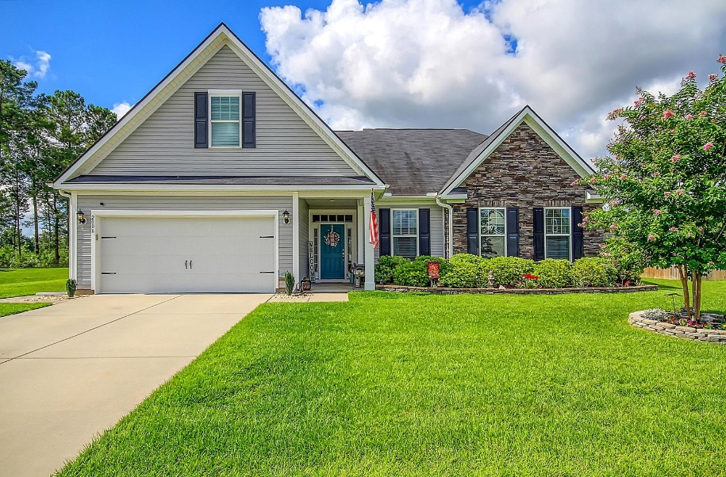
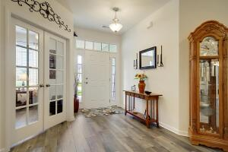
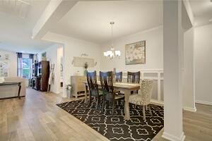
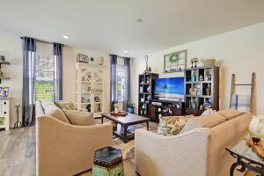
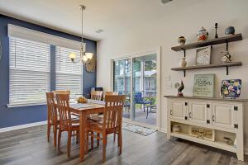
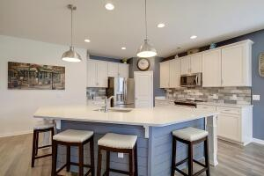
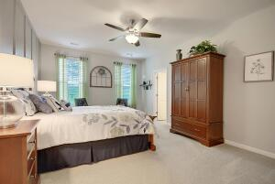
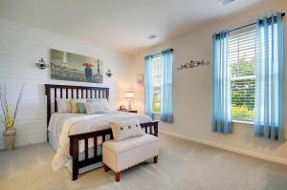
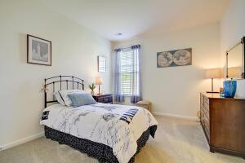
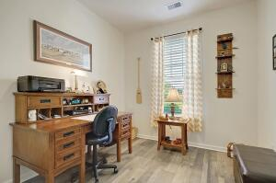
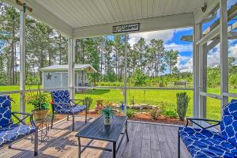
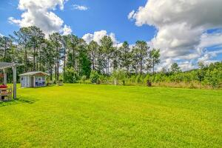
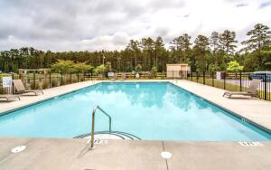
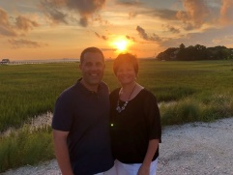

Stunning One Story in Ridgeville!
2006 Triple Crown Lane
Bridlewood Farms
Ridgeville, SC 29472
MLS# 22018153
$374,900
3 Bedrooms | 2½ Baths | 2,358 sf
Want to move in to a home that looks like a model home and is move in ready? Look no further! This one-story gem has so many custom touches that are sure to impress! There's gorgeous shiplap, custom trim work and molding throughout. This home has been well taken care of! Upon entering you'll immediately notice the open floor plan and beautiful flooring. To your right is the office which has French doors for added privacy. To your left is access to the garage, a drop zone area with a half bath and a barn door that leads to the large laundry room that offers cabinetry as well as a large closet. Back out in the main living area, the dining room has beautiful trim work and is the perfect size for entertaining. The living room is off of the dining room area and is a perfect gathering spot. Next, get ready to be wowed! The kitchen is stunning! Huge shiplapped island with seating, high-end stainless-steel appliances, large walk-in pantry, stunning tiled backsplash and gorgeous quartz countertops. The kitchen overlooks the eat in kitchen and living room. Down the hall from the dining room are two bedrooms, connected by a Jack and Jill bath. These bedrooms are a great size and both have large closets. Off of the living room is the primary bedroom with a gorgeous accent wall that has floor to ceiling wall molding. The primary bathroom has cultured marble countertops, oversized shower and large walk-in closet. This room feels like your own personal resort! Head outside for more relaxation! Large screened in porch, pergola covered patio, fire pit and gorgeous, peaceful views. All types of birds frequent this welcoming backyard. There's even a small water feature off of the porch and a shed that has its own little front porch! To say this house is gorgeous is an understatement. Move away from all the hustle and bustle of a busy town, but still have access to a community pool and play park as well as Dorchester District 2 schools!! Come see this house today!!
Larry & Kathy Mazalatis
Larry Cell 843-693-0529
Kathy Cell 843-693-0159
Office 843-871-9133
AGENTOWNED PREMIERE GROUP | 1800 TROLLEY RD | SUMMERVILLE, SC 29485

