Slide 1

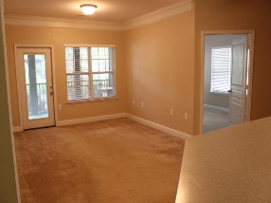
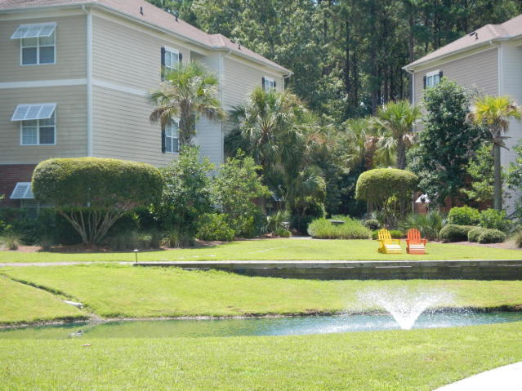
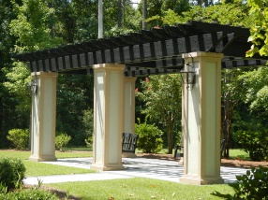
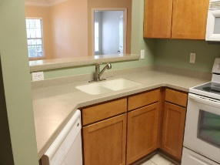
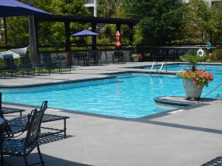
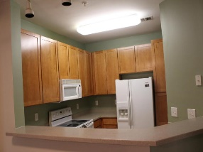
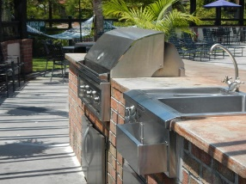
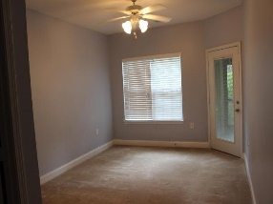
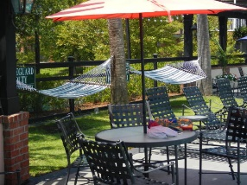

Condo in Premier Gated
Park West Community
Debbie Himebaugh
(843) 324-6959
dhimebaugh@century21properties.com
www.DebbieHimebaugh.com
2007 Basildon Rd| Mount Pleasant | MLS# 16022371 | $217,900
Brand New Flooring!
Welcome to The Battery, a Premier Luxury condominium Community located in the PARK WEST subdivision! This Great CORNER unit on the first floor has 2 bedroom 2 baths. The building backs up to pond and amenity center in this premier GATED subsection of Park West. Kitchen has Corian countertops and smooth cooktop range, microwave, dishwasher, Great room, dual Masters on either side of unit all with access to a large screened in porch and door to exit unit to parking lot. It has a full size laundry room. The community has walking paths, a car wash, dog park, Herb garden, its own very large private pool, grilling area, recreation center with pool table, home theatre, and workout room. Gorgeously landscaped with many outdoor seating and grilling areas. Come see this elegant community!
Century 21 Properties Plus | 3301 Salterbeck Ct Suite 100 | Mt. Pleasant, SC 29466

