Slide 1
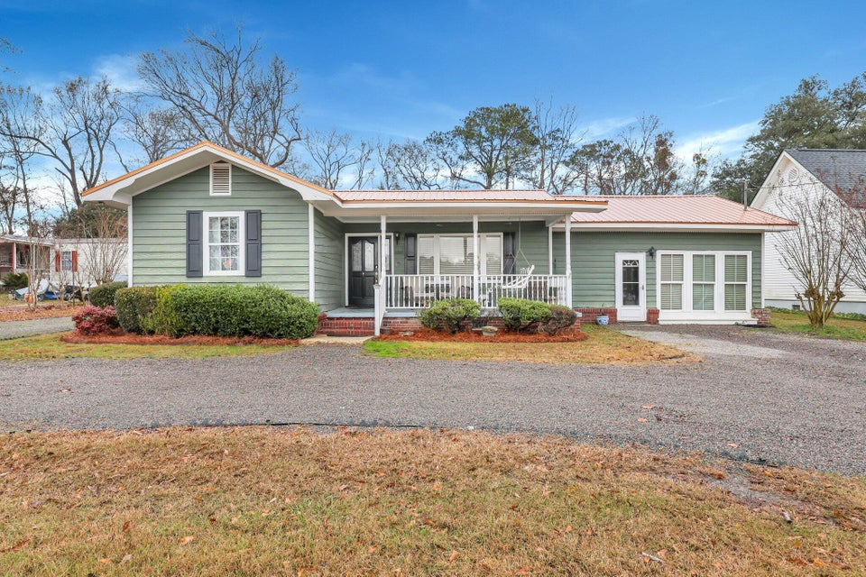
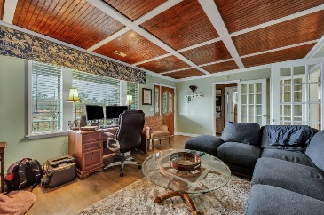
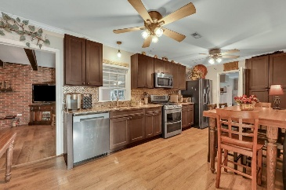
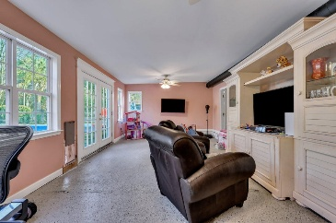
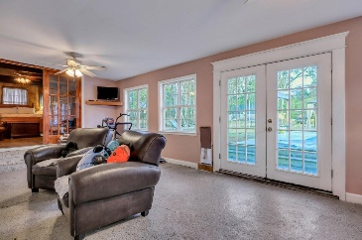
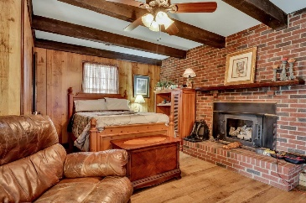
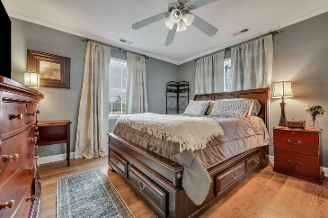
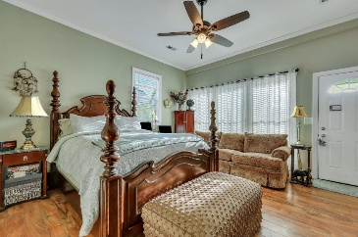
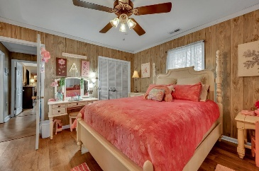
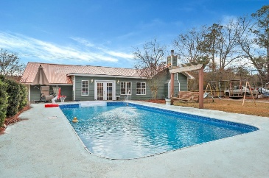
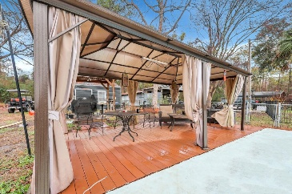



Summerville Ranch with Pool & Huge Yard
2007 Central Avenue
Summerville, SC 29483
MLS# 25000498
$425,000
B Beds | 2 Baths | 2,142 SF
Home warranty for 1 year included with purchase! Welcome home to 2007 Central Ave! This charming 3-bedroom, 2-bathroom home is loaded with upgrades and thoughtful touches, perfect for modern living and entertaining. The property features a 3-ton HVAC system with ductwork and a Rheem heat pump with an air scrubber, meticulously serviced twice a year for optimal performance. The primary bedroom includes a converted garage space with a bathroom equipped with a SaniFlo up-flush system, eliminating the need for pipes in the slab. It's also plumbed for a kitchenette, offering potential for a mother-in-law suite or rental income. The kitchen was beautifully upgraded in 2018 with Marsh cabinets, quartz countertops, a gas range, and a dishwasher, all complementing the home's modern aesthetic.
Durable LVP flooring, installed four years ago, flows seamlessly throughout. The den, currently used as a bedroom, doubles as a cozy living area, showcasing the home's versatility. Outdoor living is a highlight surrounded by trees, featuring a saltwater pool with newer pump, a grill arbor/gazebo for entertaining, and a workshop with electricity for projects or storage. The home is topped with a durable metal roof installed in 2020 and boasts newer ceiling fans throughout. Additional updates include a new septic tank and drain lines as of 2022, upgraded electrical outlets to ground, and a newer saltwater pool pump. This property truly offers a balance of style, comfort, and functionality, with countless possibilities to make it your own.
VIRTUAL TOUR
Nick Mazzilli 843-640-5575
nick@themazzilliteam.com
themazzilliteam.com
Maven Realty
2180 McMillan Ave
#71672
Charleston, SC 29405

