Slide 1
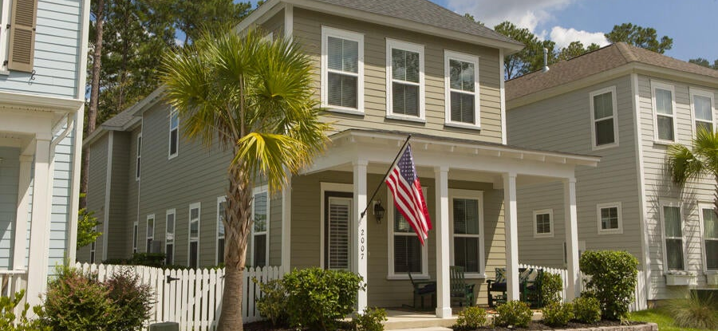
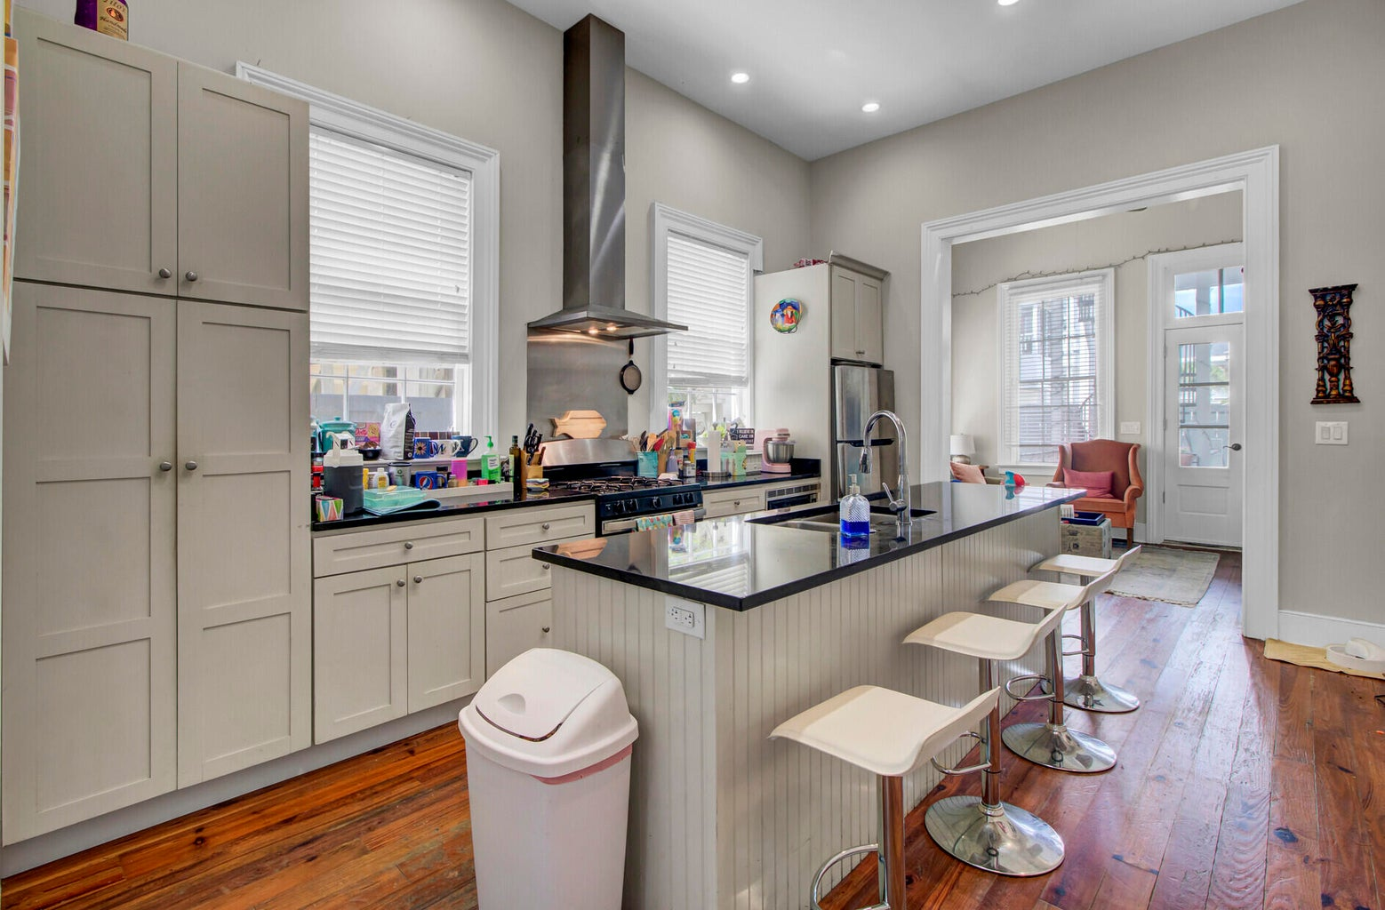
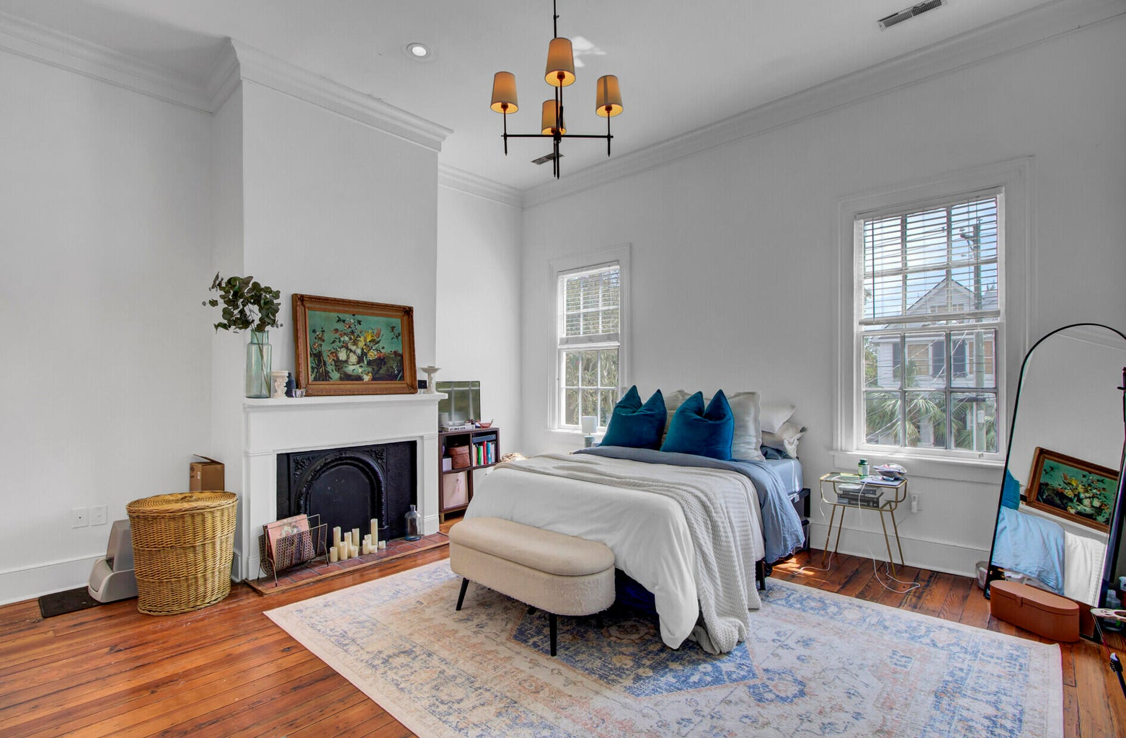
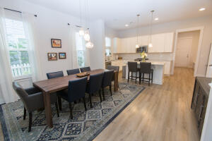

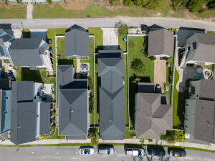
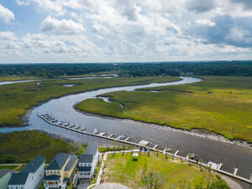


AGENT/BROKER OPEN HOUSE
Wine & Cheese Reception ~ Tuesday Oct 24th 3-5pm
Guess the selling price...Win $50 Amazon Gift Card!
2007 Codorus Lane
Bowen | Hanahan, SC 29410
MLS# 23021693 | $550,000
It takes a village ...Bowens Village ! The Estuary is a unique upscale community tucked away in Hanahan's Tanner Plantation, no flood ins req. The home, built in 2018, has the new home feel; Open floor plan, extra large owners suite, oversized two car garage with plenty of storage and storage system, mud room, large crawl space attic over entire owners suite, computerized irrigation system. Zoned for Bowens Corner Elementary School, there is a Community Boat Dock with reasonably priced boat slips, Play Parks, Swimming, Pickleball courts, Community events, hiking/jogging trails, Bowens Market. Nearby there is a Lowes food store with more shops, restaurants and medical offices. The sellers cannot say enough good things about the neighbors and the neighborhood! Come see for yourself.
Christine DeCocker
843-860-9972
ttlrealtor@gmail.com
ERA Wilder Realty Inc
125 Wappoo Creek Ste F
Charleston, SC 29412

