Slide 1
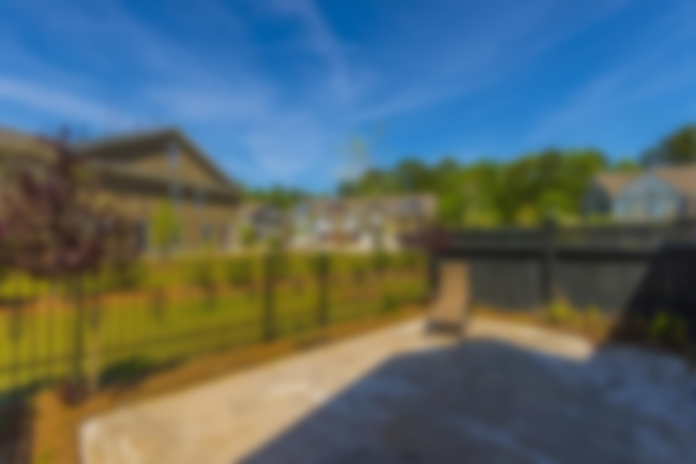
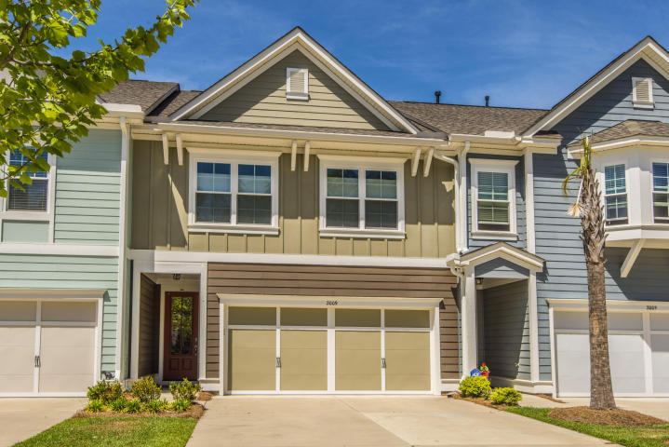
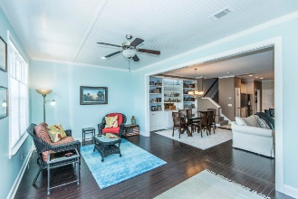
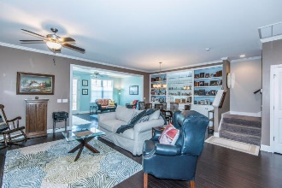
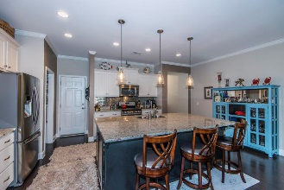
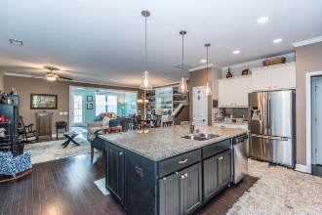
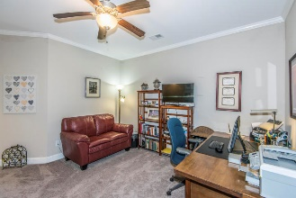
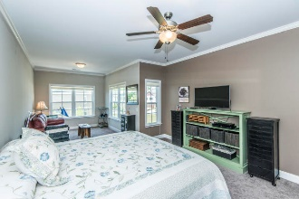
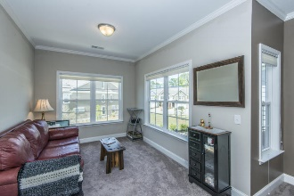
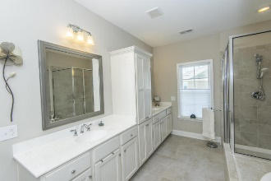
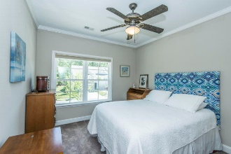
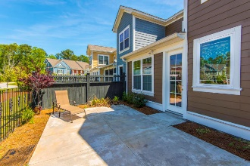


2009 Kings Gate Lane Dunes West Mount Pleasant, SC 29466 MLS# 17033091 $375,000
Like New!
Great Value!
Treat yourself to the gift of easy living with this gorgeous, designer inspired home. The open floor plan and gourmet kitchen are perfect for entertaining and offer tons of features & upgrades. The chef's kitchen will please the most discerning home cook with its huge center island, designer cabinets, beautiful granite countertops and backsplash, gas range and stainless appliances. The kitchen opens to a dining/flex space and large great room with hardwood floors and custom built-ins. Unique to this unit, there is an extended living area, perfect for use as a four-seasons room, playroom or study area. Enjoy this special space year around as it is heated & cooled! A private, fenced courtyard offers space for outdoor relaxation with plenty of room for kids or pets to stretch their legs while you grill dinner! The large upstairs Master suite includes a relaxing sitting area/television nook and a luxurious bath complete with dual vanities, linen tower, soaking tub, walk-in shower, and oversized walk-in closet. Completing the upstairs living space are two additional bedrooms, a full bath and laundry room. There is also a loft space perfect for a home office, play area or "teen lounge." This beautiful, low maintenance home is located just outside of the gates in Dunes West, a neighborhood that offers an award winning golf course and club house, pools, tennis club, boat ramp and boat storage plus plenty of walking paths. Dunes West is conveniently located close to the beaches, shopping, dining and minutes from the new Roper St. Francis hospital and a short drive to the world-class dining and shopping of historic downtown Charleston.
Asking $1,650,000
MLS# 16003205
6,527 SqFt
5 Bed/5½ Baths
22,000-lb Boat Lift
Don Dawson 843-514-0452 ddawson@carolinaone.com Carolina One Real Estate • 2713 Highway 17 North • Mount Pleasant, SC 29466
www.TeamDawsonSC.com

