Slide 1
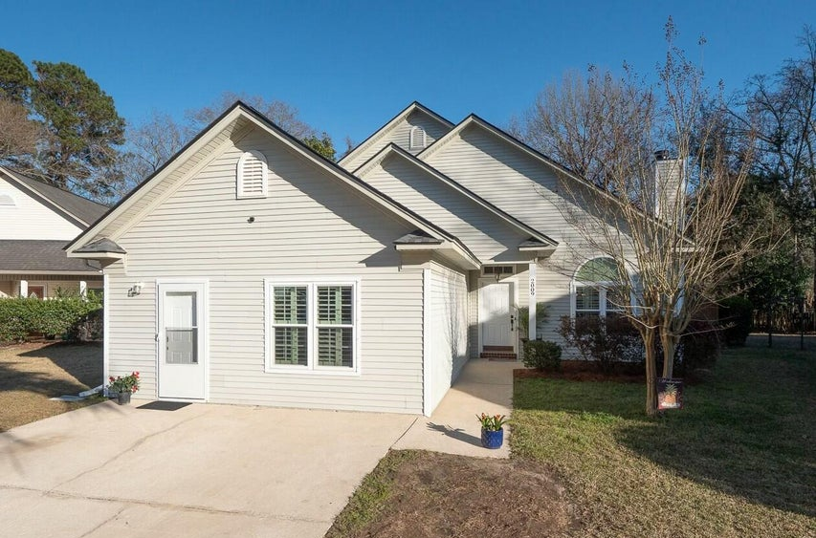
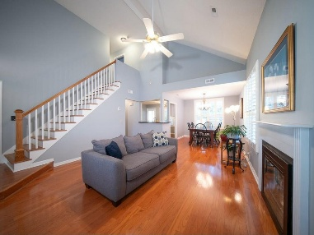
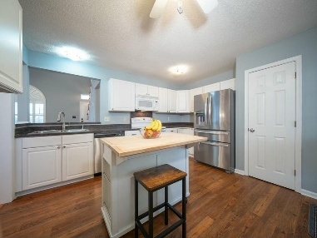
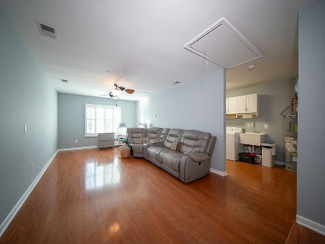
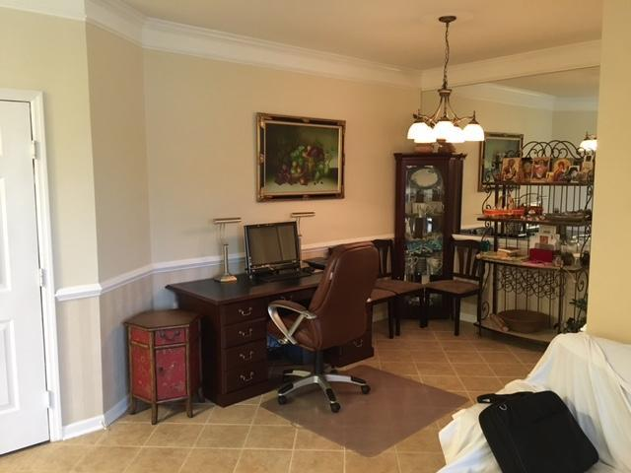
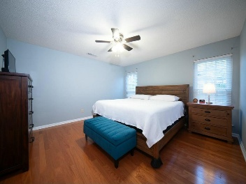
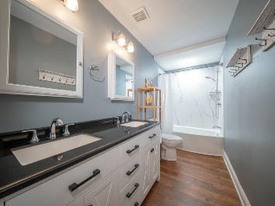
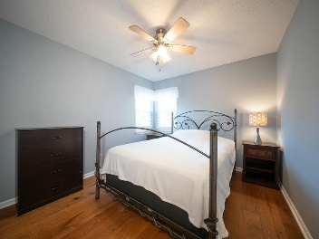
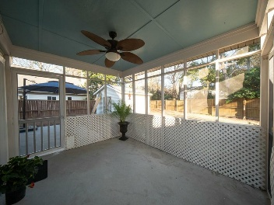
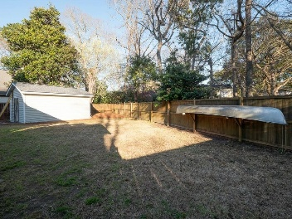


Open House Sunday 1-4 PM
2009 Arundel Place
Longpoint | Mount Pleasant, SC 29464 | MLS# 25006556 | $799,000
PRICED TO SELL! Location, location, location. Longpoint, Palmetto Islands County Park ! Family living doesn't get much better than this. This four bedroom home with primary bedroom on first floor has been updated with new roof, new windows, new bathrooms, new wood flooring and freshly painted. On the first floor you will find soaring ceilings in the living room with fireplace, dining room, spacious family room, large mud room/laundry room, kitchen and primary bedroom suite. On the second level is three bedrooms and an updated bathroom. Lots of room in the fenced private backyard for entertaining on the screen porch, covered gazebo or patio. This yard is made for entertaining. Hurricane shutters are included in this home. 12x18 shed in backyard for bikes, lawnmowers, workshop, man cave.
VIDEO TOUR
LISTED BY
Joanne Harwell
843-224-5777
Joanne.Harwell@cbcarolinas.com
cbunited.com/joanneharwell
HOSTED BY
Erik Fender
843-830-7346
erik.fender@cbrealty.com
www.coldwellbankerhomes.com
Coldwell Banker Residential Brokerage | 1127 Queensborough Blvd. 103 | Mt Pleasant, SC 29464

