Slide 1
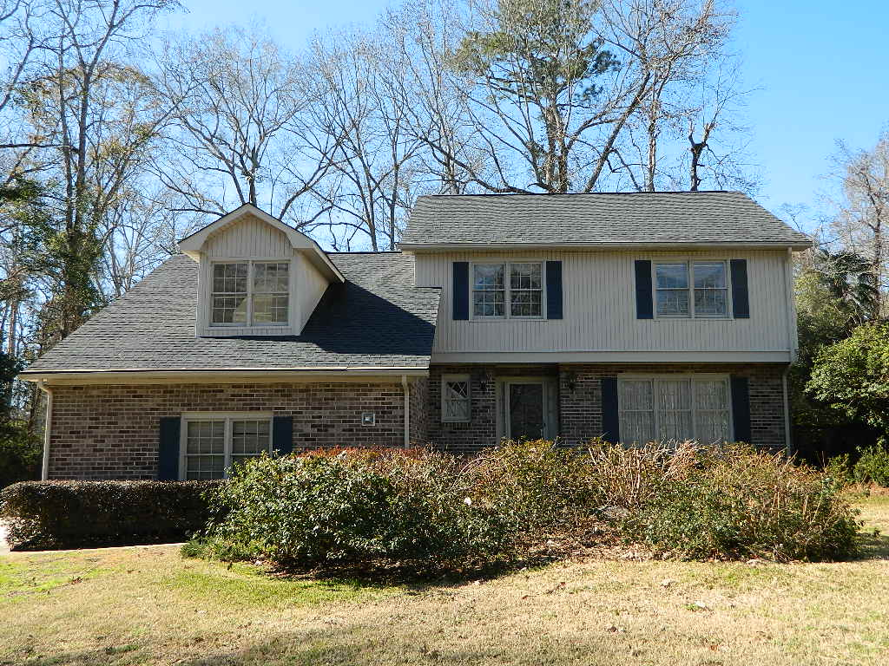
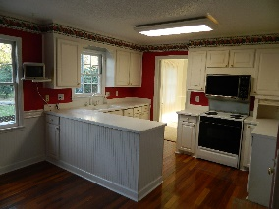
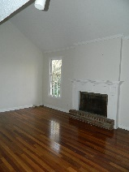
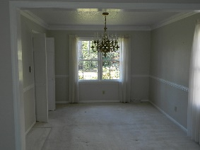
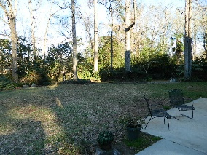
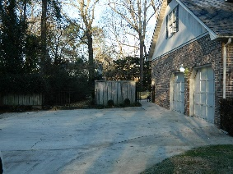

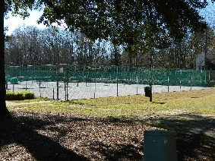


200 Ashborough Avenue Ashborough ~ Summerville, SC 29485 ~ MLS# 16001509 ~ $250,000
PRICE REDUCED IN ASHBOROUGH!
Single owner home that has been very well maintained in desirable Ashborough subdivision is ready for new owners. Brick and vinyl home has foyer with coat closet, formal living room and dining room, half bath, eat-in kitchen and sunken den with vaulted ceiling and fireplace fitted for gas logs. The eat-in kitchen has Corian countertops, double-oven electric range, Bosch dishwasher and a pantry. Upstairs find a huge FROG with laundry room for convenience, two closets and a window AC unit with remote control for added comfort. Then upstairs to a full hall bathroom with sliding glass doors on the tub/shower, and 3 bedrooms. The large master bedroom has private vanity area outside, inside vanity newly tiled full-sized shower and ceramic tile floor, and a walk-in closet.
The secondary bedrooms are large as well with plenty of closet space. Outside find a fully fenced yard, over-sized patio, another patio and seating area with brick pavers and evidence of a garden lovingly cared for through the years. Roof has 30 year architectural shingles installed in 2007, a new hot water heater in 2005, all NEW pressurized INTERIOR water pipes 2013, new master bathroom shower pan, bed, tile, grout and floor 2015, New RUUD 2 ton 14 Seer split heat pump system and air handler installed in 2014. Home just had a new vapor barrier installed 1/2016. Home has front and rear irrigation system. Home is under termite bond with HomeTeam Pest Defense. Dorchester District II schools. Enjoy the community with play park, pool and tennis courts a few feet away!
Barbara Daniels
Mobile - (843) 532-4274
bdaniels@carolinaone.com
www.barbaradanielshomes.com
Carolina One Real Estate | 900 N Main St. | Summerville, SC 29483

