Slide 1
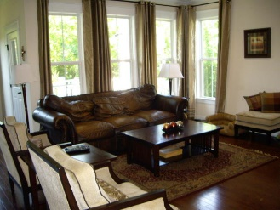
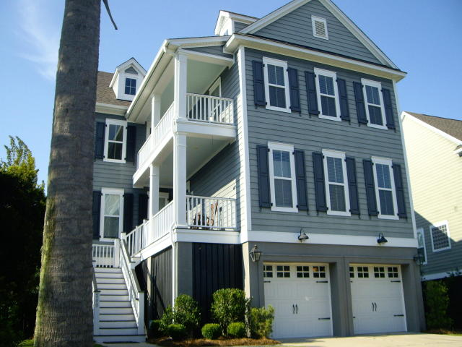
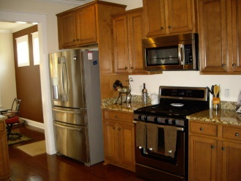
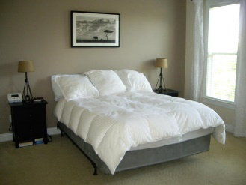
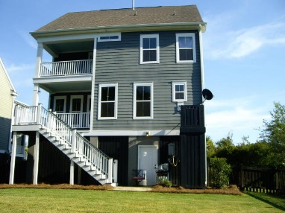
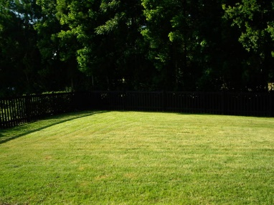
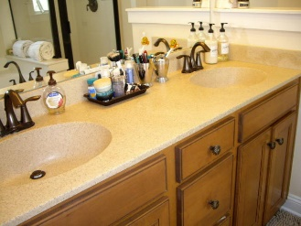
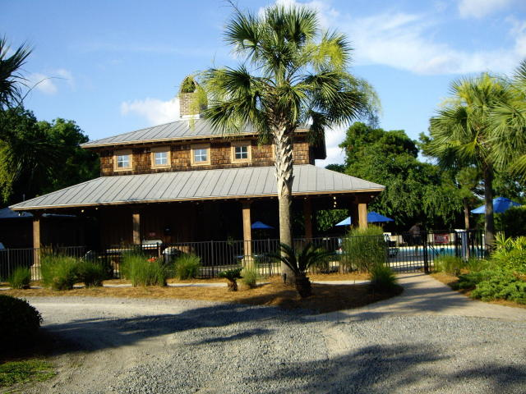
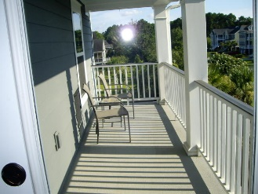
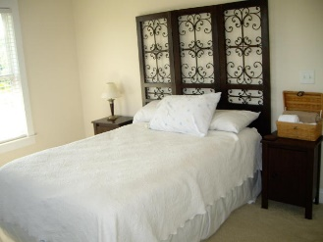


200 Clouter Creek Drive Shellring at St Thomas Island Charleston, SC 29492 MLS# 18019115 $499,000
Elevated home near Daniel Island
Looking for a large, spacious and elevated home in highly desirable Shellring at St. Thomas Island? Look no further. This beautiful Ravenwood floor plan offers a drive under 2 car garage and storage space, 4 porches, gas FP in family room, dining room, eat-in-kitchen. Luxurious owner's suite with a two walk-in-closet and double sink bathroom is conveniently located on the first floor for privacy.
Three more bedrooms and a game room on the second floor. Stainless appliances, granite countertops, upgraded cabinets, crown molding, hardwood floors, irrigation system, security system with camera, fully fenced backyard. Close to I-526 with easy commute to Boeing and all that Daniel Island has to offer. Community pool with clubhouse & grilling area. Daniel Island school district.
Cathy Rosenblum
843-817-7869
crosenblum@comcast.net

