Slide 1
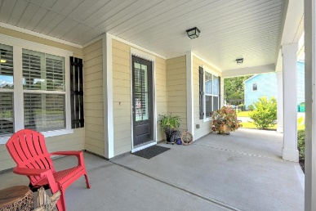
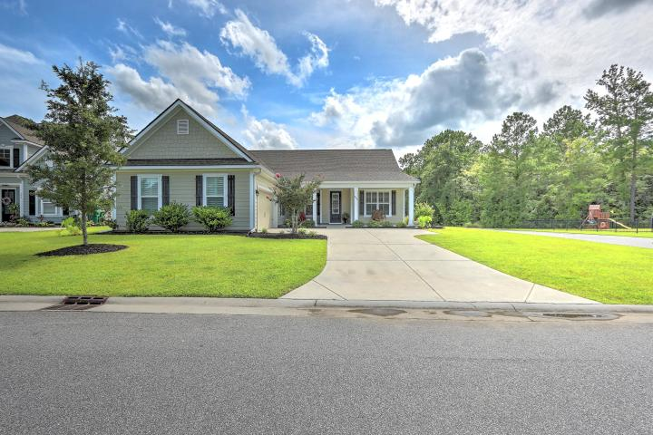
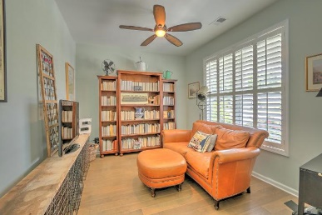
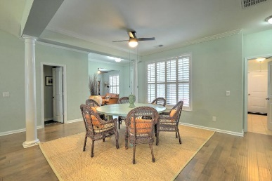
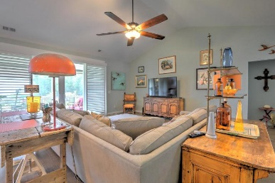
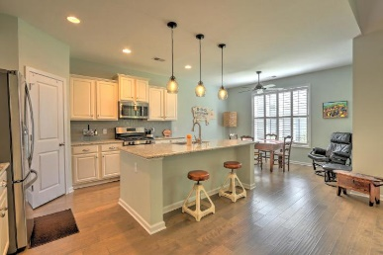
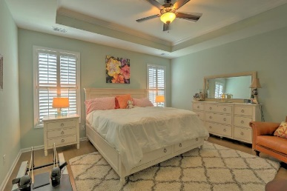
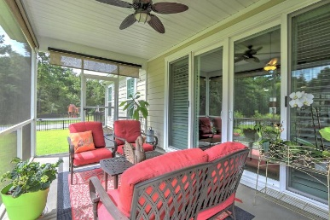
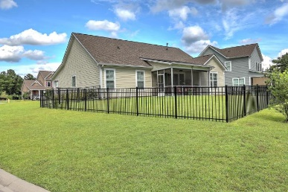
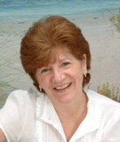

200 Cooper Run Road Bluffton, SC 29909 ~ MLS# 20023425 ~ $369,900
One Story Living ~ Just Listed!
$1,000 Buyer's Agent Bonus
For Ratified Contract That Can Close By 9/27/2019
Don't miss this remarkable one story home situated on a large premium corner lot in highly sought after Estates at Cypress Ridge. The over-sized low country style front porch along with the side entry garage provide wonderful curb to this beautiful home. Plantation shutters through-out home allow for lots of natural light. Open dining area & large family room with vaulted ceiling are open to the chef's delight kitchen with gas range, stainless appliances, white ornamental granite with glass tile backsplash. Spacious, private master suite is separated from 2 secondary bedrooms and the office / flex space. Screened porch is perfect for that morning cup of coffee or evening libation. Wrought iron fencing. All this plus resort style amenities of Cypress Ridge that include large pool, relaxing lazy river, 3 story fitness center, stocked lagoon with fishing pier, tennis & basketball courts and so much more! make your appointment to view this home today.
Maggie Curtis
REALTOR, EPRO, LMC, ABR
(843) 693-8207
maggiecurtis@comcast.net
Bob Curtis
Realtor
(843) 425-1965
thebobcurtis@comcast.net
Coldwell Banker Residential Brokerage | 1127 Queensborough Blvd. 103 | Mt Pleasant, SC 29464

