Slide 1

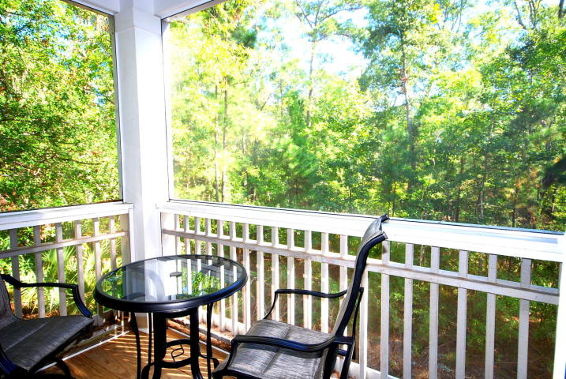
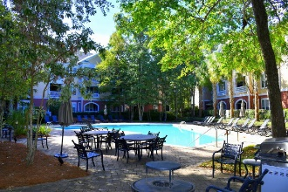
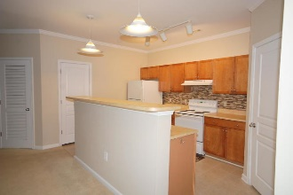
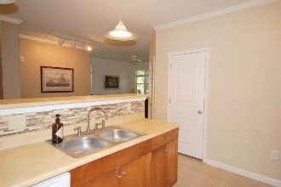
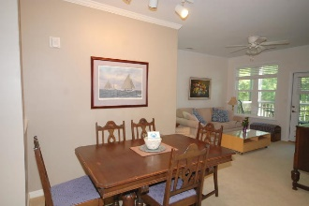
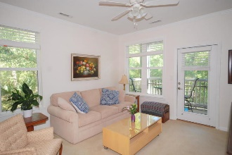

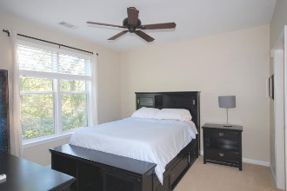
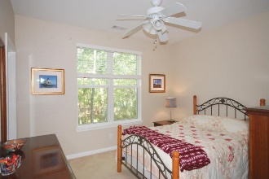
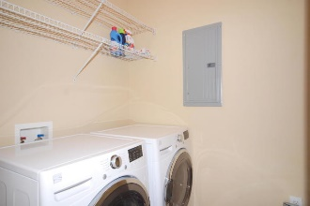
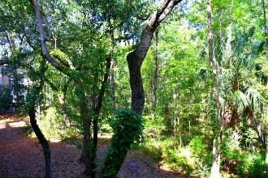
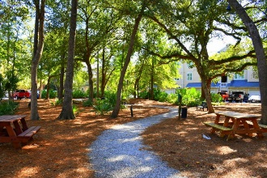
Debbie Cromer
ABR, RSPS, REALTOR, CRS
(843) 437-6342
debbie@debbiecromer.com
www.mylowcountryhomes.com
Beautiful, Private,
Second Floor Condo
200 Bucksley Lane #207
254 Seven Farms Drive | Charleston, SC 29492 | MLS# 19029387 | $227,000
Beautifully private second floor unit that backs up to the woods and has a new HVAC! Seller's favorite thing to do is to sit on the screen porch, have her morning coffee and enjoy the view! A great floor plan with the kitchen open to the dining room and living room. The spacious master bedroom is in the back of the house with plenty of quiet and a beautiful view as well as the private master bath and walk in closet. In the front of the condo you find the full hall bath and second large bedroom. Lots of special touches like the built in book case. For extra storage, there is a large laundry room off the kitchen and a storage closet on the screen porch. Don't miss this convenient location just walking and biking distance to stores, restaurants and all that Daniel Island.
Century 21 Properties Plus | 1090 Park West Blvd; Ste 3 | Mount Pleasant, SC 29466

