Slide 1
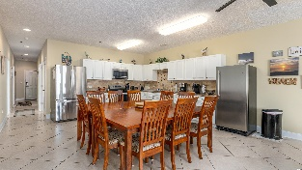
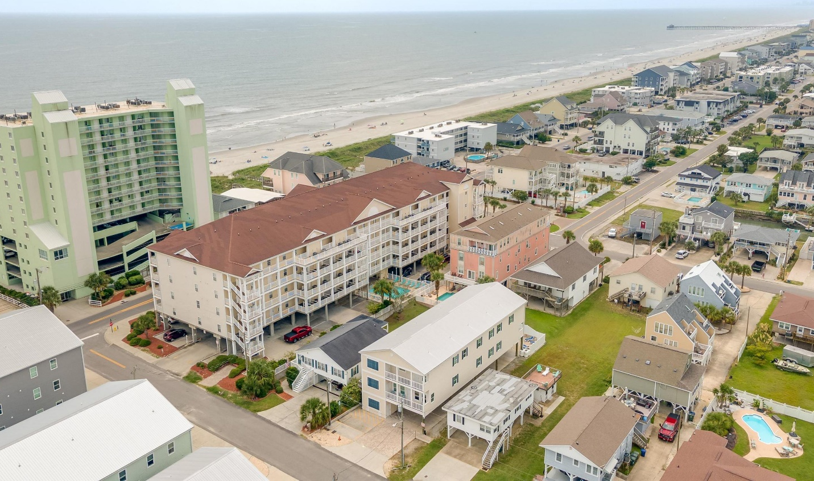
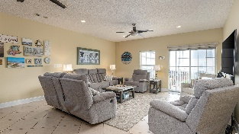
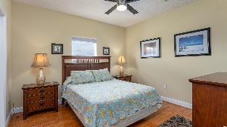
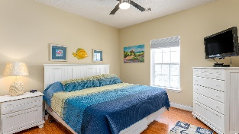
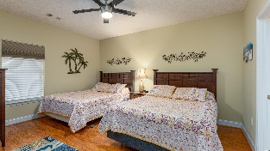
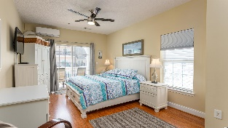
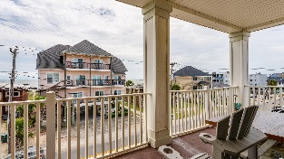
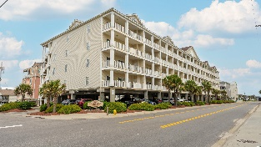
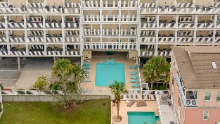
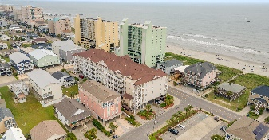



Affordable, 2,000+ sq ft condo with 4 bds/3 bas steps from the Atlantic Ocean in Cherry Grove
200 53rd Ave N # 301
Cherry Grove Villas | North Myrtle Beach, SC 29582
MLS# 2219412 | $464,000
WELCOME TO ONE OF THE TOP BEACHES IN THE U.S. IN A TOP 5 BEACH TOWN IN THE NATION: CHERRY GROVE BEACH IN NORTH MYRTLE BEACH AND CHERRY GROVE VILLAS IN Cherry Grove! This spacious condo-style beach villa has room for everyone. With four large bedrooms and three baths, it's perfect for a vacation home or a short-term rental investment. This unit has been meticulously maintained and is in excellent condition. Inside you will find a relaxing neutral and light gray color palette. It is sold pleasantly fully furnished too with a few listed exceptions. As you enter the unit, a large, extended foyer greets you with 3 amazingly roomy guest bedrooms along that corridor. There are also two big full baths and a convenient laundry room. The extraordinary kitchen, seating 10 and with lots of cabinet space and upscale appliances, is one of the stars of the unit, along with the gathering area-great room with ocean views. From there, step out on the fabulous front porch with great views of the ever-changing Atlantic Ocean across the street! Breathtaking, as is the enormous Master Bedroom, adjoining the front balcony also and enjoying a wonderful master bath and retreat. Major appliances are newer, as is refreshed decor and flooring. See features list. The HOA fee includes water, basic cable, wifi, pest control, building insurance and more. ( Ask agent.) Unforgettable, low maintenance second home lifestyle or rental investment. Frosting on the cake: upgraded ceiling fans with remote controls - steps from beach access on south/west side of building - only two condos are accessible from third floor, very quiet with low traffic - end unit with windows that give you great ,lighting and view of fabulous sunsets to the west - 85 gallon hot water tank - Mini-split AC/Heat in master minimizing the main ac usage during summer heat - New master bed with additional underneath storage - 32” flat screens with cable boxes in all bedrooms - Large flat screen tv in living area with surround sound - Engineered wood floors for easy cleaning/no carpet - Inside and outside storage - Easy access to back channel/marsh for boats, kayaking, jet skiing and fishing just steps away - Jacuzzi tube in master Really, you must see today...and enjoy this unique, upscale beach lifestyle soon!
Video Tour: https://youtu.be/kHo5tgWt9SQ
3D Virtual Tour: https://my.matterport.com/show/?m=a66RUnUzHnp
Connie Ross-Karl
702-306-2643
conniesross@aol.com
Ronnie Nichols
Realtor / BIC
ronnienichols8@aol.com
NEW WAY PROPERTIES MYRTLE BEACH

