Slide 1


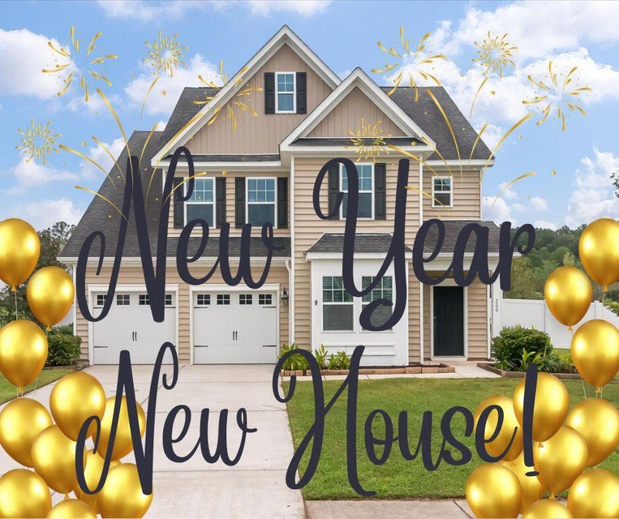
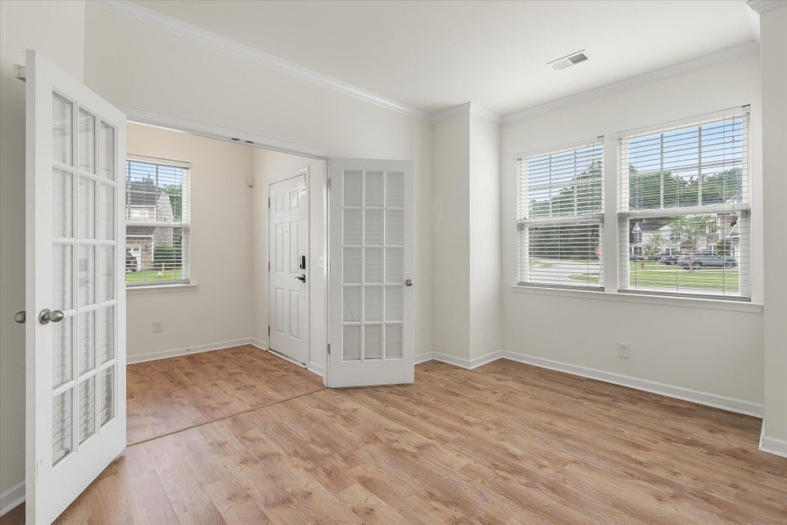
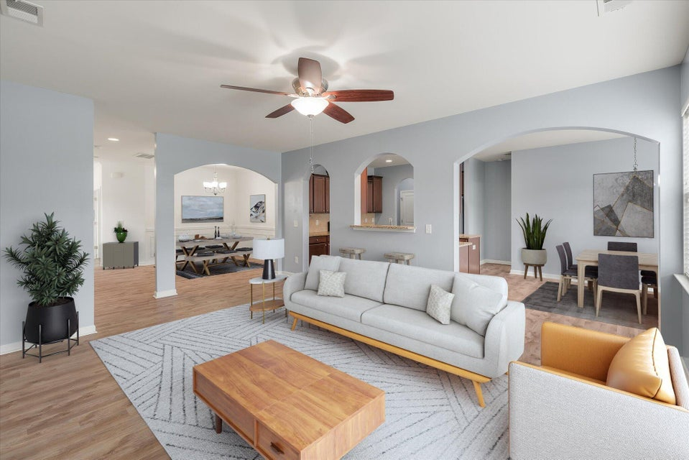
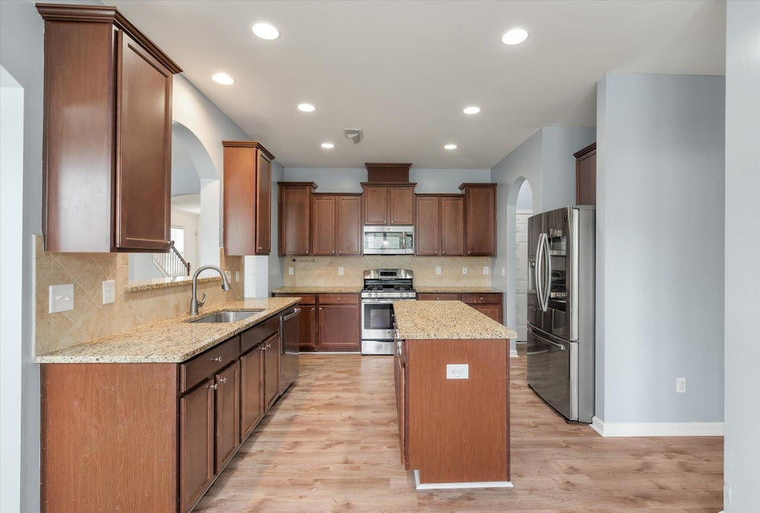
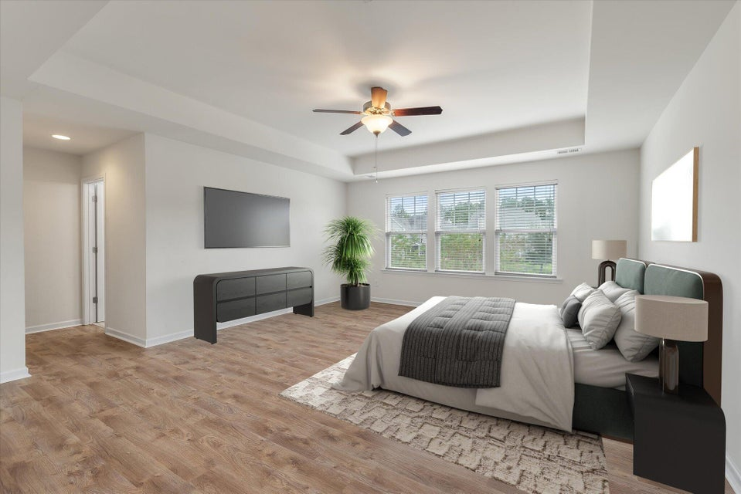
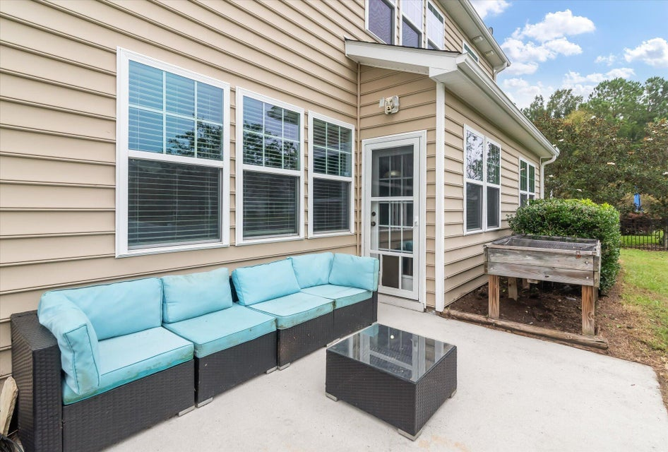
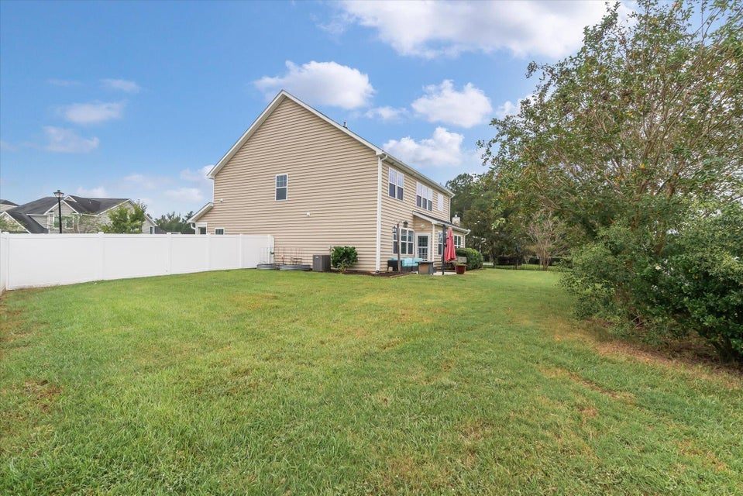
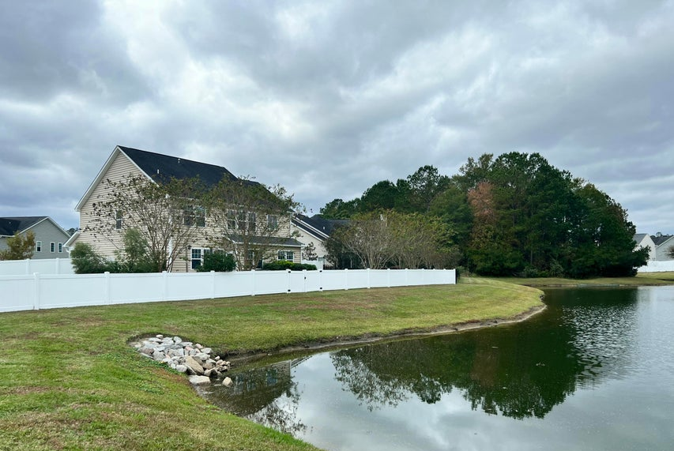
No Need to Wait!
200 Buttonbush Court
Fairmont South | Moncks Corner, SC 29461
MLS# 24025802 | NOW OFFERING AT $420,000
Why wait for a new build when this beauty is ready to go with a refrigerator, blinds and large fenced yard on a pond! Five bedrooms, 3.5 bathrooms with a downstairs guest suite.
Virtual Tour
Tina Hartford
EXP Realty LLC
843-779-8646
tinahartford@lowcoasthomes.com

