Slide 1


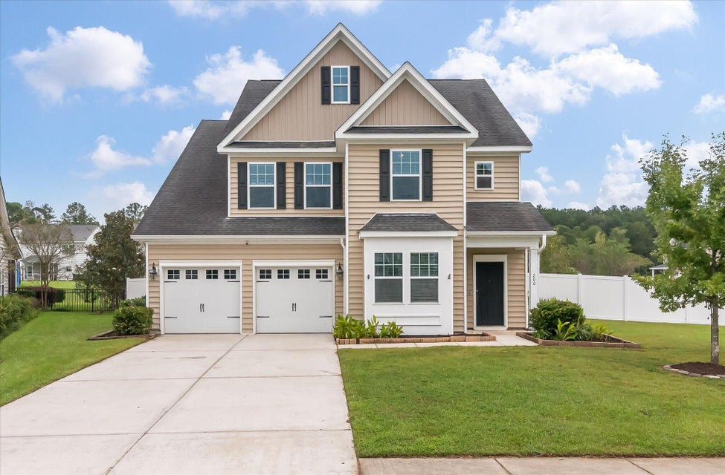
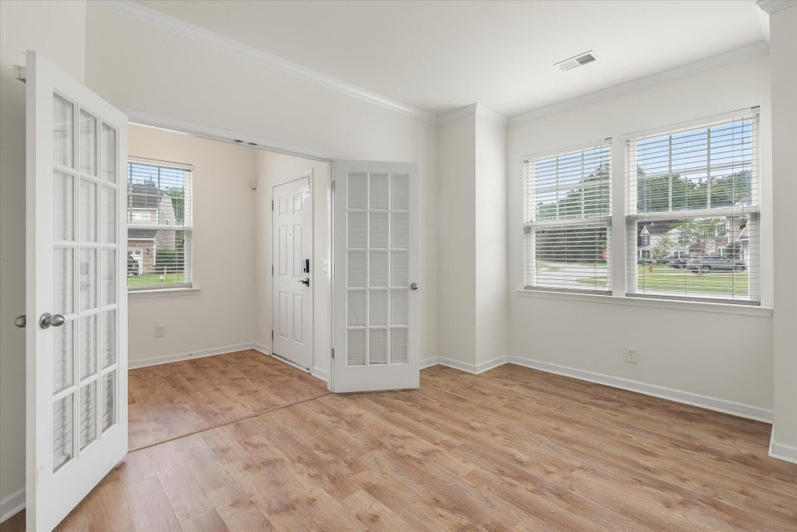
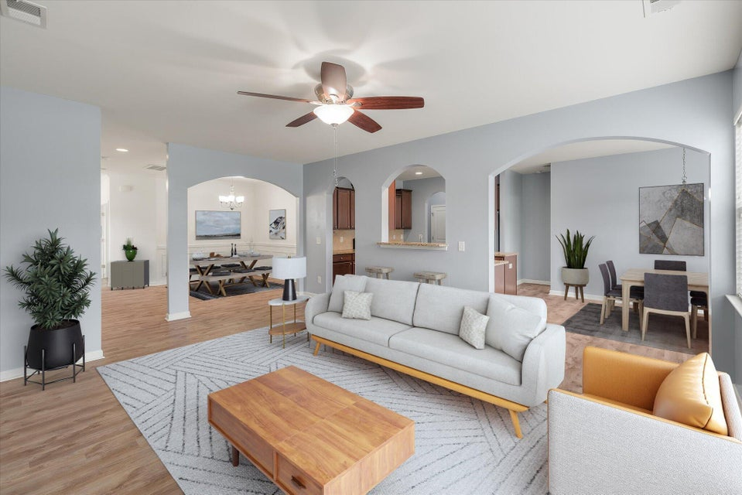
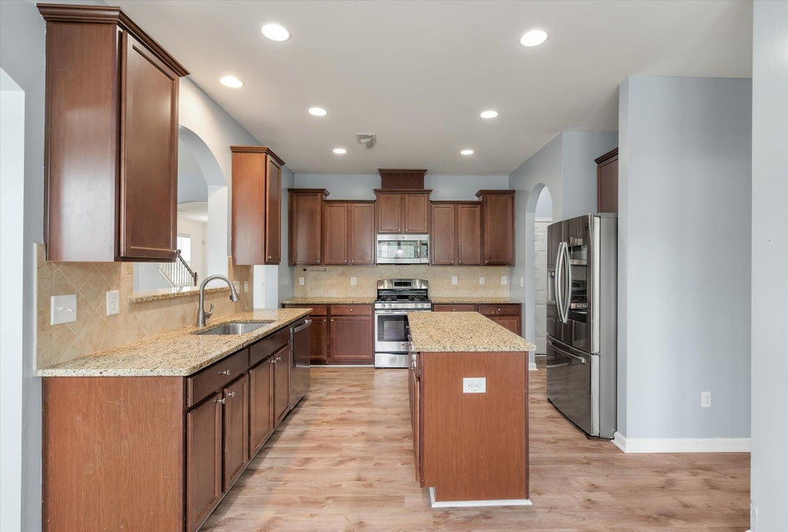
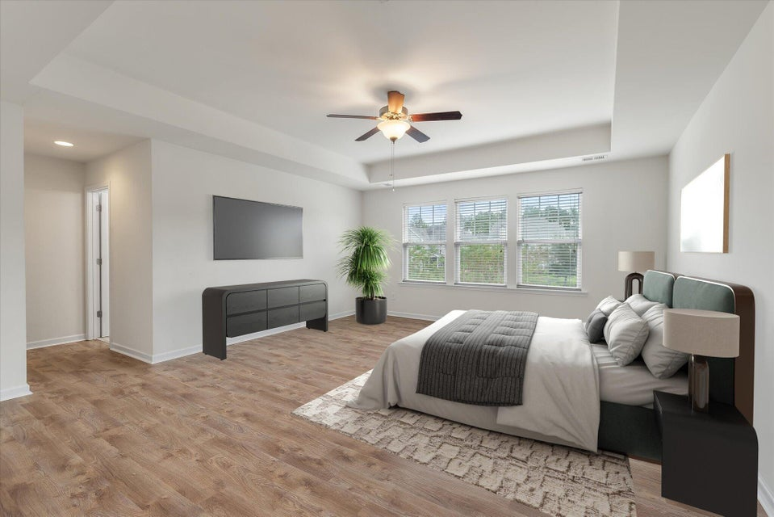
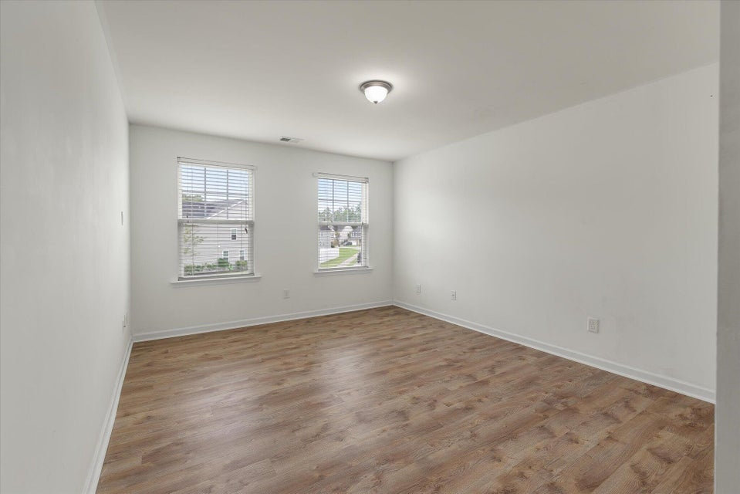
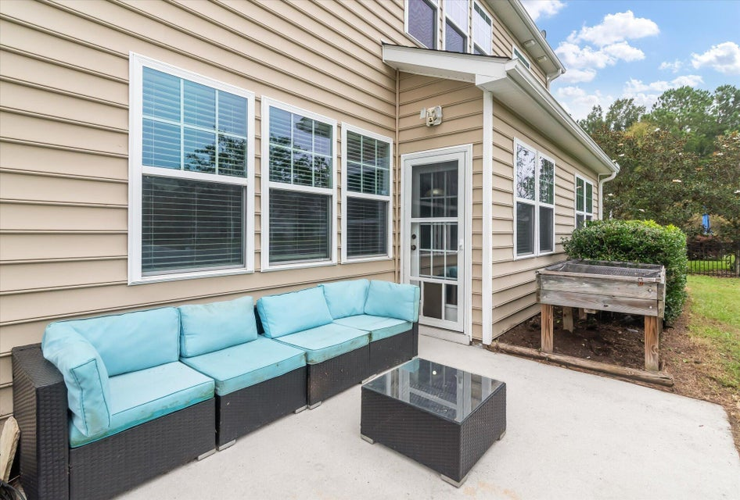
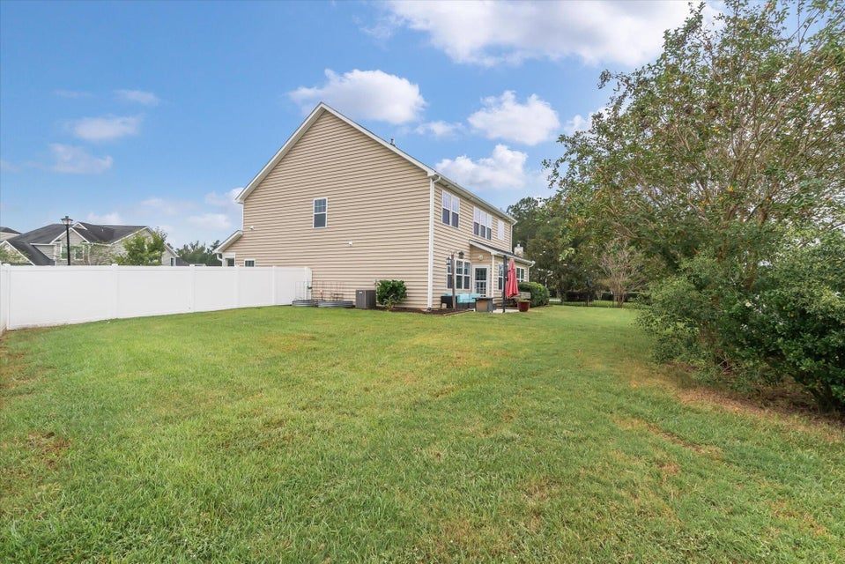
Check Out the New Price!
200 Buttonbush Court
Fairmont South | Moncks Corner, SC 29461
MLS# 24025802 | NEW PRICE $430,000
Buyers looking for a large home will love this 5 bedroom, 3.5 bathroom conveniently located near a new Publix, restaurants and Foxbank Elementary School.
Large fenced yard with raised garden beds and backs to a pond.
Price reduced to $430,000.
Virtual Tour
Tina Hartford
EXP Realty LLC
843-779-8646
tinahartford@lowcoasthomes.com

