Slide 1


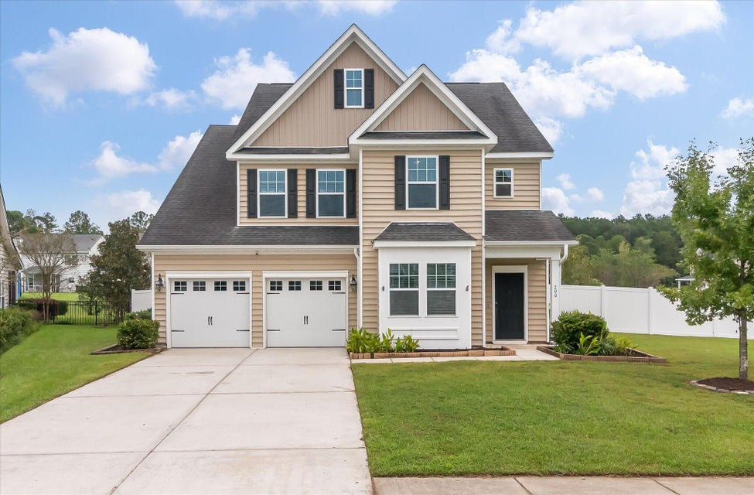
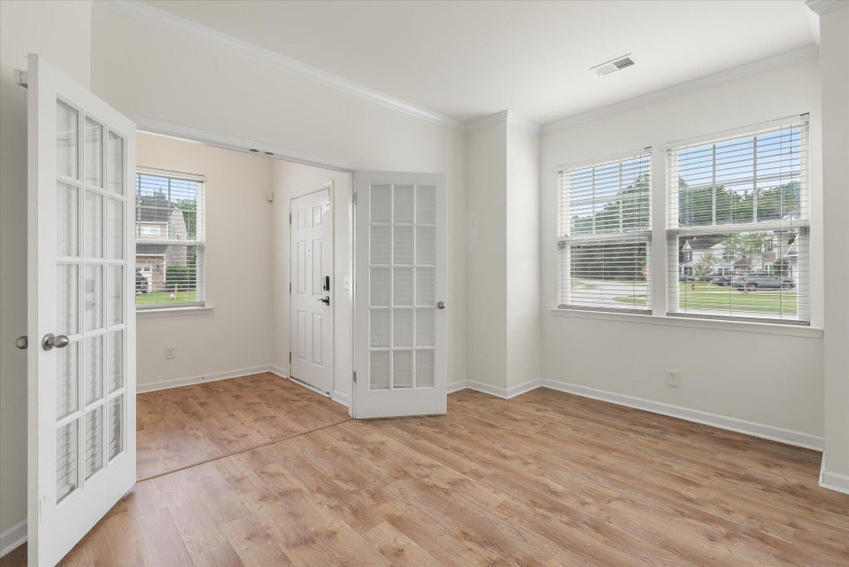
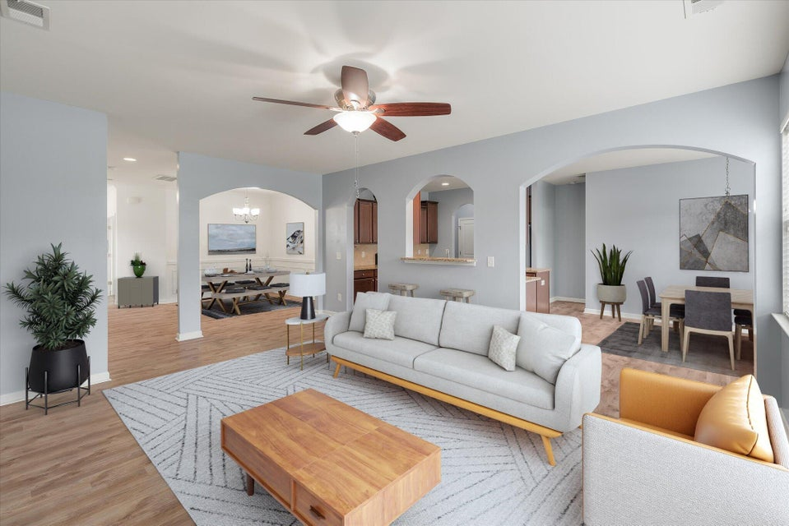
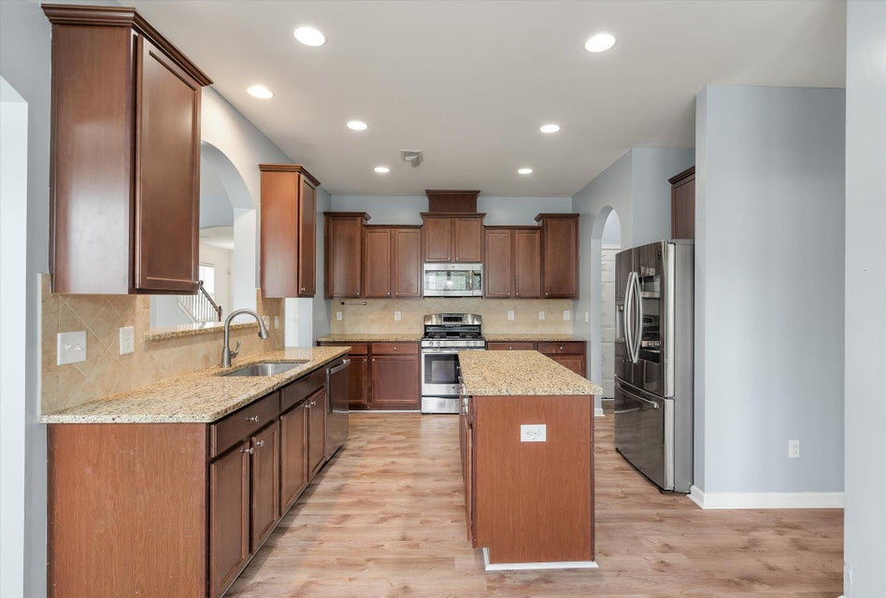
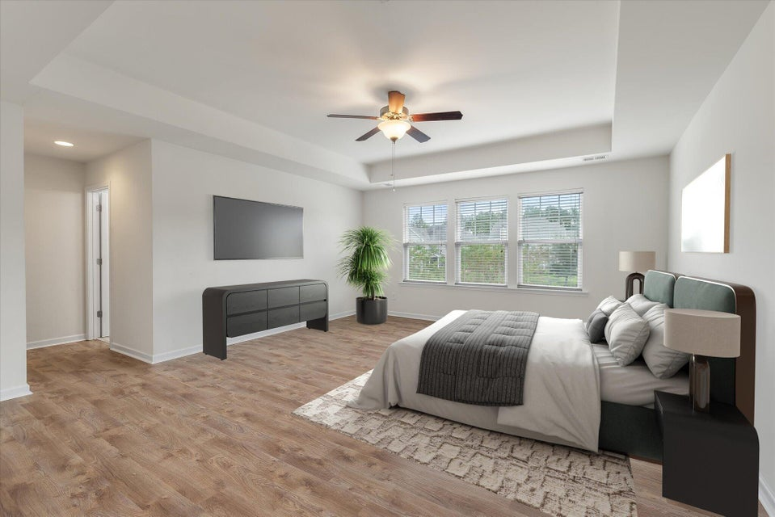
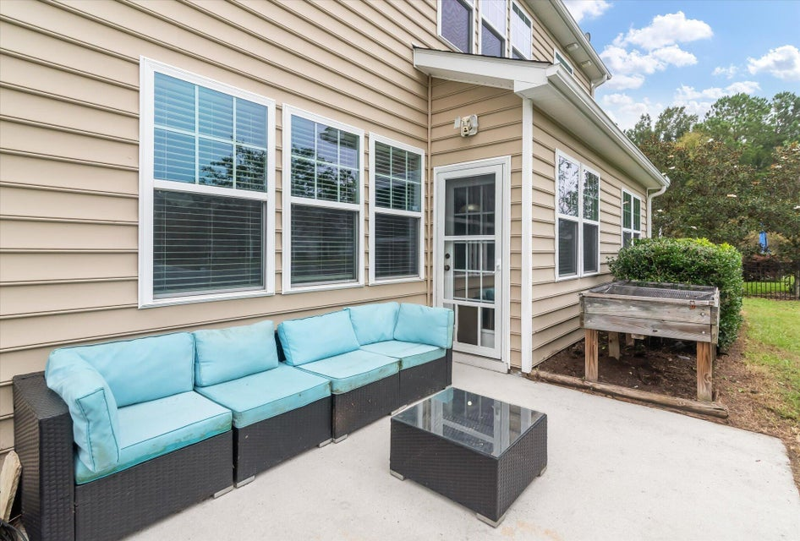
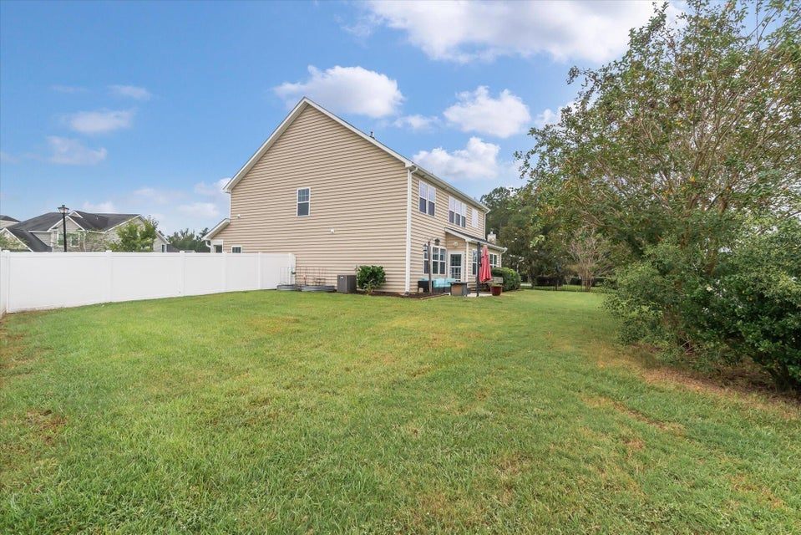
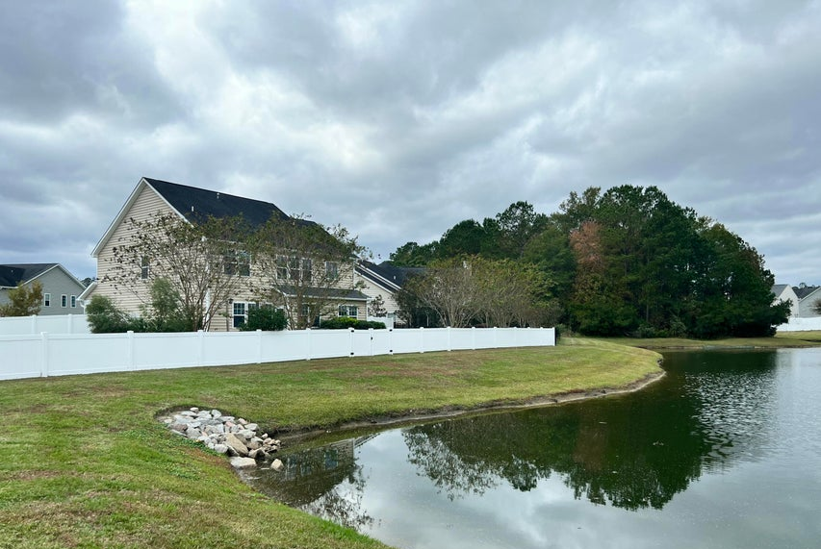
Check Out the New Price!
200 Buttonbush Court
Fairmont South | Moncks Corner, SC 29461
MLS# 24025802 | NOW OFFERING AT $420,000
Welcome to this stunning 5-bedroom, 3.5-bathroom home in the sought-after Fairmont South neighborhood of Moncks Corner! Situated on a spacious .23-acre pond lot, this home offers a completely fenced-in yard, perfect for outdoor activities, pets, and privacy. Step inside to find a thoughtfully designed layout featuring laminate flooring throughout the entire home, offering both elegance and easy maintenance. The main level boasts a convenient guest suite with a private bathroom, ideal for visitors or multi-generational living. The open-concept living space flows seamlessly into a well-appointed kitchen, making it perfect for entertaining. There is also flex space that can be closed off for an office, bourbon room or craft room. Upstairs, you'll find the additional 4 bedrooms, including a large primary suite with an ensuite bathroom for a luxurious retreat as well as laundry and another full bath.
Virtual Tour
Tina Hartford
EXP Realty LLC
843-779-8646
tinahartford@lowcoasthomes.com

