Slide 1
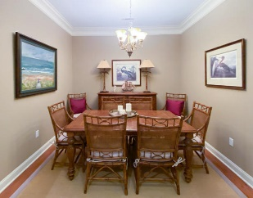
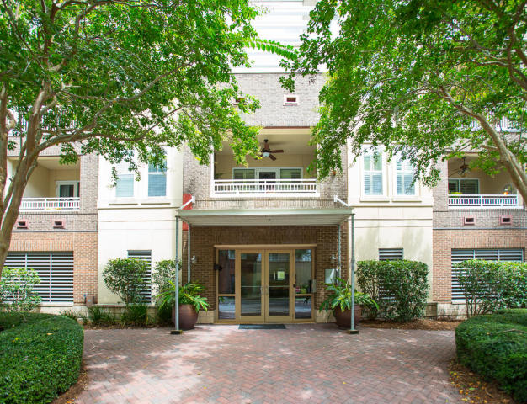
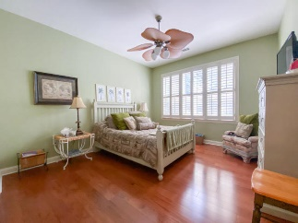
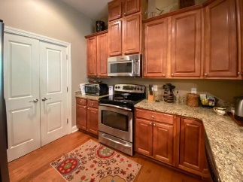
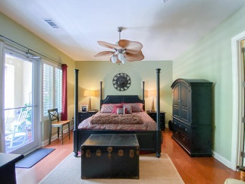
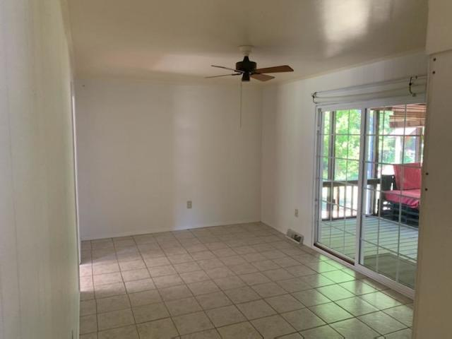
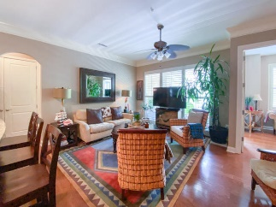
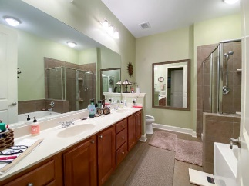
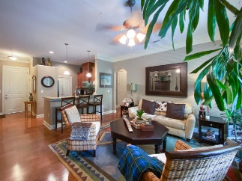
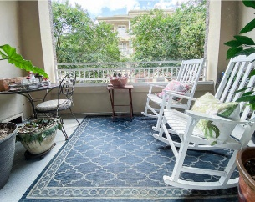
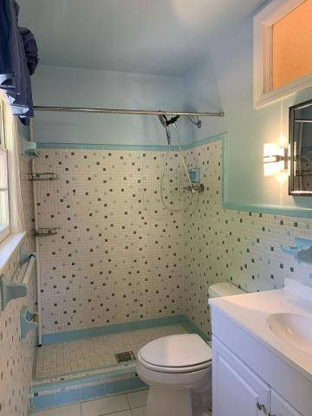
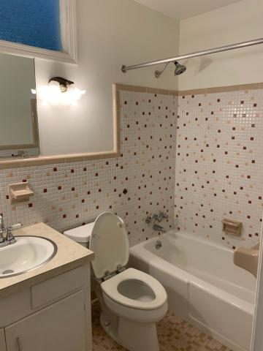


Luxury Daniel Island Condo ~ Reduced
200 River Landing Drive F 105
Charleston, SC 29492
MLS# 20021844 · $414,900
Michael Dew
O 843-769-5100
M 843-870-7000
michaeledew@gmail.com
www.michaeldewrealestate.com
Luxurious 2 bedroom 2 bath condo in the heart of beautiful Daniel Island where you have easy access to everything Daniel Island has to offer. High ceilings and hardwood floors through out. Beautiful kitchen with granite counter tops, stainless steel appliances and breakfast bar with pendant lighting overlooking the family room with floor to ceiling windows. Formal dining and study with balcony. Spacious master bedroom with access to private balcony. Large master bath with dual sinks and separate tub and shower. 2nd bedroom also has large bath. 1st floor unit convenient to parking and pool. Amenities include a gorgeous swimming pool, exercise room,, outdoor gazebo with gas grill, dedicated storage and parking space, security access, and elevators.
Community features: restaurants, shopping, dock, fishing, tennis, kids park, Volvo Car Stadium, Family Circle Tennis Center, trails, and parks.
AgentOwned Charleston Group
902 Savannah Hwy
Charleston, SC 29407
Real Estate ● Mortgage Insurance ● Business Brokerage

