Slide 1
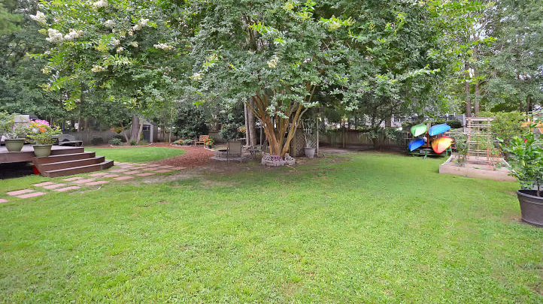
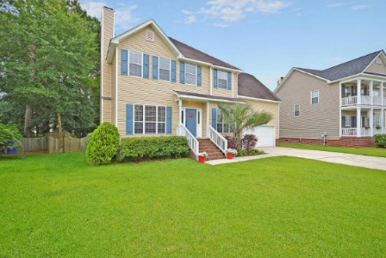
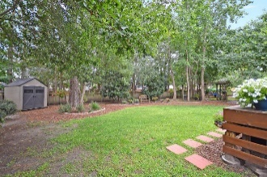
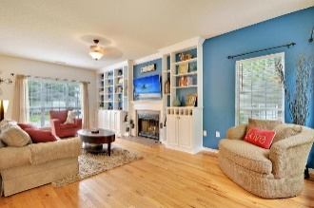
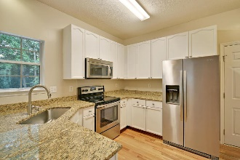
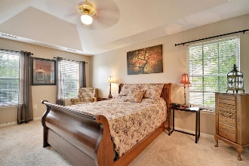
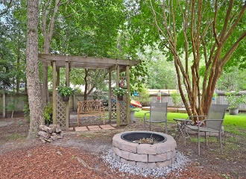

2010 S Smokerise Way
Planters Pointe
MLS# 17017702
$350,000
Soaring Ceilings, Open Concept & Dock
Amazing Backyard Oasis In Mount Pleasant!
One of the most relaxing backyards you will find in Mt Pleasant! This fully fenced yard has mature Oaks, Sweet Gum, Tea Olives, a Crepe Myrtle & a Pear Tree! The owners have lovingly restored this yard into an oasis! Sit in your swing, under the maple tree and enjoy the kids, the dogs, or just each other! Your NEW, multi-teared deck has plenty of room for dining and entertaining. On nearly a quarter of an acre! Who wants Storage? Garden Shed holds all your lawn & garden tools, and check out the garage! NEW Wrap-around Shelves AND Floor to ceiling shelves, plus room for 2 cars! This garage has a workbench and direct access to the back yard, too. Fit 4 cars in the driveway (this is rare!). Flooded with Natural Light, the Open Floor Plan has loads of breathing room! NEW, Custom Built-ins surround the TV and Fireplace to display all your favorites. NEW Blinds throughout! Enjoy great views of the backyard while cooking & spending time as a family. The Kitchen has light colored, Granite Countertops, Stainless Steel Appliances & White Cabinets. NEW Kitchen Faucet. TWO Pantries! NEW tile in the Â½ bath, Fresh Paint throughout, NEW front & back door hardware, 2nd bathroom totally RENOVATED! New Shower Tile, NEW Vanity, NEW Floor Tile, New Faucet, & Fresh Paint. The spacious master suite has vaulted ceilings and a walk-in closet. The Master Bath has an extended shower with Separate Soaking Tub & Double Vanity. The 4th Bedroom is LARGE & located over the garage. Deep Closet provides lots of storage, and this could be a great bunk room or Teen Hang-out room! The Laundry Room even has Cabinets & Shelving. Double Gate in Backyard means you can pull your boat around! Planters Pointe is one of Mount Pleasant's most sought-after neighborhoods for its fantastic amenities! Clubhouse, Swimming Pool, Pool Cabana, Tennis Courts, Play Park, & Walking Trails with Exercise Stations. Harris Teeter Grocery Store, along with Restaurants, Drycleaners & More are just around the corner. Mt Pleasant Towne Center Mall is 15 min way, Isle of Palms Beach 18 min, Downtown Charleston 30 min, Charleston Airport 30 min. Just a short drive to 3 Golf Courses located in Rivertowne, Dunes West & Charleston National. Rivertowne's Arnold Palmer designed Golf Course was named "Charleston Golf Course of the Year" by the Charleston Golf Course Association. It is the only Charleston Golf course to have a sister course at Snee Farm Country Club! Junior Golf is also available. Boat Storage is nearby, as well. This home is Move-in-Ready! This home is Priced to SELL! Don't miss out!
Call or email for details: (843) 214-8451 or robin@findyourperfectnest.com

