Slide 1
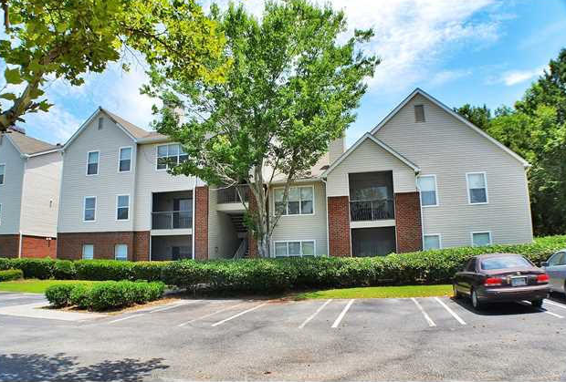
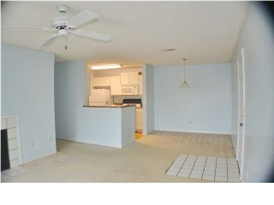
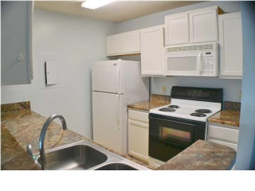
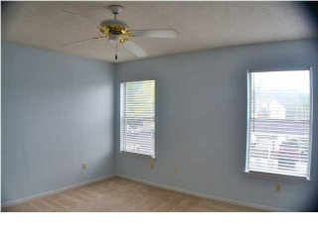
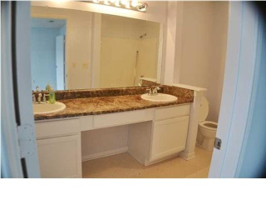
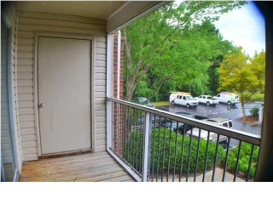
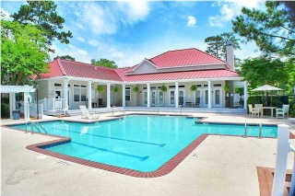
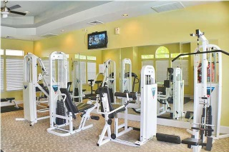
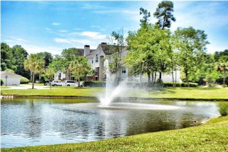


2011 N Highway 17 1700 O
The Meridian - Mount Pleasant - MLS# 14028529 - $149,000
$10k in Upgrades with Full-price Offer!
Good Investment opportunity in The Meridian, which is centrally located in Mt Pleasant and the Isle of Palms connector and the beach. Enjoy Easy Carefree Living Allowing you Time to Enjoy all of What Charleston has to Offer, The Meridian Amenities Include Tennis Court, Basketball Court, Volleyball Court, Playground, Fitness Room, Swimming Pool, Laundry Room, Boat Parking, Car Care Center, Club House & Office Suite. The Meridian HOA includes Water, Sewer, Inside Pest Control, Property Liability & Flood Insurance, Termite Bond and Trash Service. Property is currently bank owned and is being sold ''as is''.
Charla McDonald
Office - (843) 884-1622
Cell - (843) 343-1456
Fax - (843) 746-4845
cmcdonald@carolinaone.com
charlamcdonaldproperties.com
Carolina One Real Estate
628 Long Point Rd
Mt Pleasant, SC 29464

