Slide 1
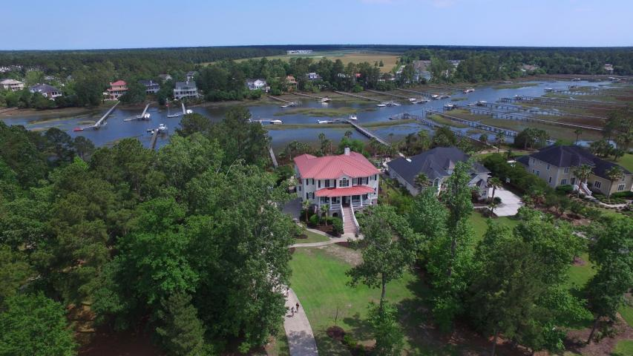
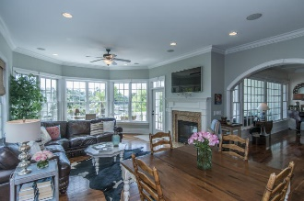
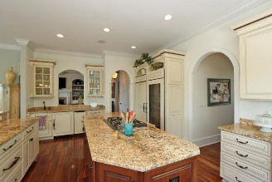
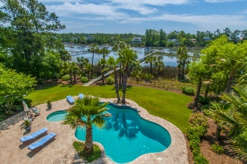
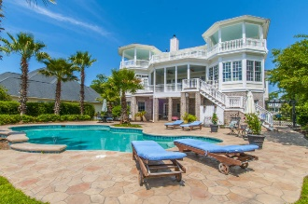
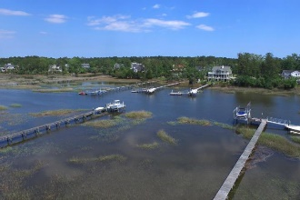


2011 Shell Ring Circle Mount Pleasant :: MLS# 16012476 :: $1,695,000
Dunes West Deep Water
This gorgeous custom built, deep water home has too many incredible features to list them all.
American Walnut hardwood floors throughout the home
High ceilings and extensive wood moldings
Family style kitchen is a chefs dream, featuring top of the line stainless steel appliances, 6' paneled refrigerator /freezer combination, expansive island, warming drawer, trash compactor, wet bar with ice maker and beverage refrigerator and bar seating for 4 or more
Warm and inviting family room, sunroom, eat in kitchen and living room are superb spaces for entertaining
Master retreat features sitting area with fireplace, a balcony that overlooks the creek, gardens and pool
Cozy Master bathroom with jetted garden tub, his and hers sinks, a separate steam shower and separate water closet, huge walk in closet
Second floor features four more bedrooms and four baths and a media/playroom with a deck.
Media/pool room with full bar, ice maker and flat screen TV area, gym, huge office and full bath all occupy this first floor
Resort like salt water pool with large covered deck and spectacular manicured yard
Dock leading out to Toomer Creek features a boat lift and a jet dock, plus large floating dock and pier head
This particular section of Toomer Creek boast navigable water at low tide and is only a few minute boat ride out to the Wando River.
This house has it all and so much more. All located inside the gated Dunes West neighborhood of Mt. Pleasant.
Clay Cunningham
O (843) 886-8110
M (843) 345-4647
clay@carolinaone.com
www.claysre.com
Carolina One Real Estate
1503 Palm Blvd Ste
Isle of Palms, SC 29451

