Slide 1
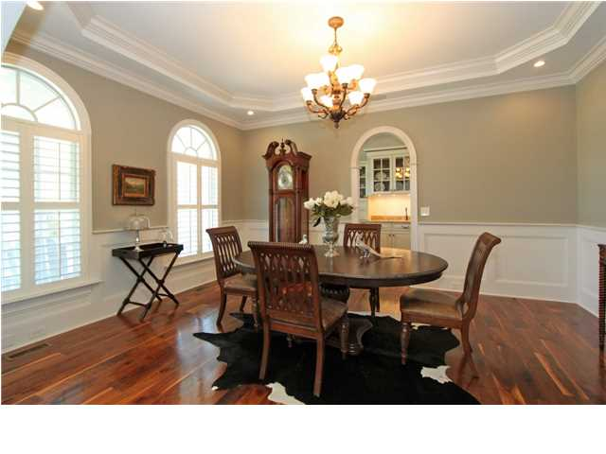
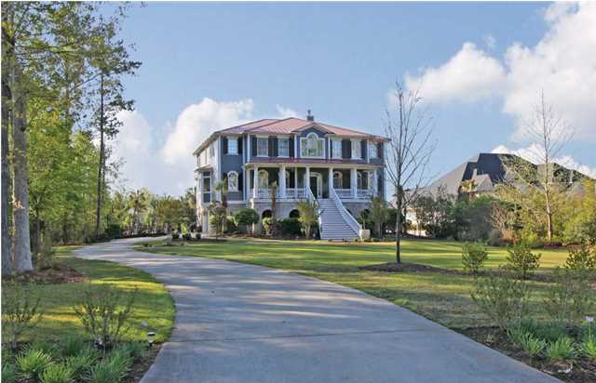
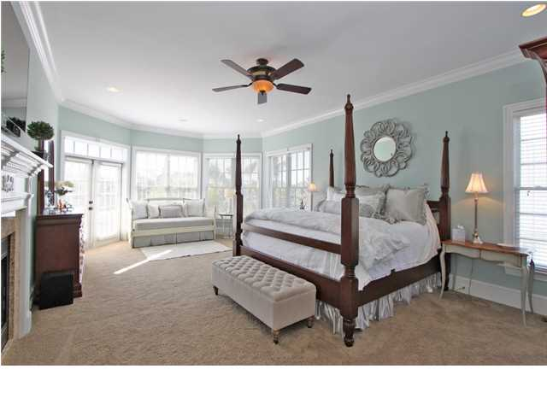
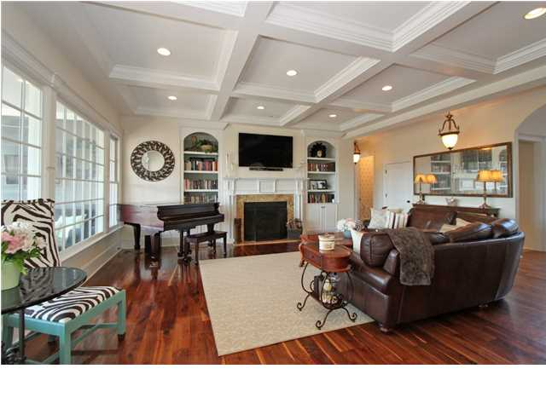
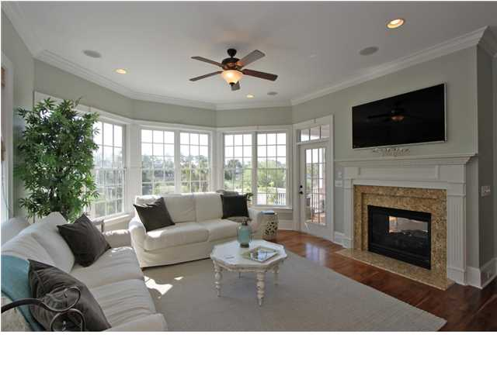
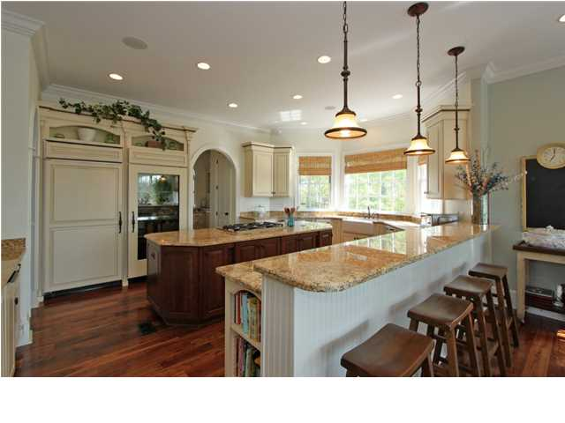
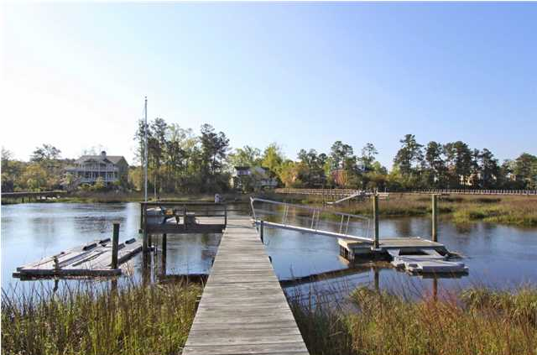
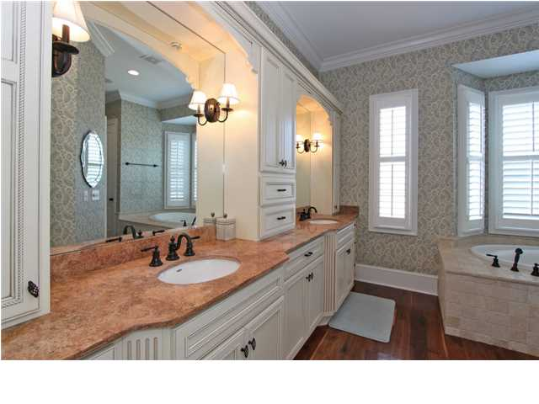
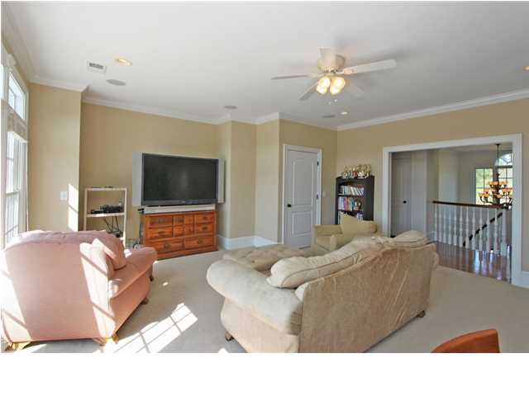
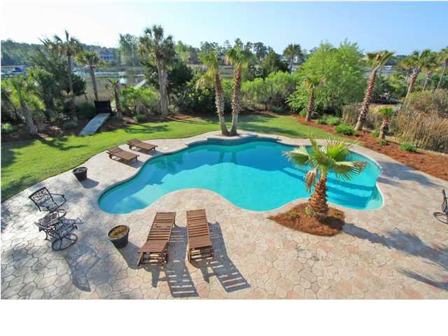
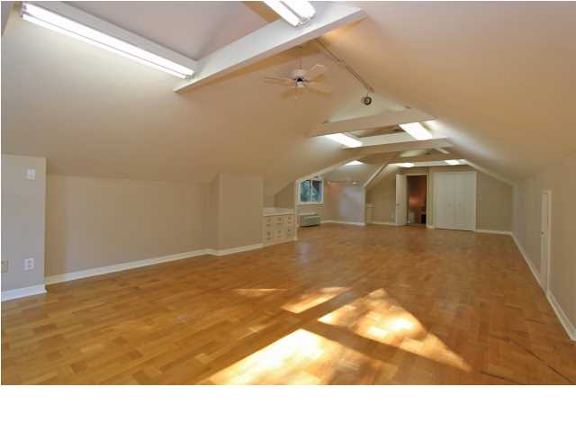


2011 Shell Ring Cir
Dunes West ~ Mt Pleasant
MLS# 1410539 ~ $1,600,000
See more at www.2011shellring.com
This gorgeous custom built, deep water home has too many incredible features to list them all. Upon entering the soaring foyer you are welcomed by an abundance of natural light and an impressive curved staircase. American Walnut hardwood floors lead you throughout the home. Formal dining room with high ceilings, and extensive wood moldings, a connected Butler’s pantry featuring glass front cabinets and granite counter tops. The spacious family style kitchen is a chefs dream. Featuring top of the line stainless steel appliances, 6’ paneled refrigerator /freezer combination, expansive island, warming drawer, trash compactor, wet bar with ice maker and beverage refrigerator and bar seating for 4 or more. The warm and inviting family room, sunroom, eat in kitchen and living room all flow beautifully together and are superb spaces for entertaining. The master retreat is as inviting during the daytime as it is after dark, situated for privacy, the master retreat features a sitting area with fireplace, a balcony that overlooks the creek, gardens and pool, a cozy bathroom with jetted garden tub, his and hers sinks, a separate steam shower and separate water closet, huge walk in closet with its own connected laundry room. The second floor features four more bedrooms and four baths and a media/playroom with a deck. Two of the upstairs bedrooms have their own porches with spectacular views of Toomer Creek sunsets. Any of the rooms on the top floor can be used as a “mother in law” suite easily accessed with the elevator. The bottom floor has all the organization you will ever need. Another full size laundry room/ mud room combination, custom built cubbies and plenty of storage space all are connected with Mexican tile floors. Next you stumble upon A media/pool room with full bar, ice maker and flat screen TV area, gym, huge office and full bath all occupy this first floor. All leading out to the resort like salt water pool with large covered deck and spectacular manicured yard . The dock leading out to Toomer Creek features a float which will accommodate a ’24 foot boat. This particular section of Toomer Creek boast navigable water at dead low tide and is only a few minute boat ride out to the Wando River. This house has it all and so much more. All located inside the gated Dunes West neighborhood of Mt. Pleasant.
Clay Cunningham
Office - (843) 886-8110
Cell - (843) 345-4647
Fax - (843) 202-2921
clay@carolinaone.com
Carolina One Real Estate
1400-E Palm Boulevard
Isle of Palms, SC 29451

