Slide 1
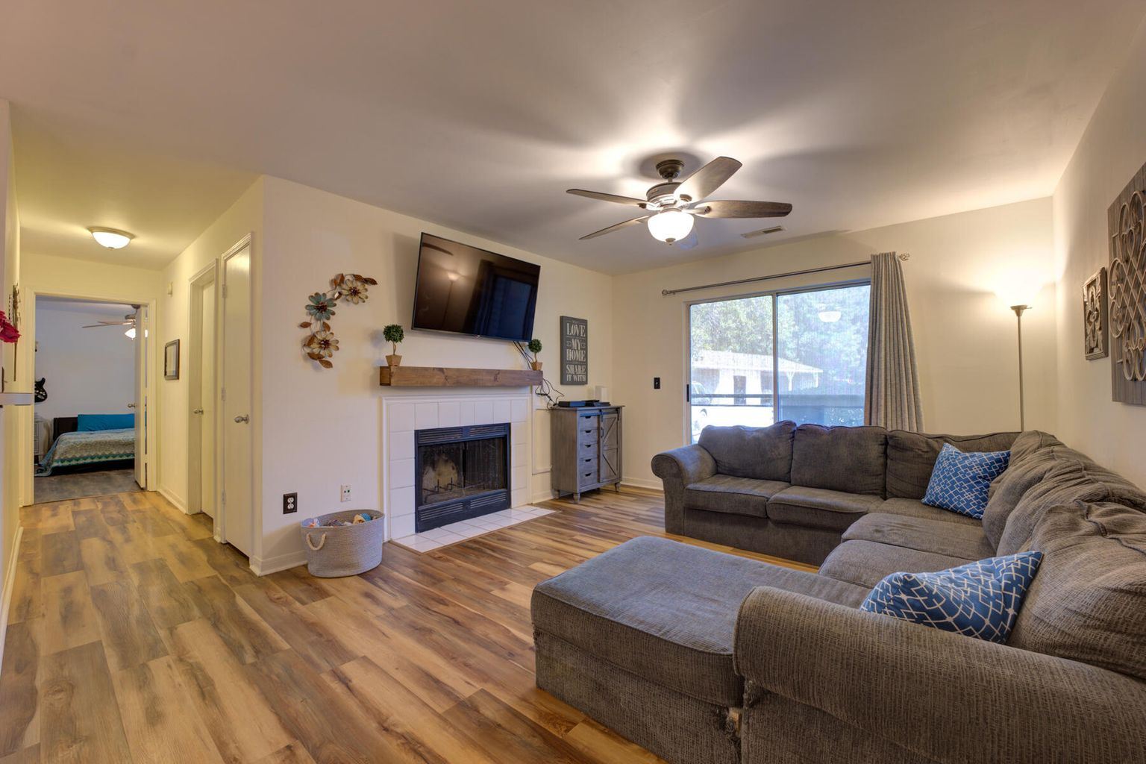
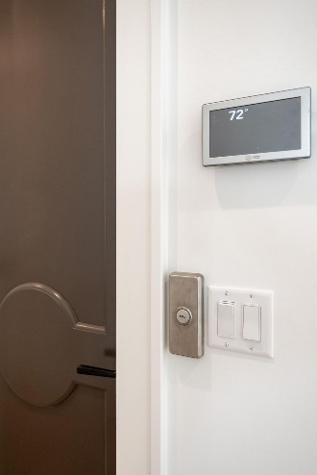
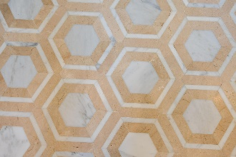
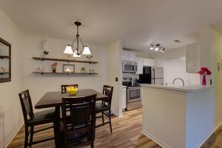
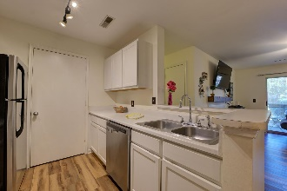
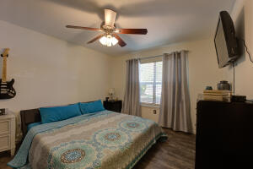
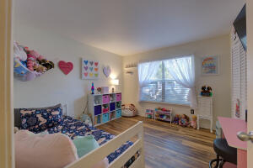
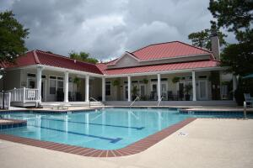
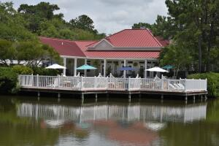


2011 N Highway 17 1400M
The Meridian | Mount Pleasant
MLS# 22015041
New Price $280,000
Minutes to the Beach
NEW PRICE
Looking to live close to the beach and have boat storage and be within minutes of Charleston and great shopping and have low maintenance? Welcome home! This great condo is it! Lots of open space, convenient first floor living; large living room, two large bedrooms, one bath with double vanity, & screened porch with storage closet. Minutes from beach & I526. No hauling groceries up stairs! Kitchen updated with stainless appliances plus wood/laminate floors and smooth ceilings. Entertaining is easy as dining area opens to living room with sliding glass doors to screened porch. Enjoy a country-club lifestyle on the manicured grounds of The Meridian. Club amenities include swimming pool with chair-lined deck, tennis and basketball courts, children's playground and magazine-worthy clubhouse. Located within minutes of beautiful beaches, public golf courses, great shopping at Town Center's over 70 stores and a short 20 minute drive to downtown Charleston or the airport, this home is convenient to hospitals and major employers. The Meridian is well managed, has deep reserves and a responsive team working to keep everything running smoothly. HOA fee includes exterior maintenance, water, sewer, pest control, property liability, flood insurance and access to amenities. Roof replaced by HOA this year. Boat Storage is an additional $40/month. Community is not approved for short term rentals, but it is one of the few condo communities approved for FDA loans. This is a gem of an opportunity to own or invest in Mt. Pleasant. Call soon! It won't last long!
Video Tour: https://youtu.be/jQSXgsNSE7A
Sarah Graham
843-693-0620
sarah@yourcharlestonlifestyle.com
yourcharlestonlifestyle.com
EXP Realty LLC
170 Meeting Street Ste 304
Charleston, SC 29401

