Slide 1
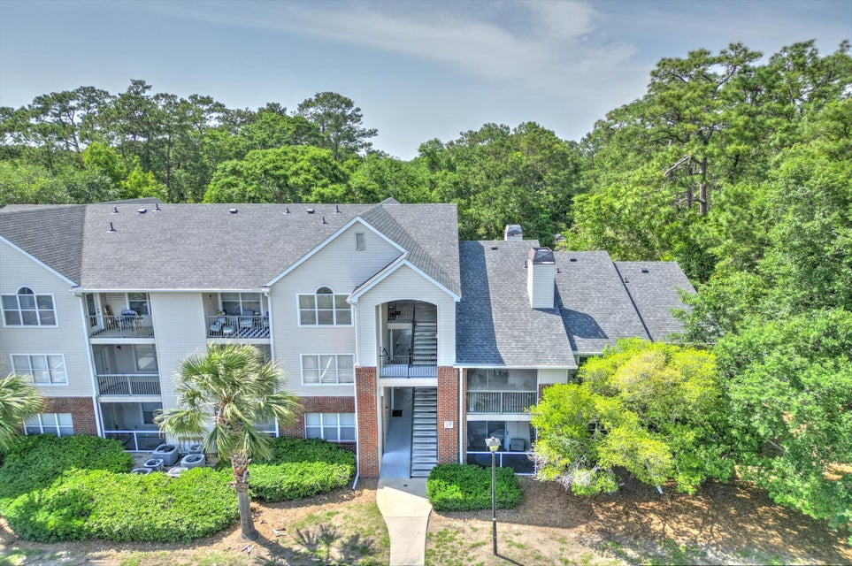
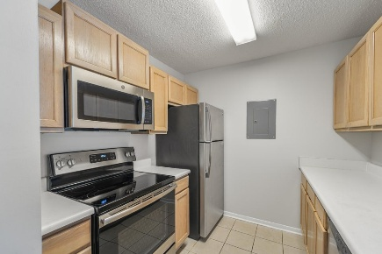
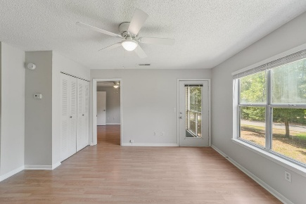
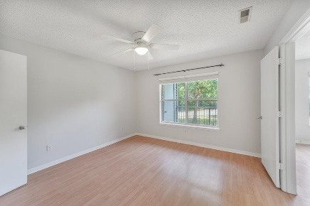
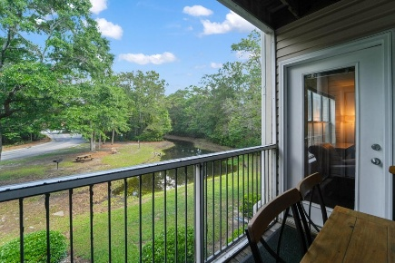
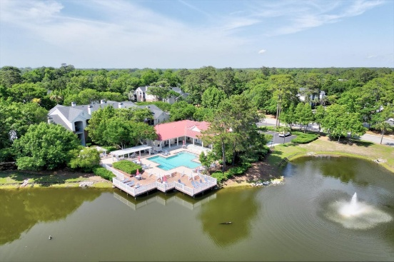






2011 N Highway 17 1400P
$270,000
The Meridian · Mount Pleasant, SC 29466 · MLS# 25017976
Lowest Priced Active 1BR condo in Mt. Pleasant (and located across from the Towne Centre off of the Isle of Palms Connector)!
PROPERTY FEATURES:
1 Bedroom 1 Bathrooms
591 Sq Ft
Nestled right in the center of Mt. Pleasant, The Meridian is a destination location for proximity to the Beaches (only 4 miles to the Isle of palms and toes in the sand), literally across the street from the Mt. Pleasant Towne Centre with dozens of shoppes, restaurants, grocery store, cinema, etc within walking distance & only 8 miles to Downtown Charleston! Just freshly painted, new ceiling fans, new 2'' blinds, & updated appliances! This 1BR/1BA condo on the 2nd floor overlooks one of the many neighborhood ponds, and the HOA fee of only $243/mo includes Water/Sewer, Community Pool, Clubhouse, Fitness Center, fishing lakes, pickleball/tennis courts, basketball court, playground for the kiddos, Boat Storage (at only an add'l $40/mo!), and a car wash! *BOM through no fault of the seller.
HAYNES JOHNSON
843-864-8159
haynes.charlestonproperties@gmail.com haynes.findhomesforsaleincharleston.com

