Slide 1
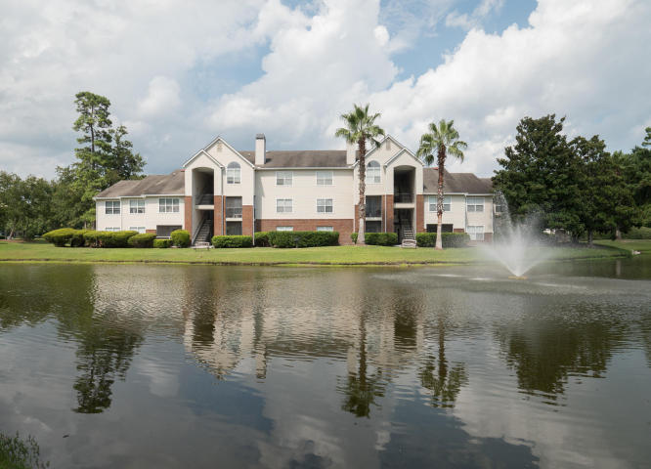
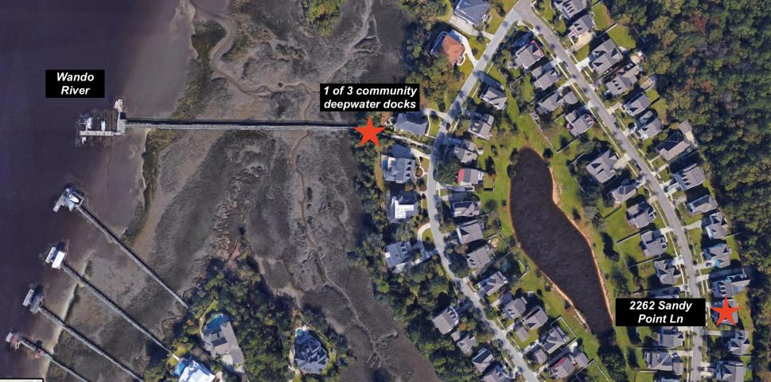
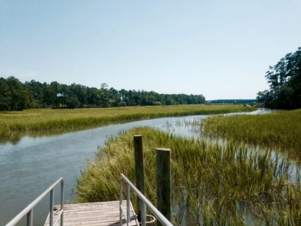
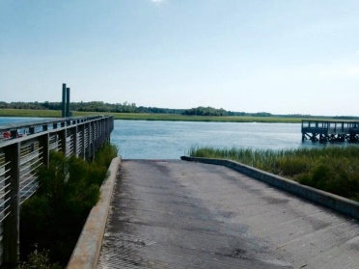
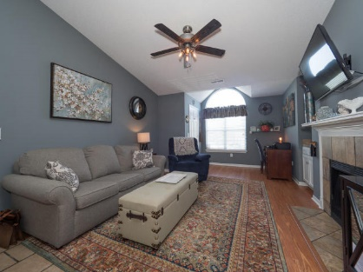
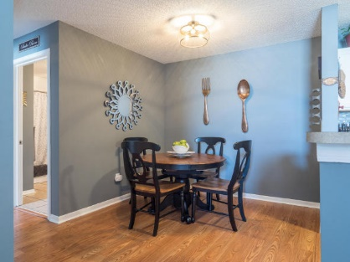
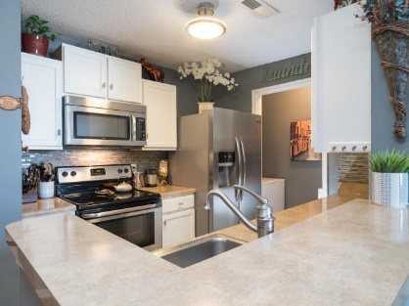
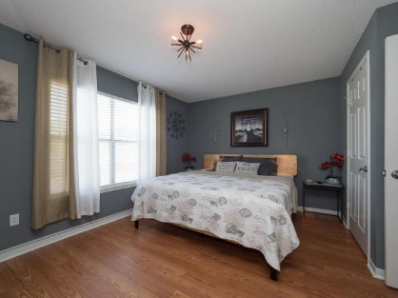
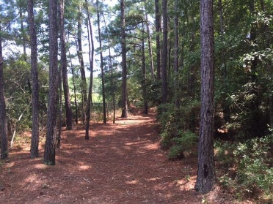
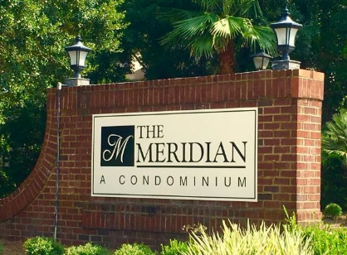
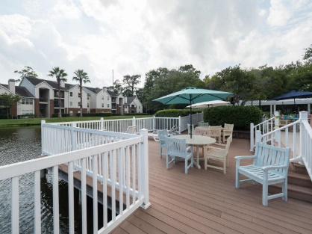
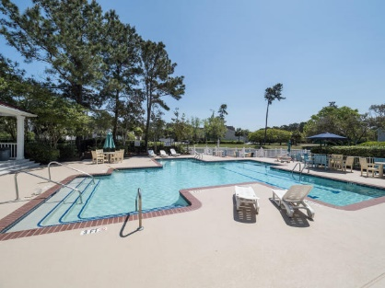
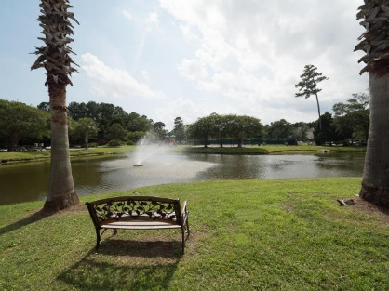
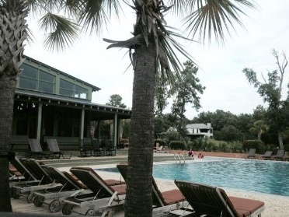


JUST REDUCED!! 2011 N Highway 17 1800S Mount Pleasant, SC 29466 | MLS# 18010070 | $159,000
At the end of the day…
relax by the lake
Welcome to The Meridian - a centrally located condo complex in the heart of Mt Pleasant, close to Towne Centre, IOP/Sullivan's Island beaches & top-rated schools. This upgraded, oversized 1BR/1BA unit includes a living room w/good storage & bump-out space (ideal for small office), vaulted ceilings & tiled wood-burning fireplace. Tasteful paint & wood laminate floors throughout living room, dining room & bedroom. Full kitchen has glass/tile backsplash, refinished cabinetry/hardware, stainless steel appliances, tile flooring & laundry room w/newer washer/dryer. Regime covers building insurance, termite bond, exterior/landscape maintenance, and water/sewer/trash utilities. Amenities include clubhouse, pool, tennis & basketball courts, fishing ponds, play park. Boat storage for additional fee.
Kris Higman
(843) 810-8824
kris.higman@cbcarolinas.com
www.CharlestonHomesByKris.com
Coldwell Banker Residential Brokerage | 1127 Queensborough Blvd. 103 | Mt Pleasant, SC 29464

