Slide 1
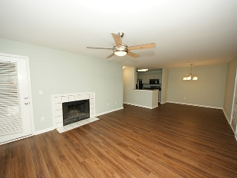
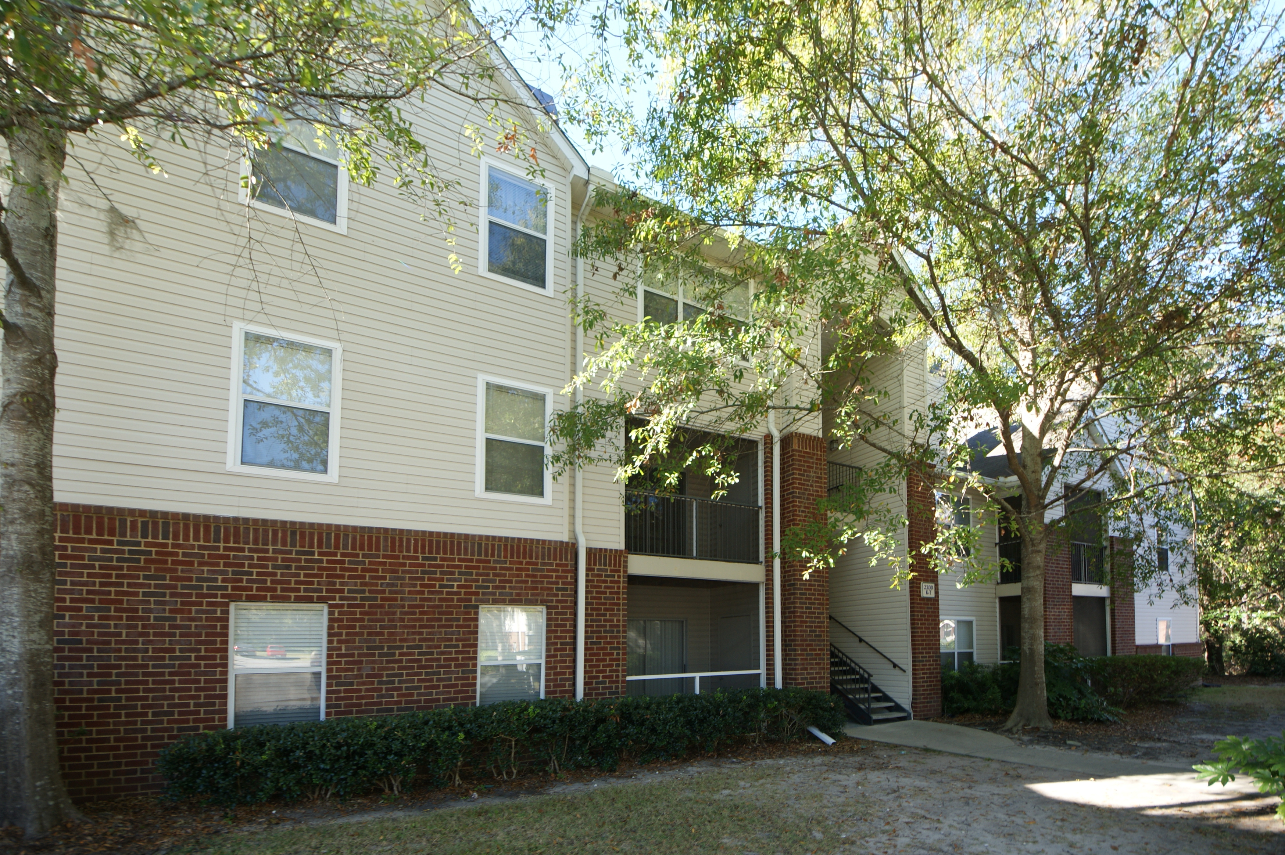
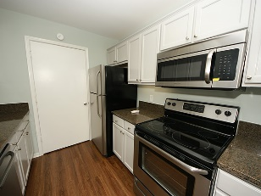
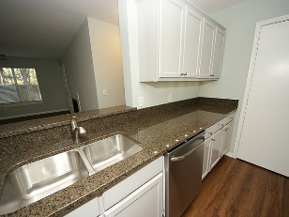
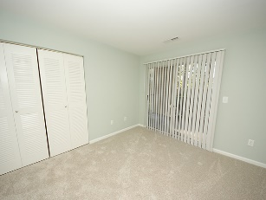
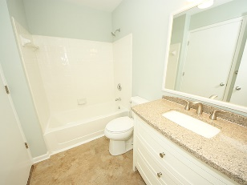
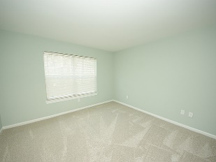
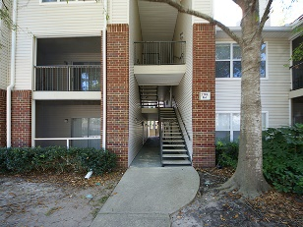
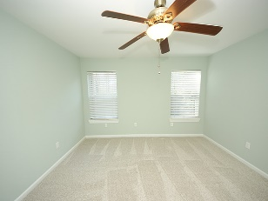
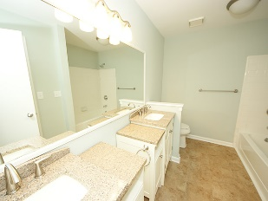
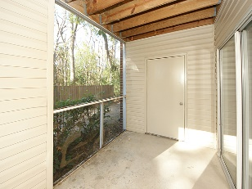

Huge Reno... Attention to Every Detail
2011 N Highway 17 2200-N
The Meridian · Mt Pleasant, SC 29466 MLS# 16029164 · $235,000
This rarely available 3 bedroom 2 bath first floor unit in The Meridian has been updated with new LVT plank flooring, new carpeting, bath remodel, new stainless appliances, newly painted walls and smooth ceilings. The kitchen has granite counters and under counter lighting. This unit also has a separately deeded carport (#802).
Close to Towne Center, Snee Farm Country Club, and the beach at Isle of Palms. The Meridian is a 28 acre landscaped condo-complex of 256 units that includes an indoor workout facility, large community pool, basketball and tennis courts, play park, stocked fishing ponds and grilling areas.
Seller is a South Carolina licensed real estate broker.
RE/MAX Alliance
1200 Two Island Ct.
Ste. A
Mt. Pleasant, SC 29466
Ken Earnhardt
Office - (843) 352-7943
Mobile - (843) 343-3872
earnhardtken@gmail.com

