Slide 1
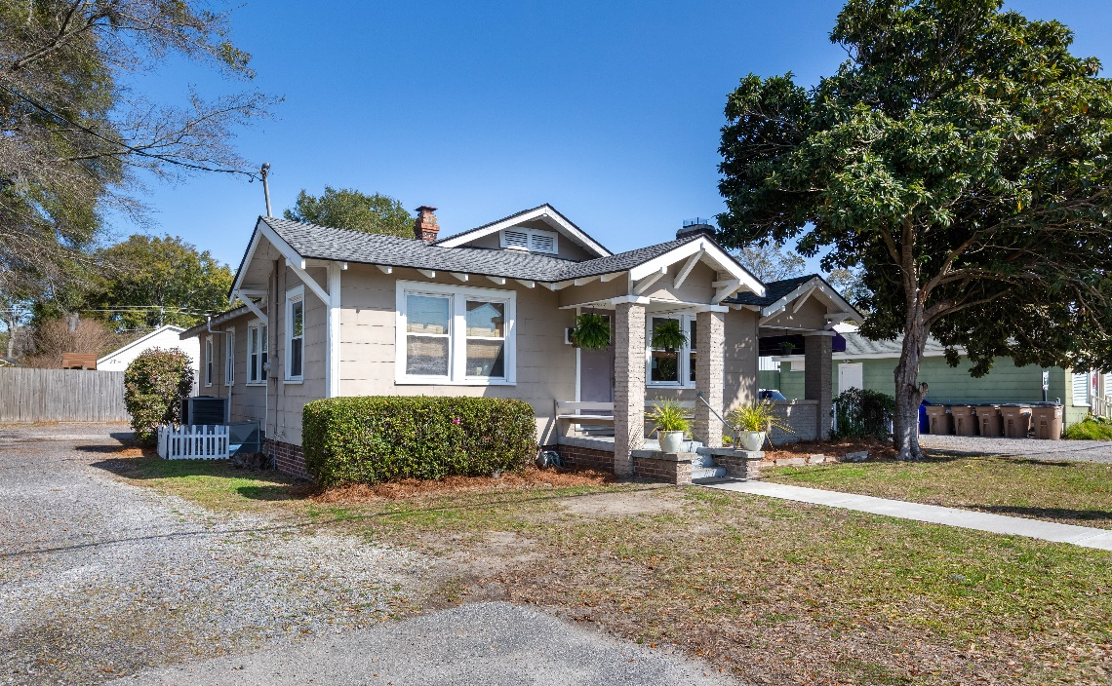
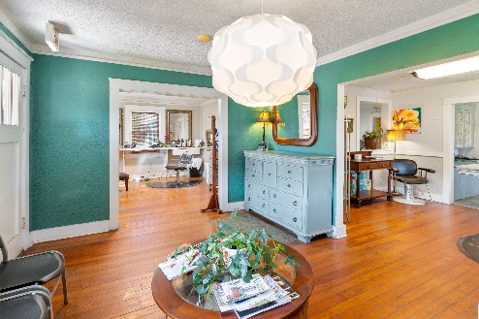
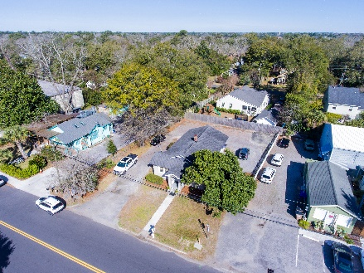
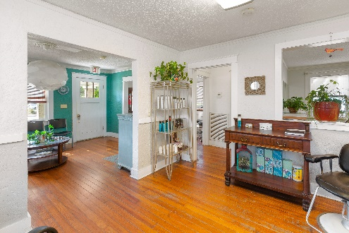
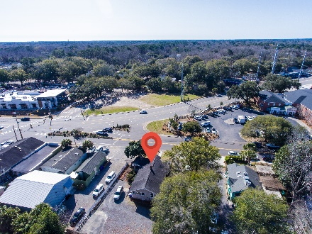


Commercial Property on James Island!
REDUCED
2012 Wappoo Drive
Charleston, SC 29412 · MLS# 31002866 · $890,000
Michael Dew
O 843-769-5100
M 843-870-7000
michaeledew@gmail.com
www.michaeldewrealestate.com
Welcome to 2012 Wappoo Dr. located in the James Island Maybank Corridor Overlay district. A former residence that as been converted to a beauty salon in 1992. Great visibility. Plenty of parking in rear of building. Very clean. Hard wood floors through out. Large screened area in back of business could be additional work space. Great covered side porch. The location is ideal with close proximity to Downtown. Current owner has been in business since 1992. Ideally a perfect location for a small business. X Flood zone.
Floorplan | MLS Listing
AgentOwned Charleston Group
902 Savannah Hwy
Charleston, SC 29407
Real Estate ● Mortgage Insurance ● Business Brokerage

