Slide 1
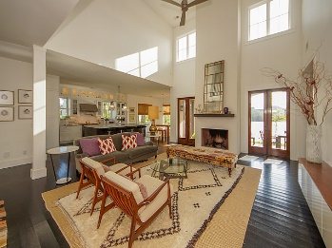
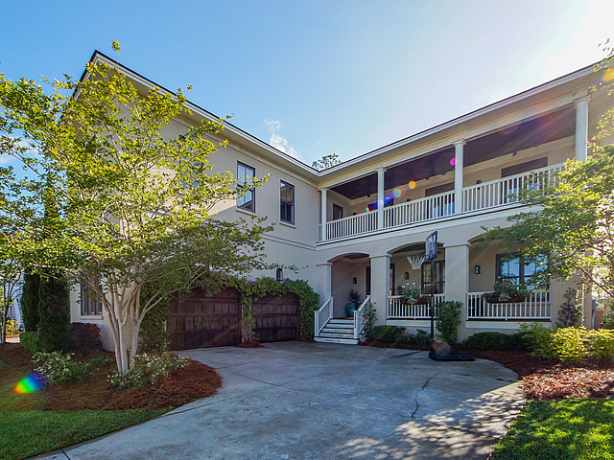
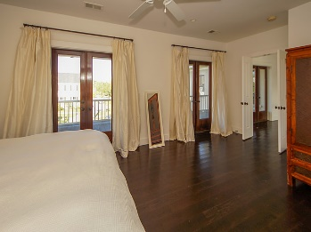
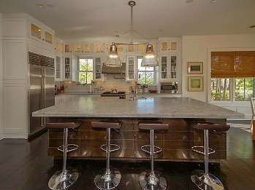
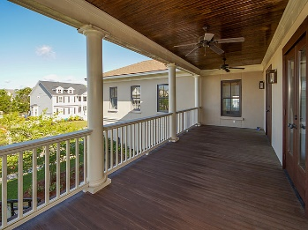
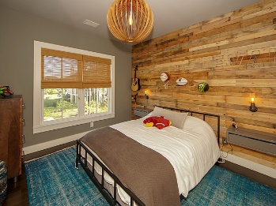
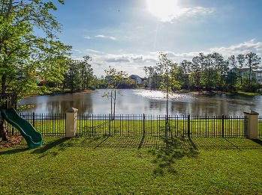


Gorgeous & Motivated
2013 Shields Lane
Mount Pleasant, SC 29466
SINGLE FAMILY HOME FOR SALE
SELLER MOTIVATED on this gorgeously upgraded (see pictures) 4BR/4BA in an open floor plan perfect for entertaining both indoor and outdoor. High end appliances (Wolf, Sub-Zero Fridge, Bosch) with subway tile backsplash and custom cabinets (glass doors are beautiful) complimented by exceptional light fixtures and a large marble island that is both beautiful and functional. Three covered porches with ceiling fans provide many areas to relax, work or read. Nine total rooms can offer many flexible options including a home office or additional room (with windows) ideal for a gym. This home allows a tremendous amount of natural light into all areas of the property. Indoor/outdoor fireplace and solid oak hardwoods.
MLS ID: | 19000386
Sale Price: | $739,000
Area: | 41 - Mt Pleasant N of IOP Connector
Bedrooms: | 4
Bathrooms – Full | 4
Apx. SqFt: | 3,372
Year Built: | 2008
Acreage: | 0.2
Tax Map #: | 583-05-00-267
David H Seay
CCIM, BIC, CCIM, REALTOR
(843) 364-6720
david@seaydevelopment.com
Seay Development, LLC
3404-202A Salterbeck Street
Mt. Pleasant, SC 29466
www.seaydevelopment.com

