Slide 1
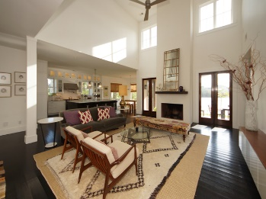
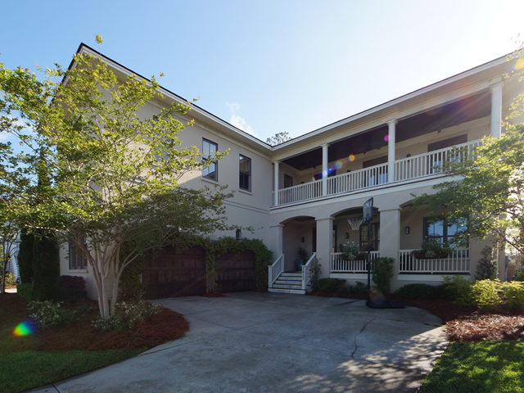
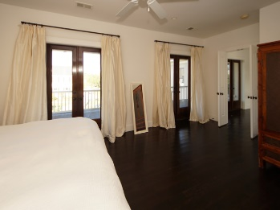
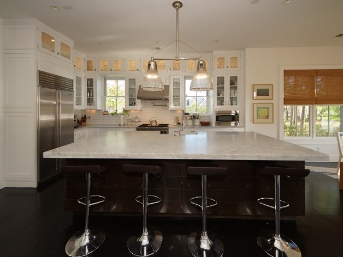
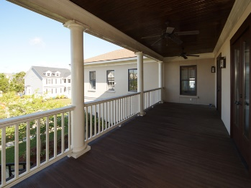
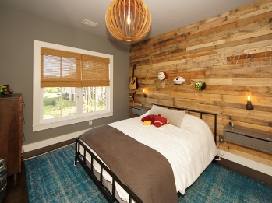
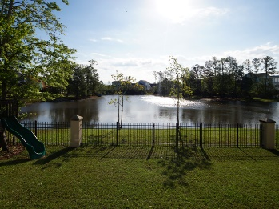


Exquisite Listing in Rivertowne On The Wando
2013 Shields Lane
Mount Pleasant, SC 29464
SINGLE FAMILY HOME FOR SALE
A custom, Mediterranean modern style, real stucco home that takes full advantage of sunrise and sunset at the center of a large pond. An open and contemporary floor plan perfect for entertaining both indoor and outdoor. High end appliances (Wolf, Sub-Zero, Bosch, etc.) and custom cabinets complimented by exceptional light fixtures and a large marble island that is both beautiful and functional. Three covered porches with ceiling fans provide many areas to relax, work or read. Nine total rooms can offer many flexible options. All existing bedrooms are upstairs along with the laundry room. This home allows a tremendous amount of natural light into all areas of the property. indoor/outdoor fireplace and solid oak hardwoods throughout. Listing agent is co-owner.
MLS ID: | 17009984
Sale Price: | $799,000
Area: | 41 - Mt Pleasant N of IOP Connector
Bedrooms: | 4
Bathrooms – Full | 4
Apx. SqFt: | 3,372
Year Built: | 2008
Acreage: | 0.2
Tax Map #: | 583-05-00-267
David H Seay
CCIM, BIC, CCIM, REALTOR
(843) 364-6720
david@seaydevelopment.com
Seay Development, LLC
3404-202A Salterbeck Street
Mt. Pleasant, SC 29466 www.seaydevelopment.com

