Slide 1
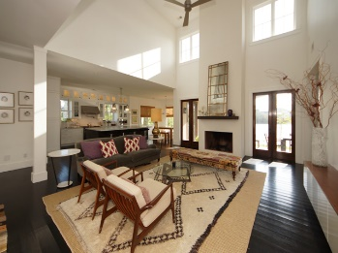
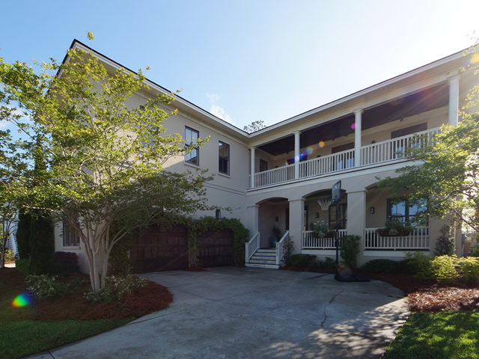
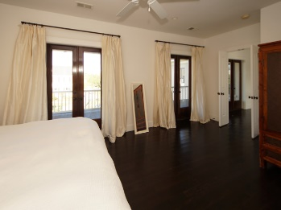
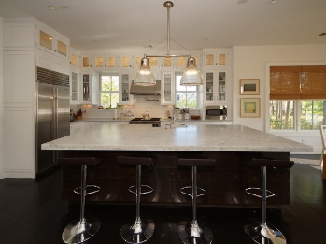
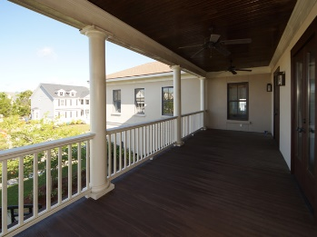
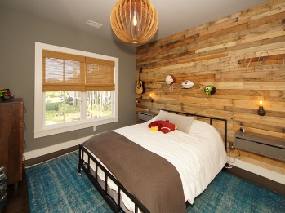
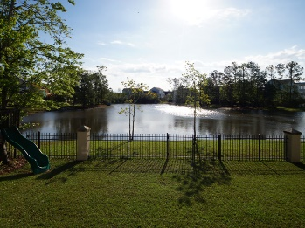


Price Reduced
Move-In Ready ~ Occupy Immediately
2013 Shields Lane
Mount Pleasant, SC 29466
SINGLE FAMILY HOME FOR SALE
Five Bedrooms and Four Bathrooms in an open and contemporary floor plan perfect for entertaining both indoor and outdoor. High end appliances (Wolf, Sub-Zero Fridge, Bosch) with subway tile backsplash and custom cabinets (glass doors are beautiful) complimented by exceptional light fixtures and a large marble island that is both beautiful and functional.
Three covered porches with ceiling fans provide many areas to relax, work or read. Nine total rooms can offer many flexible options including a home office or additional room (with windows) currently servicing as a home gym. Four bedrooms upstairs (including master) and one bedroom downstairs. This home allows a tremendous amount of natural light into all areas of the property. Indoor/outdoor fireplace and solid oak hardwoods.
MLS ID: | 18009882
Sale Price: | $784,500
Area: | 41 - Mt Pleasant N of IOP Connector
Bedrooms: | 5
Bathrooms – Full | 4
Apx. SqFt: | 3,372
Year Built: | 2008
Acreage: | 0.2
Tax Map #: | 583-05-00-267
David H Seay
CCIM, BIC, CCIM, REALTOR
(843) 364-6720
david@seaydevelopment.com
Seay Development, LLC
3404-202A Salterbeck Street
Mt. Pleasant, SC 29466
www.seaydevelopment.com

